Slide 1
Help us to say yes Webinar:
Claiming costs under a Defendant’s Costs Order
Criminal Cases Unit
18 October 2022

Slide 2


Technical tips for this webinar
Please put yourself on mute during the webinar
You can ask us questions at the end of each session through the ‘meeting chat’
Click on the ‘meeting chat’ to ask a question
You can keep the meeting chat open throughout to view other people's questions
Email us if you experience technical issues during the webinar:
communicationsdepartment@justice.gov.uk
Camera and audio off when icons appear like this:
Click here to view the meeting chat

Slide 3
Content
Additional training and guidance available
Fastrak (DCO1) claims and non-fastrak (DCO2) claims
The claim form
General guidance
Where to send your claim and digital time converter
Common reject reasons

Slide 4

Claiming costs under a defendant’s costs order:
Purpose of the webinar:
To assist you in completing and submitting your claim for costs and reduce rejections
By the end of the webinar, you will have an understanding of:
Which claim form to use and how to complete it
Common reasons for claims being rejected

Slide 5
Background

Slide 6
Background:
Claims are determined by case workers, senior case workers and case managers depending on the amount claimed and their complexity.
They are determined under Regulation 7 of the Costs in Criminal Cases (General) Regulations 1986 and paid from the central fund.
The regulations were amended by the Legal Aid, Sentencing & Punishment of Offenders Act in October 2012 under which the rates and scales to be allowed on determination, both in relation to litigator and advocate fees are set by the Lord Chancellor and capped at Legal Aid rates.
Rates can be enhanced for solicitors under specific criteria and uplifted by a maximum of 100% and, for counsel’s fees, can be exceeded where the fixed fee would not provide reasonable remuneration.
All claims are assessed on their merits and we take into account any representations you make wish make in support of your claim.

Slide 7
The claim form

Slide 8
What form?
The digital claim forms are mandatory:
We no longer accept claims submitted as a PDF document or a scanned copy of the claim form.
To avoid the information you enter being corrupted, you must download and complete a fresh claim form for each case:
Fastrak – Magistrates Court costs up to £2,000 (combined profit costs and advocate fees): https://www.gov.uk/government/publications/dco-magistrates-court-fastrak-claims-form-dco1
Defendant cost order (DCO 2): Costs over £2,0000, proceedings in the crown court and appeals against conviction and sentence:
https://www.gov.uk/government/publications/dco-non-fastrak-claims-form-dco2

Slide 9
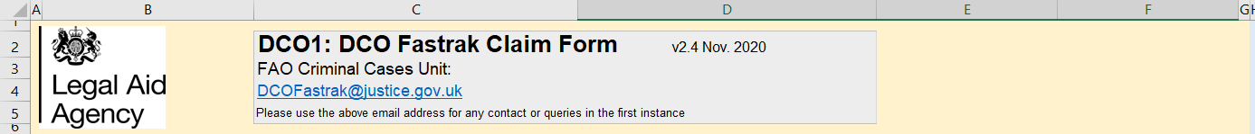
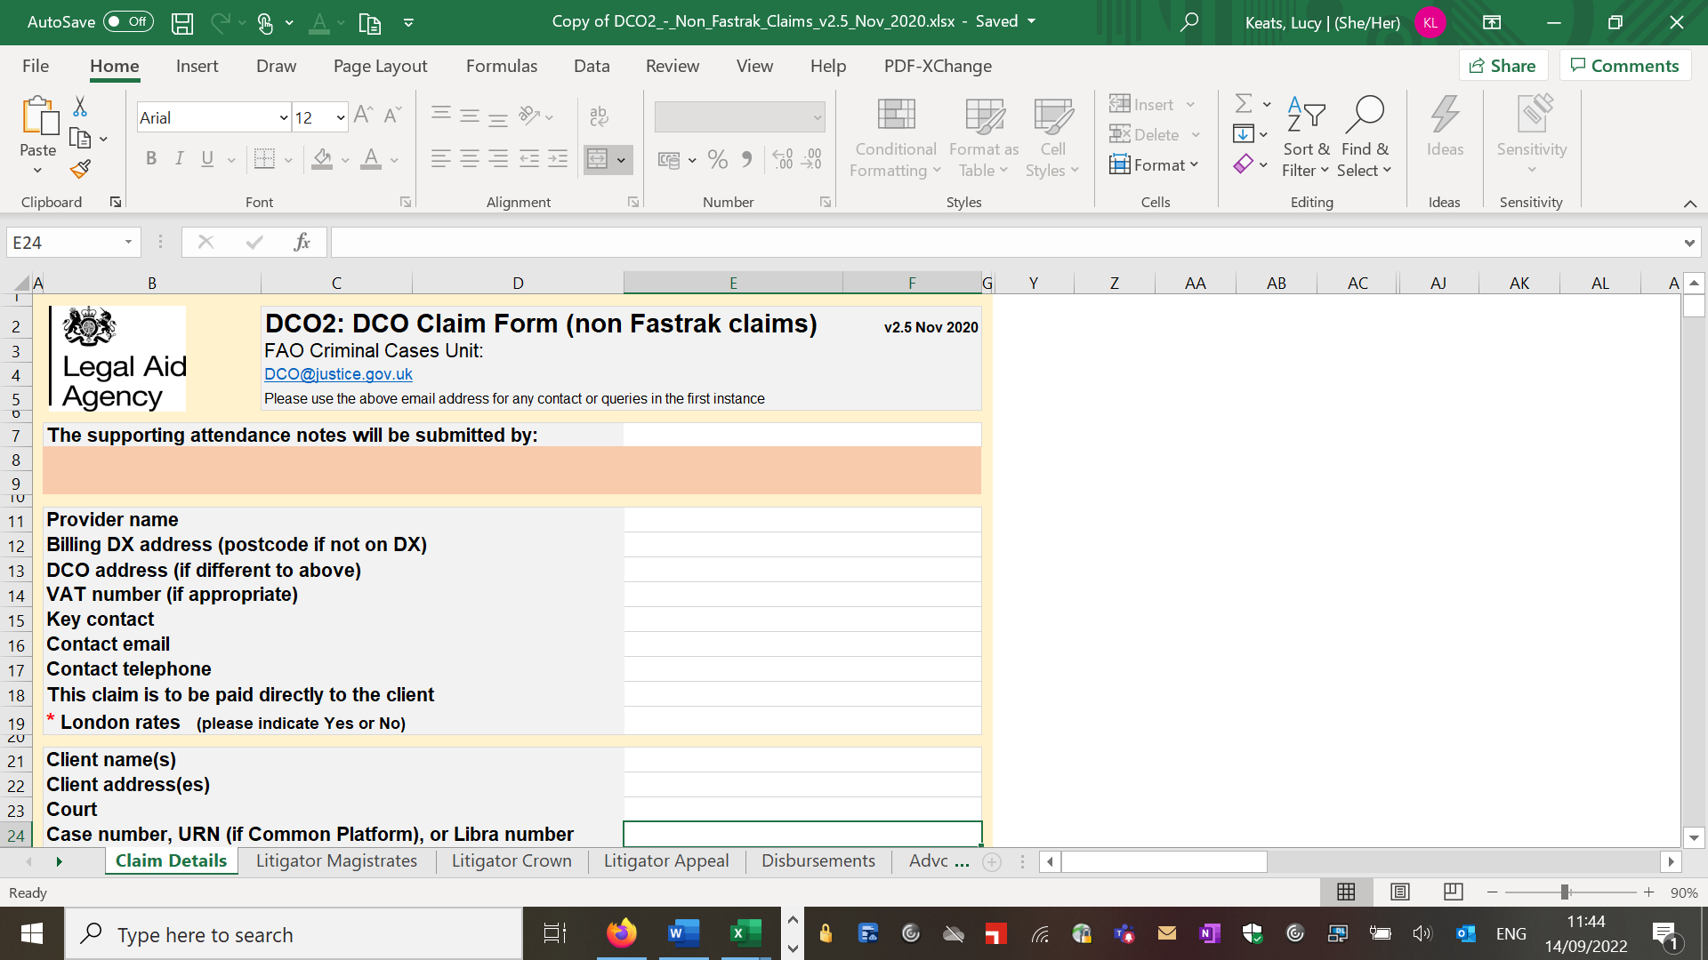
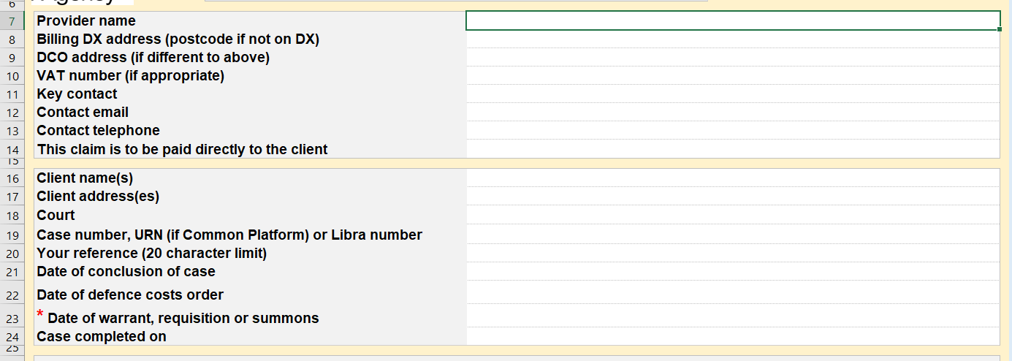
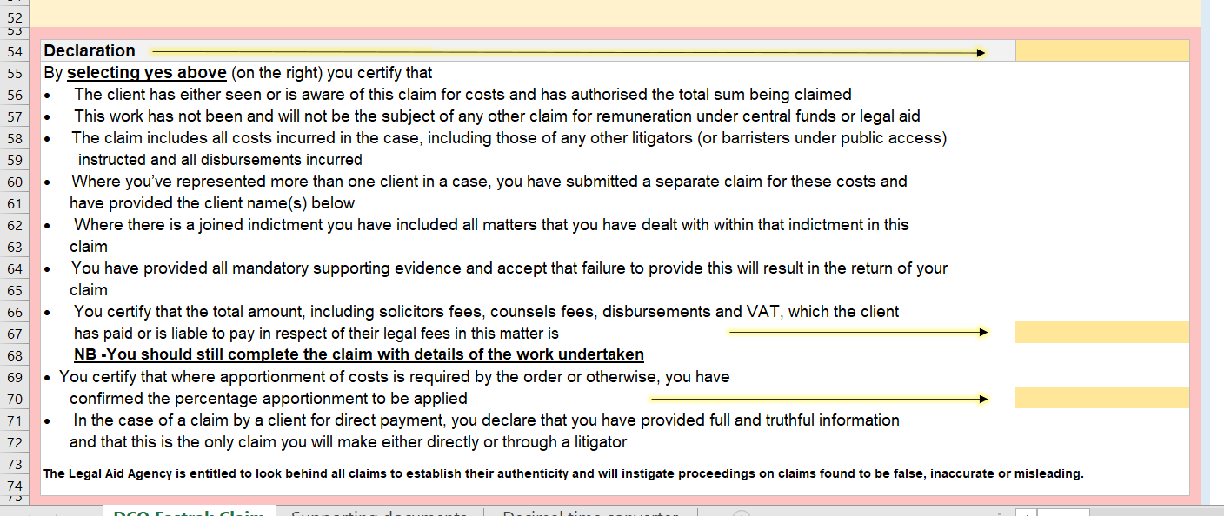
Completing the form:
Ensure you are using the latest version of the form for each claim
Let us know if the claim is to be paid direct to the defendant
The client name and address must be the same as on the costs order
Complete the declaration
Enter the total costs your client was liable to pay
If your client was only acquitted on some charges, the court should specify an amount or percentage of costs to be allowed.

Slide 10
Supporting information and documents:
Fastrak claims (DC01):
You must include:
The defendant’s costs order, including page 2: Specifying the offences
Your client care letter / private retainer
Counsel’s fee notes and work logs
Invoices / receipts for any disbursements over £20

Slide 11
Supporting information and documents:
Non- fastrak claims (DCO2):
You must include:
The defendant’s costs order, including page 2: Specifying the offences
Your client care letter / private retainer
Counsel’s fee notes and work logs
Invoices / receipts for any disbursements over £20
Attendance notes
Correspondence file
Please note:
The prosecution papers, copies of reports or any other documents do not need to be submitted with your claim.
If the case manager needs any further documentation they will contact you

Slide 12
Supporting information and documents:
All claims:
Please complete the relevant supporting information section:
This forms the basis, together with the above of the decision on assessment
Include any aspects of the case or defendant that may not be apparent from the limited documentation provided
In particular, clarification should be provided where:
You are not local to either the court or the defendant
Counsel’s fees are claimed in excess of the prescribed fees
Kings counsel (KC) has been instructed
Work has been carried out by a grade A fee earner (DCO2 only)

Slide 13
Where to send your claim

Slide 14
Where do I send my claim?
Fastrak claims:
DCOfastrak@justice.gov.uk
Please include with your claim as separate email attachments
DCO2 claims:
dco@justice.gov.uk
If your papers are too large to attach to your email, submit your claim and contact us to make arrangements for your papers

Slide 15
Further information when sending your claim:
Papers should be submitted with your claim as separate email attachments:
You can attach up to 10MB per email and we are happy for you to submit your papers attached to a series of emails
Each email should be headed with the defendant’s full name
Each attachment should be named appropriately, for example, S16 / DCO, client care letter, correspondence file:
If there are a number of documents / files that are the same please name separately, for example, correspondence file
Where it is not possible to send documents via email, you should submit your claim form via email and request access and guidance to uploading documents to the secure file exchange:
It is important to try to replica the structure of a paper file
You should number or upload files in chronological order and give them meaningful titles
Papers cannot be viewed via mime cast links or drop box, submitted via disc, USB or hard drive or any other web-based platform

Slide 16
Common reasons for rejection

Slide 17
Common reasons for rejection:
Latest / new form not completed:
If a new form is not used for your claim the figures may not populate / carry over correctly or the rates allowed may not be correct
The digital form is mandatory. PDF or scanned claims are not accepted
Incorrect form:
Magistrates court under £2,000 profit costs + counsel’s fees = DCO1
Crown court / over £2,000 (profit costs + counsel’s fees) = DCO2
Incomplete claim form:
Declaration not completed
Defendant’s costs liability not completed
Fee earner details missing
Date of warrant / summons not completed

Slide 18
Common reasons for rejection:
Other common reasons | Solutions
Defendant’s name and address do not match the court order | Include reasons as part of the supporting information e.g. defendant moved to address above on X
Defendant is a company | Costs can only be awarded if the defendant is “an individual” – s16 POA 1985
No detail of work undertaken provided | Preparation / consideration is not sufficient. What documents were considered? Who was attended?
Time is not in decimal format | The form calculates the costs to be allowed based on the time entered. If it is not entered as a decimal this will affect the payment you receive. (A decimal time converter is on page 19)

Slide 19
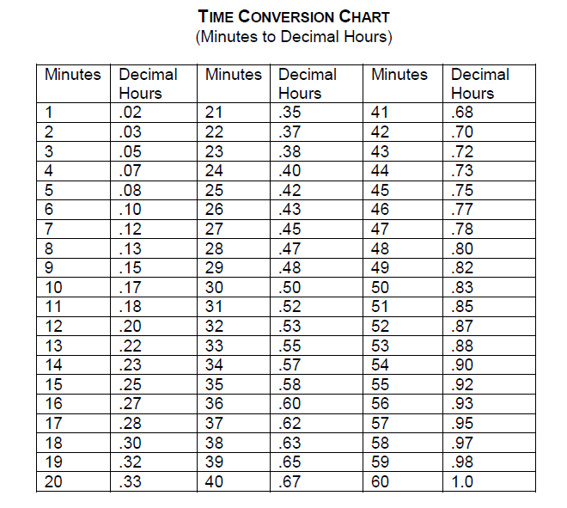
Time conversion chart:
We have included the decimal time conversion chart for your ease of information:

Slide 20
Contact us / helpful links

Slide 21
Contact us: Please contact the CCU team if you have any questions concerning making a claim for costs: CCU@justice.gov.uk We will be happy to help

Slide 22
Helpful links Costs in Criminal Cases (General) Regulations 1986: https://www.legislation.gov.uk/uksi/1986/1335/contents/made CCU: https://www.gov.uk/guidance/claim-back-costs-from-cases-in-the-criminal-courts Rates and Scales documents
https://assets.publishing.service.gov.uk/government/uploads/system/uploads/attachment_data/file/592292/guide-1.doc
https://assets.publishing.service.gov.uk/government/uploads/system/uploads/attachment_data/file/592293/guide-2.doc

Slide 23

Our training website
Online Support Webchat
Webinar Recordings
Our ‘Help Us Say Yes’ webinars focus on areas where there have been issues or high enquiry levels
Popular sessions are posted on the training website: Ministry of Justice
Use Webchat for help with IT system issues

Slide 24


Our communications channels
Legal Aid Bulletin
Social Media
LAA Portal
A fortnightly e-alert with links to relevant pages
Follow us on Twitter
We post the status of our online systems on the portal’s home page
Join our thousands of subscribers
Read our blog
Get help from our customer service twitter account
Contact the team: CCU@justice.gov.uk

Slide 25
End slide

