Slide 1
Help us say yes Webinar: LAA contract manager visits for civil providers holding a civil and family contract
Legal Aid Agency Contract Management & Assurance (CMA): 2022/23
04 October 2022

Slide 2


Technical tips for this webinar
Please put yourself on mute during the webinar
You can ask us questions at the end of each session through the ‘meeting chat’
Click on the ‘meeting chat’ to ask a question
You can keep the meeting chat open throughout to view other people's questions
Email us if you experience technical issues during the webinar:
communicationsdepartment@justice.gov.uk
Camera and audio off when icons appear like this:
Click here to view the meeting chat

Slide 3
Content
Additional reviews
Additional training and guidance available
Managing contracts
Guiding principles

Slide 4

Civil provider contract overview
Purpose of the webinar:
        The purpose of this webinar is to improve the way the LAA work with providers holding the general civil contract.
By the end of the webinar, you will have an understanding of:
What we do in contract management and assurance (CMA)
What you can expect from your contract manager
Additional reviews that may be completed
Where you can access additional support and training

Slide 5
Our guiding principles

Slide 6


Our vision and guiding principles
To support swift access to justice…
through working with others…
to achieve excellence in the delivery of legal aid.
We have set our ambition and approach to delivery with four guiding principles in mind.
We want to be:
User centred
Right first time
Open and transparent; and
A responsive, diverse, learning organisation

Slide 7
Managing contracts

Slide 8
Role of contract managers:
Contract managers normally engage with your LAA contract liaison manager
They ensure that each firm or organisation with a LAA contract complies with the terms of that contract
Contract managers intervene early if there are any issues and work with the provider, as they will have formed a constructive working relationship with your organisation
Contract managers are the main point of contact for your firm’s / organisation’s contract liaison manager on legal aid contract matters. They:
Check compliance against case files
Monitor performance against key performance indicators (KPIs)
Provide updates on contractual changes
Should be approached on changes to your business practices, including: changes to key personnel such as supervisors, business structure, and office location.

Slide 9
What you can expect:
Contract managers aim to work with providers to ensure compliance with the contract
Contract managers will be professional and polite
Correspondence will be answered in a timely manner
As a provider, we would expect the same standards from you and your staff.
Contact from your contract manager can take place in different ways.
This will include:
Telephone calls
MS Teams meetings
E-mail
Face to face meetings
Secure file exchange (SFE)

Slide 10
Contract management annual review checks:
Staff Compliance
Practising certificate
Supervisor declaration forms
Business Compliance
Office manual including organogram
Indemnity insurance
Other Compliance
Work in progress / payment on account
Key performance indicators
SQM / Lexcel accreditation
Panel membership and
accreditation
Provider activity report

Slide 11
File reviews:
Your contract manager will review a sample of controlled work claimed for each category of law. This normally takes place annually
The sample will need to incorporate different forms of service, for example, legal help, family help (lower) and different matter types
For multi-office firms, files will be selected from all offices
A small sample of open files will also be chosen for review on the day.

Slide 12
File review outcomes:
Ideally providers should review files prior to the visit so that they are aware of any issues
A contract notice may be issued if there is a claiming error and costs recouped where appropriate
If this happens, the firm will be asked to self-review files to ensure that there are no other errors, if a contract notice is issued
The contract manager will complete any contract notice verification activity within 4-6 months of the issue of the contract notice

Slide 13

Compliance against key performance indicators (KPIs):
The following are key indicators that contract managers monitor most closely. Please refer to your contract for full details:
Performance indicator | % not to be exceeded
Refused applications for civil funding | 15%
Rejected applications for civil funding | 5%
Rejected claims for certificated costs | 5%
Reductions on escape fee claims | 10%
Reductions on certificated work claims | 15%

Slide 14
Provider activity report (PAR):
PAR contains a range of provider-specific data that captures all aspects of the work being delivered under the legal aid contract. It is refreshed and distributed quarterly.
It contains the following information:
Fund take data so providers can see how much they have claimed from the legal aid fund during a specific period.
KPI performance data in all areas of civil and crime
Civil firms' reports will contain a breakdown of outstanding payments on account
Up to date matter start usage
Most recent peer review scores

Slide 15
Unrecouped payment on account (UPOA) report:
The UPOA report contains details of any certificated matters opened where a final bill has not been received. It is refreshed and distributed quarterly.
It contains the following information:
Details of each case and confirmation of the certificate status (live, discharged or revoked)
Value of any payments on account made to date
Value of any interim bills paid
Details of payment on account (POA) made to previous advice providers or counsel

Slide 16
Unrecouped payment on account report:
LEAD SUPPLIER | CERTIFICATE STATUS | CASE REFERENCE | APPLICANT NAME | CERTIFICATE ISSUE DATE | PAID SUPPLIER NAME | POA £ | INTERIM £
1B111B | LIVE | RMBCHCEI5476/A/M/3 | JIM JONES | 15/03/2012 | JONES & CO | 0.00 | 0.00
1B111B | LIVE | RMBCHCEI5476/A/M/3 | JIM JONES | 15/03/2012 | SYLVESTER MCCOY QC | 0.00 | 0.00
1B111B | LIVE | RMNKFPEIBD23/A/G/6 | PENELOPE PITSTOP | 07/01/2013 | JONES & CO | 493.00 | 0.00
1B111B | LIVE | RMNKFPEIBD23/A/G/6 | PENELOPE PITSTOP | 07/01/2013 | BOB FLEMING | 47.00 | 0.00
1B111B | DEAD | YLIGLSYYCQ63/A/C/14 | TERRY MCDERMOTT | 12/05/2015 | VICTOR REEVES | 2,805.00 | 0.00
1B111B | DEAD | YLIGLSYYCQ63/A/C/14 | TERRY MCDERMOTT | 12/05/2015 | JOHN LEMON | 354.00 | 0.00
1B111B | DEAD | YLIGLSYYCQ63/A/C/14 | TERRY MCDERMOTT | 12/05/2015 | JONES & CO | 1,439.00 | 0.00
1B111B | DEAD | YLIGLSYYCQ63/A/C/14 | TERRY MCDERMOTT | 12/05/2015 | TERRY NUTKINS | 449.00 | 0.00
1B111B | DEAD | QLNDFMEI7X71/A/Z/8 | MARGARET ANDRE | 26/06/2015 | JONES & CO | 0.00 | 0.00
1B111B | DEAD | XQTOEMEIBW61/A/B/7 | MICHELLE GRANT | 10/05/2016 | JONES & CO | 0.00 | 1,406.00
1B111B | Live | 300000195074 | Chelsea Hughes | 02/09/2016 | JONES & CO | 5,102.00 | 0.00
1B111B | Discharged | 300000224339 | Florica Smith | 21/11/2016 | KIRK STEVENS | 4,034.00 | 5,338.00
1B111B | Discharged | 300000224339 | Florica Smith | 21/11/2016 | JONES & CO | 395.00 | 0.00
1B111B | Live | 300000226180 | Alex Higgins | 25/11/2016 | MARIA THOMAS | 212.00 | 0.00
1B111B | Live | 300000226180 | Alex Higgins | 25/11/2016 | JONES & CO | 2,540.00 | 0.00
1B111B | Discharged | 300000319979 | James Louis | 15/08/2017 | IAN BAILEY | 533.00 | 0.00
1B111B | Discharged | 300000319979 | James Louis | 15/08/2017 | JONES & CO | 2,290.00 | 0.00

Slide 17
Unrecouped payment on account (UPOA) hints and tips:
Live or dead?
POAs and interim bills
POA on ‘inactive’ and discharged cases
Reporting settled cases
Work in progress

Slide 18
Common errors:
CW1 form completion and evidence of means
NMS usage
Delays in submission of certificated and escape case claims
Failure to report changes in contact details or changes to business structure

Slide 19
Other reviews

Slide 20
Types of review:
Peer review
Core testing
Targeted file review

Slide 21
Peer review:
Peer review is the assessment by a panel of independent experienced legal practitioners of the standard of work performed by Legal Aid providers. Providers are likely to be subject to a peer review every 3 - 5 years.
Priorities for peer review:
Contract manager referrals when there are concerns about the quality of a provider’s work, a peer review may be used to identify whether the provider is meeting the standard required by the contract standard terms.
Where a provider has previously been in receipt of a confirmed ‘below competence’ (4) rating or ‘failure in performance’ (5) rating and subsequently this has later been followed by a second peer review as a competence threshold rating (3) or higher (1 or 2), the LAA may peer review the provider again in 12 months (or earlier as considered appropriate) to ensure that a competence threshold (3) rating is maintained.
Providers who do not currently have a recent peer review rating where there are no known quality concerns.

Slide 22
Core testing:
What is core testing?​
An assessment of the amount of error in payments and applications for Legal Aid​
A monthly sample of claims and applications across all types and categories of work (including civil certificated and crime higher work)​
Why does the LAA conduct these audits?​
The duty to demonstrate accurate spending of public funds​
Independently verified by the national audit office, and laid before Parliament​
Results published as part of annual report and accounts​
Results inform improvements to LAA processes or identify if further assurance is required
How does it differ from contract management activity?​
Conducted independently of the contract manager by the core assurance and risk management team​
A random sample, not linked to any risk or indicators​
The audit identifies errors made by LAA staff and processes, in addition to those made by providers or clients

Slide 23
Targeted file review:
Occurs where data suggests that there is an issue that should be explored further: for example, duplicate claims, use of codes
Commissioned by the contract manager, but often conducted by assurance analysts
File selection is not random. It is targeted to explore the potential issue, with the number of files depending on the circumstances
Providers are asked to send files to the LAA for review. You can send paper files or by secure file exchange (SFE)

Slide 24
Additional guidance and training materials / contact us

Slide 25
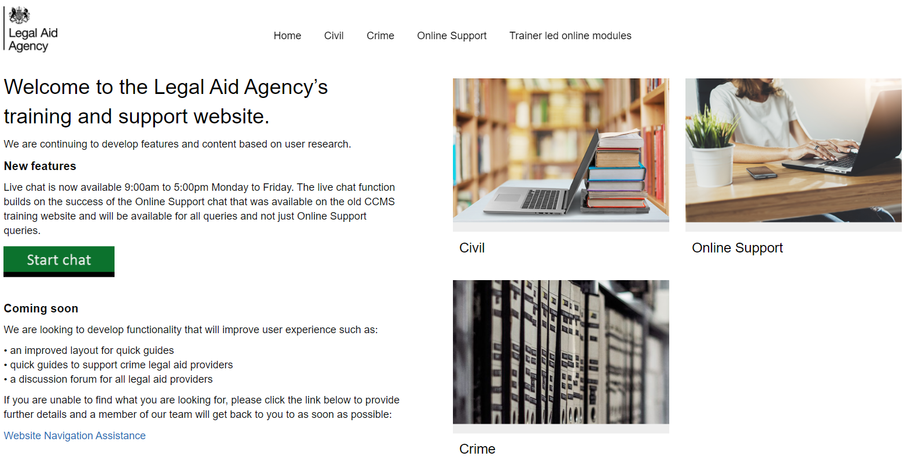
Legal aid agency training website:

Slide 26

What you can find on our website:
CCMS quick guides
CCMS online training
Online support webchat
Getting started
Making an initial application
Managing live cases
Closing cases and billing
Advanced billing
Exceptional case funding
High-cost cases
Sign up on Eventbrite: https://www.eventbrite.co.uk/o/legal-aid-agency-6102545875
Use Webchat if you need help with IT system issues
Webinar recordings
Our ‘Help Us Say Yes’ webinars focus on areas where there have been high enquiry levels, issues raised and helping providers in ‘getting it right first time’
Popular sessions are posted on the training website: Ministry of Justice
Eligibility calculator
Course: CCMS Provider: Means assessments and contributions (justice.gov.uk)

Slide 27

When we don’t get it right first time:
Civil Application Fixer
Email: applicationfixer@justice.gov.uk
Do you think the Legal Aid Agency has made a mistake with your application, amendment or means assessment on CCMS?
This fixer is designed to help reduce appeals and save time during the initial decision-making stages of civil applications
Civil Claim Fix
Email: LAACivilClaimFix@justice.gov.uk
Do you think the Legal Aid Agency has incorrectly rejected your civil claim or outcome?
If we have made a mistake, we will offer a priority re-submission service to help you get paid quicker

Slide 28

Our regulatory framework and guidance:
Legal Aid, Sentencing and Punishment of Offenders Act 2012 (LASPO):
https://www.legislation.gov.uk/ukpga/2012/10/contents/enacted
Civil Legal Aid (Merits Criteria) Regulations 2013:
https://www.legislation.gov.uk/uksi/2013/104/contents/made
Civil Legal Aid (Procedure) Regulations 2012:
https://www.legislation.gov.uk/uksi/2012/3098/contents/made
Civil Legal Aid (Financial Resources and Payment for Services) Regulations:
https://www.legislation.gov.uk/uksi/2013/480/contents/made
Civil Legal Aid (Remuneration) Regulations 2013:
https://www.legislation.gov.uk/uksi/2013/422/contents/made
Cost Assessment Guidance:
https://www.gov.uk/guidance/funding-and-costs-assessment-for-civil-and-crime-matters
Lord Chancellor’s Guidance under Section 4 LASPO
Evidence Requirements for Private Family Law matters
Means Assessment Guidance
Civil Finance Electronic Handbook
LAA Training and Support Website

Slide 29

Contact us:
Urgent issue?
Customer Services
0300 200 2020
Technical issue?
Online-Support@justice.gov.uk
Pre-CCMS Query?
ContactCivil@justice.gov.uk
Enquiry?
Tweet @LAAHelpTeam

Slide 30


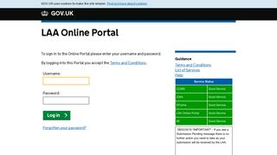
Our communications channels:
Legal Aid Bulletin
Our fortnightly e-alert covers legal aid news and links to relevant GOV.UK pages
Social Media
Follow us on Twitter: @LegalAidAgency and @LAAHelpTeam
LAA Portal
We post info on the status of our online systems on the portal’s landing page
Emailing you
On occasion, we email your organisation’s contract liaison manager (your nominated contact) with important information
If your contract liaison manager, or your nominated contact address changes, notify your LAA contract manager
They are responsible for cascading LAA information to relevant employees
Sign up: xx

Slide 31
End slide

