Slide 1
Nationality and Borders Act Webinar: Changes to the Immigration and Asylum Specification from 01 April 2023
Service Development
08 & 09 March 2023

Slide 2


Technical tips for this webinar
Please put yourself on mute during the webinar
You can ask us questions at the end of each session through the ‘meeting chat’
Click on the ‘Q&A’ icon to ask a question
You can keep the meeting chat open throughout to view other people's questions
Email us if you experience technical issues during the webinar:
communicationsdepartment@justice.gov.uk
Camera and audio off when icons appear like this:
Click here to view the Q&A

Slide 3
Content
National referral mechanism (NRM)
Priority removal notices (PRNs)
Controlled legal representation (CLR)
Group 2 Refugee Decisions (Differentiation)

Slide 4

Changes to the Immigration and Asylum Specification from 1 April 2023
Purpose of the webinar:
        To understand the changes to the Immigration and Asylum Specification that will be in place from 1 April 2023
By the end of the webinar, you will have an understanding of:
What the main changes will be to the Immigration and Asylum Specification
How to claim for the new work
How to claim for controlled legal representation matters from 01 April 2023

Slide 5
National Referral Mechanism (NRM)

Slide 6
National Referral Mechanism (NRM): What is changing?
From 01 April 2023, you will be able to claim for advice given to a client in relation to entering the National Referral Mechanism (NRM)
What is in scope?
If an existing client is identified as having indicators of trafficking then the following advice can now be given:
Procedural advice including:
  What is the NRM?
  What does it do?
  How do I get referred into it?
Individual advice:
  What the impact of entering the NRM would have for an individual client’s immigration or asylum case

Slide 7
National Referral Mechanism: What is changing continued?
Key Contract Amendments:
8.36: Any associated advice in relation to the National Referral Mechanism will not constitute a separate Matter from the original Matter and you may not open a separate Matter Start.
8.56: You may provide Add-on Services in relation to potential referral into the National Referral Mechanism where:
(a) you are advising a Client under a Matter Start in circumstances where Add-on Services may be provided under the Act; and
(b) you recognise indicators of the Client being a potential victim of modern slavery.
8.57: Add-on Services should include:
(a) a factual explanation of the NRM;
(b) an explanation of support surrounding the NRM;
(c) an explanation of how the NRM interacts with the immigration system; and
(d) an explanation of the referral process.
8.58: The following are not within the scope of Add-on Services:
(a) identifying whether the Client is showing trafficking indicators; and
(b) ongoing advice and support through the NRM process.

Slide 8
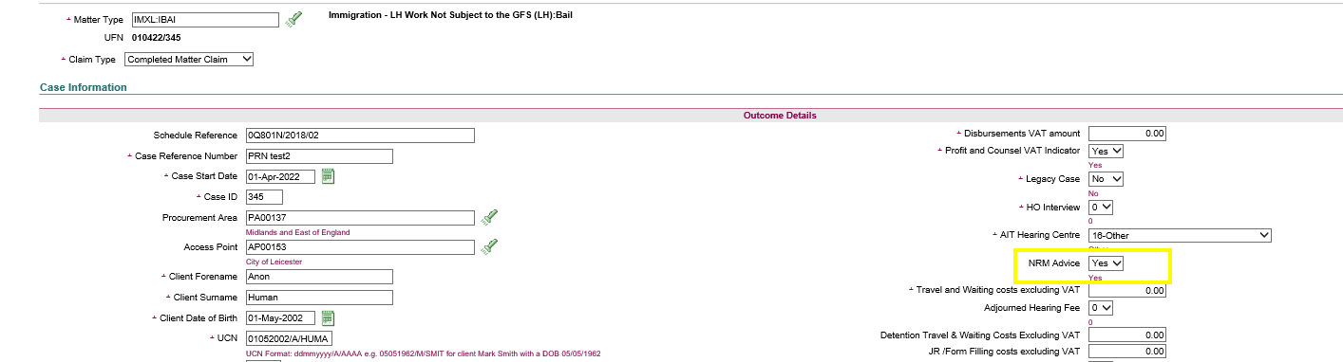
National Referral Mechanism: How do I make a claim?
NRM advice will be claimed as a bolt-on fee of £150 to an existing legal help claim, as shown below:

Slide 9
Priority Removal Notices

Slide 10
Priority Removal Notices (PRNs): What is changing?
From 1 April 2023, you will be able to claim up to 7 hours of non-means tested advice for a client who seeks advice following receipt of a PRN from the Home Office
What is in scope?
Up to a maximum of 7 hours of non-means tested advice can be given to a client who is in receipt of a PRN from the Home Office
Once it has been determined a client has a substantive matter, the PRN matter should be concluded and a new matter should be opened to conduct the follow on work.
Follow on work is defined as any substantive matter, in scope or out of scope (where Exceptional Case Funding is granted), identified as a result of the initial PRN advice given.

Slide 11
Priority Removal Notices: What is changing continued?
Key Contract Amendments:
8.31: Advice in relation to obligations under a Priority Removal Notice is a separate Matter Start to any associated Immigration or Asylum Matter
8.59: The scope of work is as set out in paragraph 31ZA of Part 1 of Schedule 1 to the Act
8.60: There is no means assessment required to open a Matter Start to provide advice in relation to a Client’s Priority Removal Notice obligations under the Nationality and Borders Act 2022.
8.61: You may provide up to (but no more than) 7 hours of Contract Work and when this limit is reached you must determine whether the Client qualifies for another form of publicly funded assistance
8.62: Where at any time prior to concluding 7 hours of Contract Work you determine that the Client qualifies for any other form of Contract Work in the Immigration and Asylum Category of Law you must cease to provide Priority Removal Notice advice and commence a Matter under that form of Contract Work.
8.63: In the circumstances described in Paragraph 8.62 you must close the Priority Removal Notice Matter and submit a Claim based on Hourly Rates for the work undertaken to that point.

Slide 12
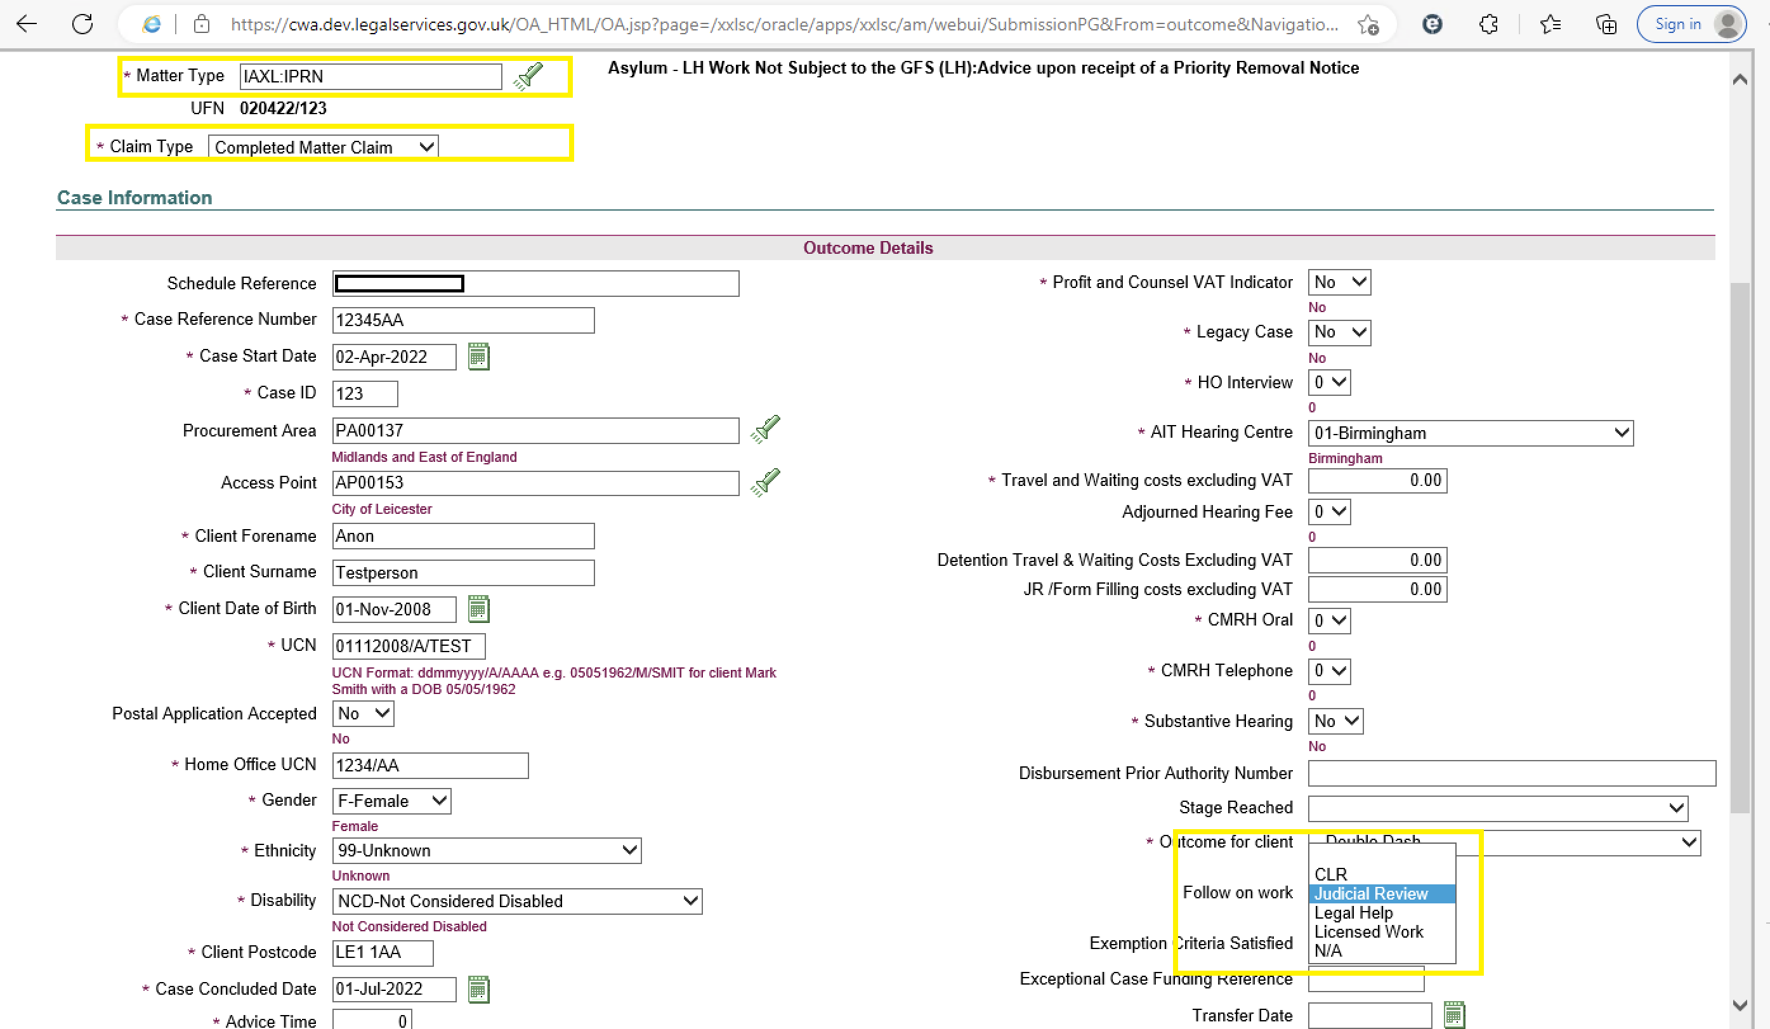
Priority Removal Notices: How do I make a claim?
Initial PRN advice: will be claimed as Hourly Rates using the MT1 (matter type 1) Code IAXL in combination with MT2 (matter type 2) Code IPRN. Follow on work: will be claimed as a separate New Matter Start at Hourly Rates using the appropriate MT1 Code in combination with the most appropriate MT2 Code.
When making a claim for the initial advice you must select the most appropriate Follow on work type from the drop down in the new CWA field.

Slide 13
Controlled Legal Representation

Slide 14
Controlled Legal Representation (CLR): What is changing?
From 1 April 2023:
All CLR cases subject to the Standard Fee Scheme, started from this date, will use either the 2(d) or 2(e) fee rates.
CLR rates 2(a), 2(b), 2(c) and the interim hourly rates will not be applicable to CLR matters with a grant date of 1 April 2023 or after.
The escape fee threshold will be reduced from:
  3x the standard fee to 2x the standard fee for any CLR matter with a grant date on or after 1 April 2023
  3x the standard fee to 2x the standard fee for any Legal Help matter with a start date on or after 1 April 2023
The Legal Help stage and the CLR stage will constitute two separate matters and so the escape fee threshold will be calculated independently of each other

Slide 15
Controlled Legal Representation: What is changing…continued?
Concerning Matter Start Rules:
Paragraphs 8.25 and 8.32 confirm that any Asylum or Immigration application and subsequent appeal attracting a Standard Fee Stage 2(d) or 2(e) Claims will constitute separate matters.
Concerning which fee is applicable:
Paragraphs 8.72 and 8.86 set out, in newly formatted tables, which CLR Standard Fee will be applicable in different situations, according to the date that the CLR was granted and with reference to whether or not a substantive hearing took place. To note that where a Standard Fee applies to CLR work with a grant date on or after 1 April 2023 only 2(d) or 2(e) fees will be available.
Concerning the change in Escape Fee Threshold:
Paragraphs 8.94 to 8.100 set out the changes to the Escape Fee thresholds and how these are calculated.

Slide 16
Controlled Legal Representation: How do I make a claim?
CLR matters opened on, or after, 1 April 2023 and attracting the Standard Fee Scheme rate will be claimed using the MT1 Code IACE, IACF, IMCE or IMCF in combination with the most appropriate MT2 Code.
Any preceding Legal Help stage matter claim should be submitted as a Completed Claim with the Outcome Code IE.
  Where a Legal Help matter was opened before 1 April 2023 the escape fee threshold will be calculated as 3x the standard fee scheme rate and the CLR claim, opened on or after 1 April 2023, escape fee threshold will be calculated at 2x the standard fee scheme rate.

Slide 17
Group 2 Refugee Decisions (Differentiation)

Slide 18
Group 2 Refugee Decisions (Differentiation):
This work was introduced into the Specification in July 2022
Claimed as a separate new matter to any ongoing asylum claim using the code combination IAXL:IDIF
This matter start should cover the following work where appropriate;
  Advice on the preliminary Group 2 Refugee decision
  Rebuttal of the preliminary Group 2 Refugee decision
  Advice on the outcome of the rebuttal
Where a Client with an open asylum matter receives notification from the Home Office of a provisional Group 2 Refugee decision, the provider should ensure that a copy of the relevant CW1 form and copies of the means evidence are retained on the rebuttal matter file, and a note made of the UFN of the linked asylum claim.
  If the client has advised that a change in circumstances has occurred since the original assessment which may affect their eligibility, apply the guidance in section 11 of the Lord Chancellor’s Guidance to determine if a reassessment is required on the open asylum matter.
  If a reassessment is not required then the provider can also rely on the original assessment for the new matter start.
If you have instructions from the client on an existing, ongoing substantive matter then this should remain open whilst the secondary matter, the rebuttal, is conducted.

Slide 19
Additional guidance / contact us

Slide 20
Links
Contract documents as well as a table of amendments can be found at
Standard civil contract 2018 - GOV.UK (www.gov.uk)
Full details of LASPO and Remuneration Regulations can be found at
Civil legal aid: civil regulations, civil contracts, and guidance - GOV.UK (www.gov.uk)
Guidance on how to make Controlled Work claims can be found at
CWA codes guidance - GOV.UK (www.gov.uk)
The full text of the Nationality and Border Act 2022 can be found at
Nationality and Borders Act 2022 (legislation.gov.uk)
More details about the National Referral Mechanism can be found at
National referral mechanism guidance: adult (England and Wales) - GOV.UK (www.gov.uk)

Slide 21

Our training website
Online Support Webchat
Use Webchat for help with IT system issues
Webinar Recordings
Our ‘Help Us Say Yes’ webinars focus on areas where there have been issues or high enquiry levels
Popular sessions are posted on the training website: Ministry of Justice

Slide 22
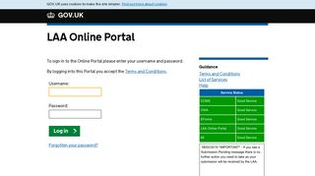


Our communications channels
Legal Aid Bulletin
Social Media
LAA Portal
A fortnightly e-alert with links to relevant pages
Follow us on Twitter
We post the status of our online systems on the portal’s home page
Join our thousands of subscribers
Read our blog
Get help from our customer service twitter account

Slide 23
End slide

