Slide 1
#HelpUsSayYes Webinar: Reporting outcomes
Civil Billing
December 2023

Slide 2


Technical tips for this webinar
Please put yourself on mute during the webinar
You can ask us questions at the end of each session through the ‘meeting chat’
Click on the ‘meeting chat’ to ask a question
You can keep the meeting chat open throughout to view other people's questions
Email us if you experience technical issues during the webinar:
LAAHelpUsSayYes@justice.gov.uk
Camera and audio off when icons appear like this:
Click here to view the meeting chat

Slide 3
Content
Outcomes: General information
The statutory charge
Completing a statutory charge outcome
Completing a cost outcome
Additional guidance / contact us

Slide 4

Reporting outcomes: Statutory charge cases
Purpose of the webinar:
The purpose of this webinar is to provide you with information on reporting outcomes on statutory charge cases and cases where costs have been awarded
By the end of the webinar, you will have an understanding of:
How to complete outcomes
How to report cost and damages awards
Information needed for statutory charge decisions

Slide 5
Outcomes: General information

Slide 6
What is an outcome:
An outcome is your way of telling us the case has concluded:
Once you have informed us, we can discharge the certificate and you can submit your final bill
Recording outcomes allows you to record:
Your clients awarded inter partes costs (or part of them)
The date of final work on which the matter concluded:
This date is used as the date of discharge of the certificate
Once we are informed:
It allows us to record a decision on the statutory charge, where your client has recovered or preserved monies, property or other assets
Top tip: A reason for discharge is needed unless the certificate is already discharged or revoked
Notes:
The date of final work is the date on which the matter concluded – this is generally when you have done the last substantive work on the file for the client. This is used as the date of discharge of the certificate so please ensure that it is correct or it could cause issues on assessment of your claim.
Unless the certificate has already been discharged or revoked, please provide a reason for discharge.

Slide 7
When to submit an outcome:
Generally, outcomes should be submitted when the case has been concluded and discharge of the certificate is required:
Multiple proceedings: Submit one outcome for all proceedings at the end of the case
The best time to submit an outcome is immediately once the case has ended:
Has benefits from a statutory charge perspective
Once the certificate is discharged, your client can stop paying any contributions
Reduces the risk of delays in processing your final bill.
We can send you prompts if we do not receive your claim within a certain time period.

Slide 8
When to submit an outcome: Statutory charge and cost cases
Where there is a possibility of the statutory charge arising, you are under a duty to report to us promptly once the terms of the order or agreement are known:
Submit an outcome, rather than a billing enquiry, even if you do not wish the certificate to be discharged at that time.
Cost cases:
The final outcome with completed cost award can only be submitted:
Once cost negotiations are concluded
Any payments received
There are no further recovery work to be carried out under the certificate.
If discharge of the certificate is required at an earlier date, this can be requested via a case enquiry

Slide 9
Evidential requirements:
The final order made in the proceedings always needs to be uploaded.
If no final order was made, or you have not yet received it from the court, please upload the closing letter sent to your client confirming how the matter concluded.
In a family case, complete and upload a CIVADMIN1:
This does not have to be signed or dated by your client to be sent to us.
Let us know what each party offered at the outset of the proceedings and whether any counter-offers were made:
The parties’ Form Es may be useful, so it is worthwhile to upload these as well, especially Section 5 (the order sought questions).
Top tip: Outcomes need to be submitted for each proceeding

Slide 10
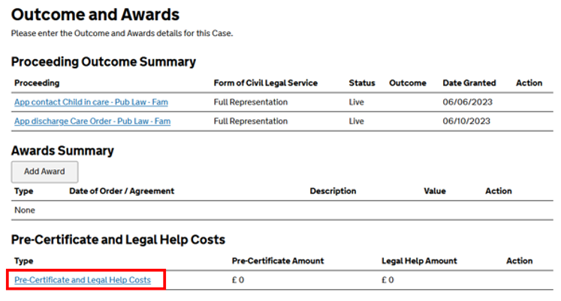
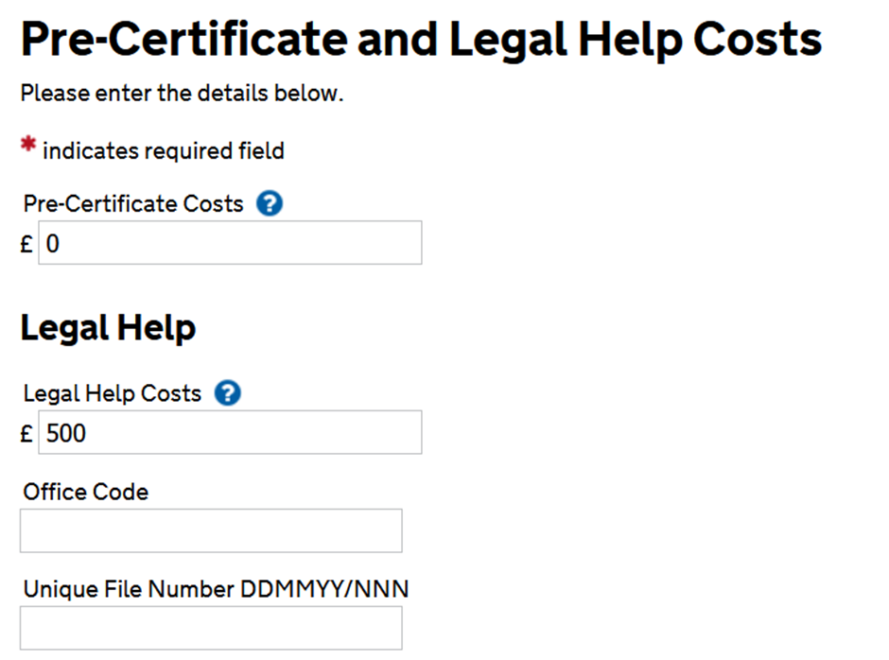
Legal help:
The statutory charge is calculated by reference to the cost of the funded services.
Where a certificate has been issued, this will include costs claimed under the certificate and any costs claimed under controlled work (including legal help).
The legal help information entered on CCMS will be used to calculate any statutory charge liability:
Please check this carefully when submitting your outcomes and ensure that the figure entered reflects what you have received, including VAT.
If you have opened a legal help file but are not making a claim under legal help, inform us in the 'Other Information' box. This will avoid us needing to send a further query.

Slide 11
The statutory charge

Slide 12
What is the statutory charge?
The statutory charge:
Is designed to put legally aided clients as far as possible in the same position as successful non-legally aided clients who are responsible at the end of their cases to pay their own legal costs if their opponent in the litigation does not, or is unable, to pay them.
Ensures that funded clients contribute towards the cost of funding their cases so far as they are able
Can deter legally aided clients from running up costs unreasonably by giving them a financial interest in how much money is being spent.
The law that creates the statutory charge is based on the solicitor’s charge:
The principle behind the solicitor’s charge is that it is fair for solicitors to be able to take their costs out of any property their clients recover or preserve because of the services provided.
Please see Chapter 2 of the Statutory Charge Manual, which gives a full picture of the statutory charge

Slide 13
What is the statutory charge (continued):
The relevant statutory provision is section 25 Legal Aid, Sentencing and Punishment of Offenders Act (LASPO) 2012: https://www.legislation.gov.uk/ukpga/2012/10/contents/enacted
This provides that “Where civil legal services are made available to an individual under this Part, the amounts described in subsection (2) are to constitute a first charge on:
(a) any property recovered or preserved by the individual in proceedings, or in any compromise or settlement of a dispute, in connection with which the services were provided (whether the property is recovered or preserved for the individual or another person), and
(b) any costs payable to the individual by another person in connection with such proceedings or such a dispute. (2)
Those amounts are:
(a) amounts expended by the Lord Chancellor in securing the provision of the services (except to the extent that they are recovered by other means), and
(b) other amounts payable by the individual in connection with the services under section 23 or 24.”

Slide 14
When property is recovered:
Paragraph 2.2.4 of the Statutory Charge Manual defines recovery of property as:
“where the client succeeds in claiming ownership of someone else’s property, or obtaining possession of property to which the title was not in issue (e.g. evicting squatters), or in compelling the sale and distribution of proceeds of sale. At the end of the dispute there is a gain for the legally aided individual.”
Recovery will therefore cover the transfer of a formerly jointly-owned property to your client, an increase in the share of a property held by your client, or a lump sum payable to them for no consideration.
In a non-family case, any damages received by the client is a recovery for statutory charge purposes.

Slide 15
When property is preserved:
Paragraph 2.2.5 of the Statutory Charge Manual defines preservation of property as:
“where the legally aided individual succeeds in fending off a claim by someone else to his or her property or to possession of his or her property, i.e. at the end of the dispute the legally aided individual keeps all or part of what he or she regards as his or her own. If the individual keeps only part, he or she may be worse off at the end of the dispute than at the start, but the statutory charge will still attach to the property which he or she has kept”
Preservation will also occur if the opponent wanted a sale of the property, but your client was successful in “defeating” that and remaining in the property and avoiding an Order for sale (see the case of Parkes v. Legal Aid Board [1996] 4 All ER 271).
The property will also be preserved if, in a mortgage repossession case, the lender’s application for possession is unsuccessful and the client is able to remain in the property.

Slide 16
Completing a statutory charge outcome

Slide 17
CIVADMIN1
Our presenter will take you through completing the CIVADMIN1 form:
A copy of the model / example form was provided with the webinar joining instructions.
The form to use can be accessed via this link:
https://assets.publishing.service.gov.uk/government/uploads/system/uploads/attachment_data/file/1089884/civadmin1-form.pdf

Slide 18
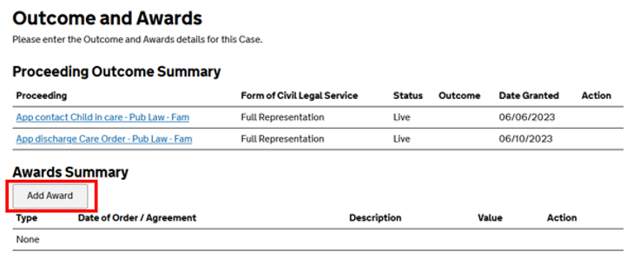
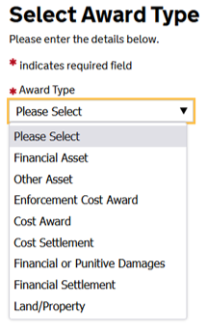
Information needed:
Outcomes and awards:
If a client has been awarded a lump sum (in a family case) or has received an award of damages (in a non-family case), enter the amount received in the ‘damages’ element of the awards section of the outcome:
If there has been a change in how a property’s held between the parties in a family case, complete the land element of the awards section with details of the property.
If any other assets have been awarded, for example, jewelry, shares in a company, cars, antiques, complete the assets element.

Slide 19
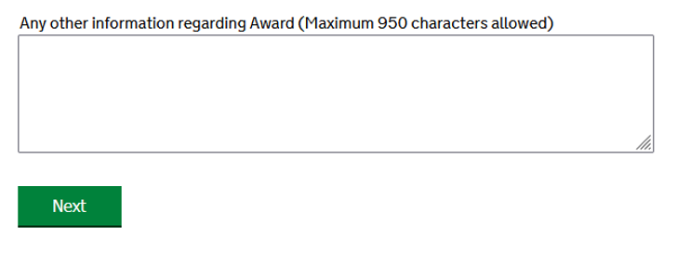
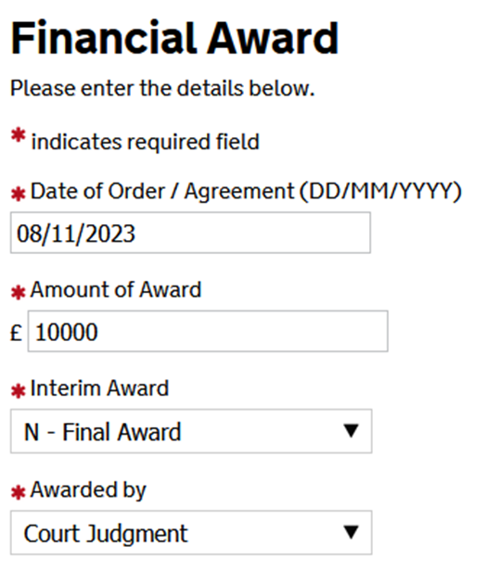
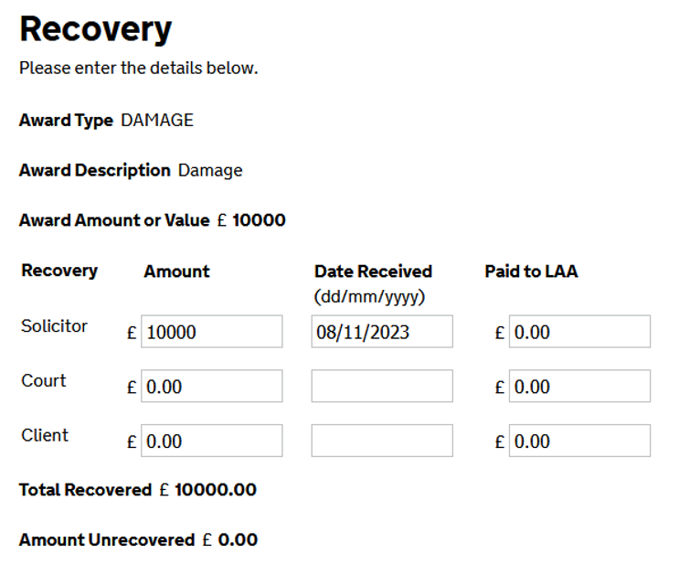
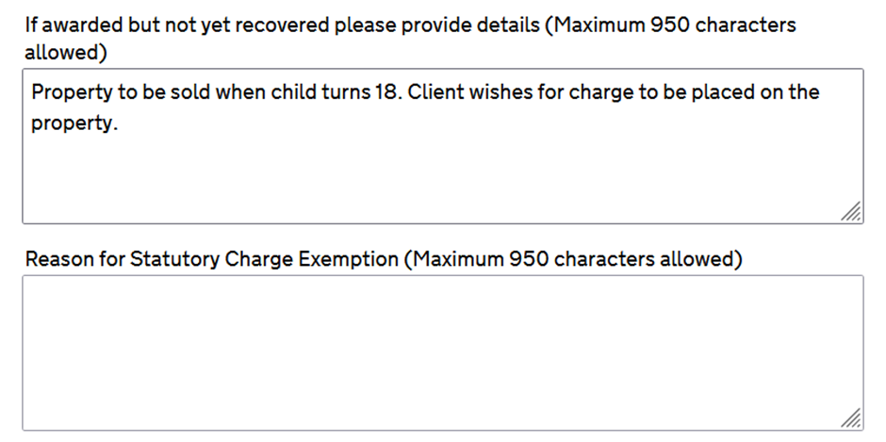
Information needed continued:
Each element has an “other information” box that can be completed to give the caseworkers more information if needed
For information: Additional sections to complete when applicable:

Slide 20
Helping us to process the statutory charge outcome first time
If there is to be a sale / transfer of the property in the future, tell us what you know about the progress
Tell us the name of the solicitors dealing with the conveyancing, if it is not yourselves
When drafting the final order, remember to include the statutory charge postponement clause
Include your client’s proposals to satisfy the liability under the statutory charge
Transfer the monies to satisfy your client’s liability under the statutory charge by way of a bank transfer. The information needed to do this is:
Bank: Natwest
Account Name: LAA Receipts
Sort Code: 60-70-80
Account number: 10014578
Payment Reference: client’s certificate number
If you have sent payment, please confirm the amount and date paid so that this can be matched up with the client's account

Slide 21
Completing a cost outcome

Slide 22
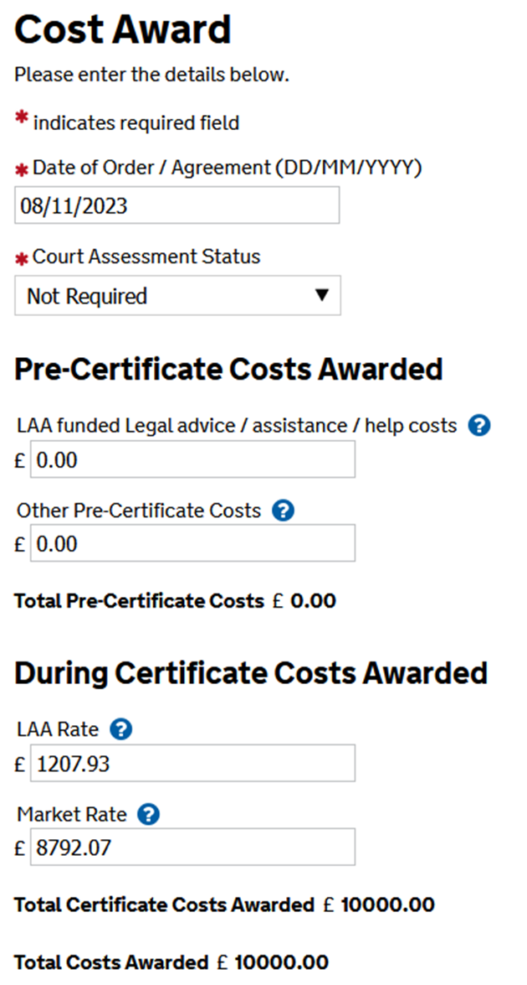
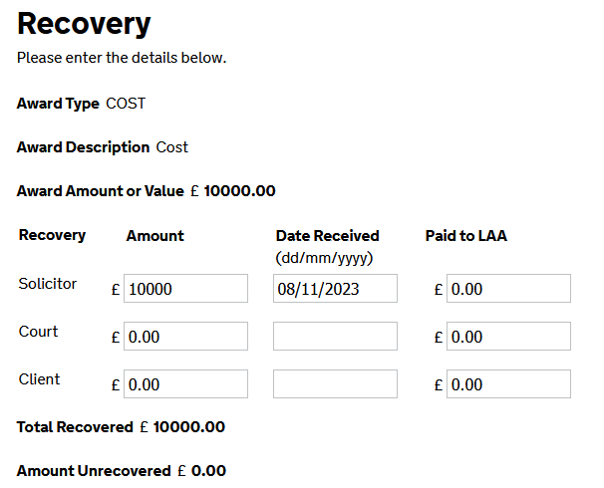
Completing the outcome:
Where cost orders have been made in favor of your client:
You must submit copies of all these orders
Raise a cost award on CCMS
Top tip: Both the cost award and recovery screens must be fully completed
Ensure you click ‘calculate’ at the bottom of the page to get ‘Total recovered’ and ‘Amount unrecovered’ figures:
If a negative figure appears, you will need to complete the ‘Award’ section

Slide 23
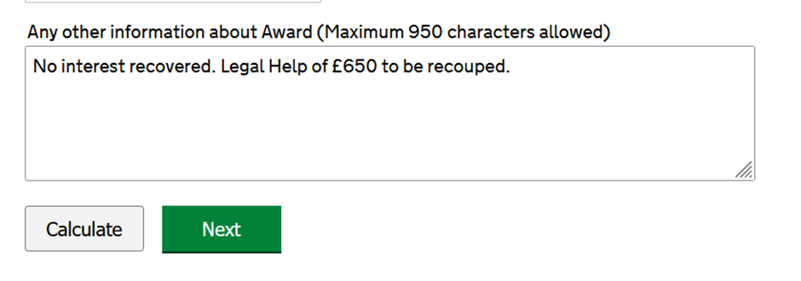
Costs recovered in full:
If damages are also recovered:
Submit a payment to cover the statutory charge (or indicate if no claim is to be made against the fund).
The LAA will not be able to give authority for the release of any monies unless we receive a written undertaking as to costs.
Use the text field to indicate whether there are any legal help costs or interest on costs to recoup

Slide 24
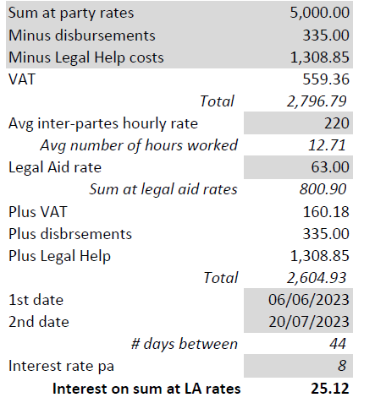
Calculation of interest:
In this example:
8 percent interest on £5,000 equates to annual interest of £400 interest accrued over 44 days
Total interest recovered is 400 X 44 ÷ 365 = £48.22
Costs at LAA rates are calculated as £2,604.93:
The amount owed to the LAA is 48.22 x 2,604.93 ÷ 5,000 = £25.12.
Please note: This includes the interest on the legal help fees recoverable by the LAA.
For further guidance, please refer to Section 19.4 of the Civil Finance Electronic Handbook

Slide 25
Costs recovered partially or not at all:
Inter partes costs must be claimed from the LAA at LAA rates
Once the final bill is paid, the LAA will assume responsibility for recovering the outstanding costs
The information provided on the outcome must be complete and accurate
Please upload:
Order for costs
Default cost certificate (DCC)
Relevant correspondence

Slide 26
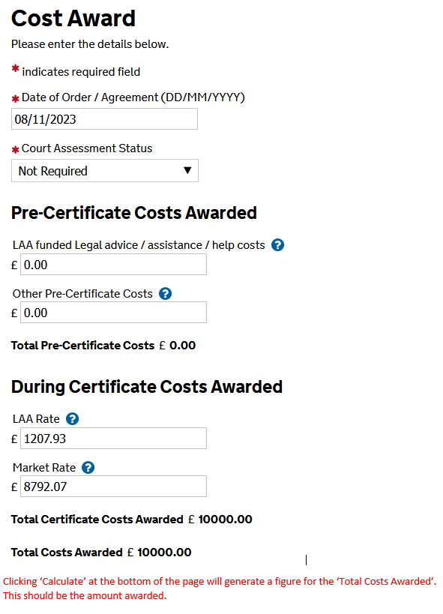
Costs recovered partially or not at all continued:
LAA rate figure will be the amount of inter partes costs being claimed from the LAA:
This will sometimes be shown on a separate schedule attached to the bill of costs
Market rate figure will be DCC total (inclusive of court fees) minus any pre-certificate costs, minus the LAA rate figure
Total payable by the defendant can be calculated by adding up the LAA rate figure, the market rate figure, and the pre-certificate costs

Slide 27
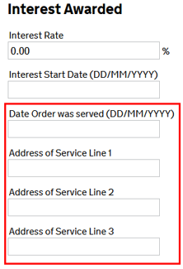
Costs recovered partially or not at all continued:
The date and address of service must be entered.
The other party's name and address must be entered in the 'Liable Parties' section.

Slide 28
Costs award reporting after final bill payment:
Increased numbers of cases being settled with a full costs recovery at the conditional fee arrangement (CFA) level in inquest or other cases against public bodies cases.
The recovery does include the certificated costs that have already been claimed and paid from the LAA.
The recovery, although under a CFA, needs to be reported to the LAA where certificated costs are impacted.
A fresh Outcome should be submitted with details of the cost award / recovery
At that stage the LAA will then initiate any recoupments of already paid certificated costs recovered as part of the settlement
Please do not send in any cheques or bank transfers for monies to be recouped or previously paid.
The LAA will action the recoupments direct from the firms' legal aid account

Slide 29
Reporting process on closed cases:
Submit a ‘General Enquiry’ via the CCMS portal:
Include the certificate number in the subject header
Advise us that a recovery of costs has been made:
Ask us to reopen the matter on CCMS
Confirm the amounts to be recouped. Include any:
Counsel fees
Interest on costs
Legal help
The LAA will clear the previously submitted outcome:
Submit a fresh outcome and cost award:
Upload the order for costs
We will process the outcome and any recoupments once the new outcome has been submitted

Slide 30
Additional guidance / contact us

Slide 31
Contact us:
CCMS: Submit a ‘billing’ or ‘general’ enquiry
Civil general enquiries: Tel: 0300 200 2020 or ContactCivil@Justice.gov.uk
Users experiencing technical problems with the Client and Cost Management System (CCMS) contact: online-support@justice.gov.uk

Slide 32
Civil claim fix:
If you disagree with our decision to return your outcome, you can challenge it through the LAA’s civil claim fix process:
If you believe:
The information requested is not required
The information requested has already been uploaded
Challenges should lay out the reasons for disagreeing and be sent to: LAACivilClaimFix@justice.gov.uk
The civil claim fix service has a 24-hour turnaround target
Reports are provided to the contract management teams and feedback is given to individual caseworkers

Slide 33
Additional guidance:
Civil Finance Electronic Handbook
Statutory charge manual
CIVAMIN1 Form: https://assets.publishing.service.gov.uk/government/uploads/system/uploads/attachment_data/file/1089884/civadmin1-form.pdf

Slide 34

Our training website
CCMS Quick Guides
CCMS Online Training
Online Support Webchat
Use Webchat for help with IT system issues
Webinar Recordings
Our ‘Help Us Say Yes’ webinars focus on areas where there have been issues or high enquiry levels
Sign up on ‘Eventbrite’
Popular sessions are posted on the training website: Ministry of Justice
Interactive advanced guide
Course: Cost awards interactive (justice.gov.uk)

Slide 35
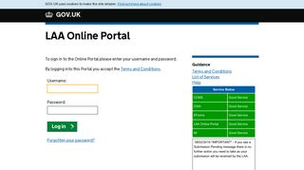


Our communications channels
Legal Aid Bulletin
Social Media
LAA Portal
A fortnightly e-alert with links to relevant pages
Follow us on X (formerly Twitter)
We post the status of our online systems on the portal’s home page
Join our thousands of subscribers
Read our blog
Get help from our customer service twitter account

Slide 36
Legal Aid Agency 13th Floor (13.51) 102 Petty France London SW1H 9AJ
gov.uk/government/organisations/legal-aid-agency

