Slide 1
Immigration billing overview: Controlled Work
Help Us Say Yes Webinar
10 October 2024

Slide 2


Technical tips for this webinar
Please remain on mute during the webinar
You can ask us questions throughout each section using the ‘meeting chat’
You can keep the meeting chat throughout the event to view other questions
Email us if you experience technical issues during the webinar: LAAHelpUsSayYes@justice.gov.uk
Camera and audio off when icons appear like this:
Click here to view the meeting chat

Slide 3
Content
Reporting new matter start (NMS) data
Reporting outcome claims under controlled work
Submitting amendments to your submissions
Useful contacts and links
Types of submission

Slide 4
Purpose of this webinar
This webinar covers the basics of what needs to be reported in your CWA submissions, in the Immigration category
By the end of this webinar you will understand:
  The difference between your new matter start (NMS) reporting and your outcomes reporting
  How to report your NMS data against the correct procurement area and office schedule
  How to identify which codes and costs information should be used when reporting your claims for costs, under each fee scheme
  What claims can be made at different stages of a case and what information needs to be reported
  How and when to request amendments to previous submissions

Slide 5
Types of submission

Slide 6
Two types of submission required
There are two types of submission that you are required to make via CWA each month:
New matter start (NMS) usage in that month
Outcomes for cases that have concluded in that month
  Submissions are made one month in arrears, for example, the submission for SEP2024 cannot be submitted until October 2024.
  The deadline is 20th of every month, such as, you have until 20 October to submit your submission for SEP2024.
  Once a submission has been completed and submitted, no new outcomes can be added to it.
  If you have no work to report, you must still complete a monthly submission.
    This is referred to as a ‘nil submission’.

Slide 7
Reporting new matter starts usage

Slide 8
Reporting new matter start (NMS) usage
You may open a combination of legal help (LH) and controlled legal representation (CLR) matter starts during any month.
When reporting your usage, you should report the overall total opened in that month, against that schedule authorisation:
For example, if you opened 20 legal help and 5 CLR matters in your office which holds an authorisation in the Midlands and East of England procurement area (PA), you report a total of 25 against that authorisation.
All your immigration matter starts, have been allocated under category code IMMAS. When reporting usage, they should all be reported against that code.
If you hold DDAS or DAC authorisations, you will have separate NMS allocations for each centre / scheme and need to report matters opened against each of these as appropriate.

Slide 9
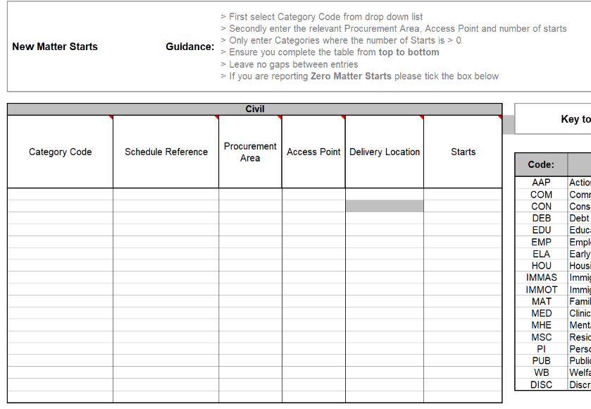
Reporting the data
This data can be reported either line by line directly into CWA or via the bulkload spreadsheet if also reporting outcomes.
Please note:
Your schedule reference is unique to each office, in the format [Account number]/2024/01: For example: 1A234C/2024/01
The procurement area and access points should match those on your schedule.
For example, you open an immigration matter from an office in the Midlands and East of England procurement area, but the client is in Liverpool, you report the matter against the Midlands and East of England PA as that is what is in your schedule.
You must enter a line for each authorisation you have, under that schedule, where a matter start has been opened.

Slide 10
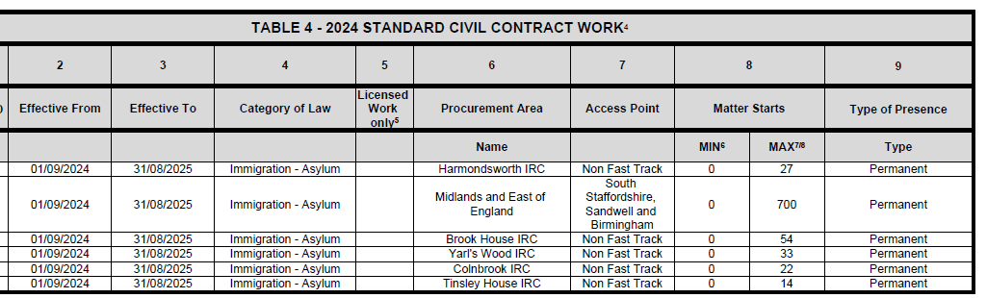
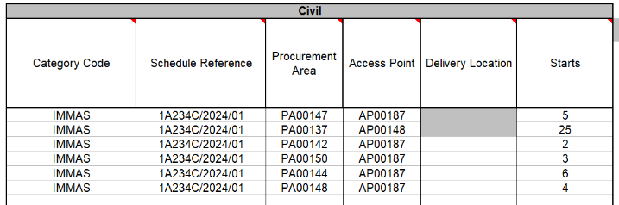
Visuals of reporting
This is what Table 4 on your schedule may show – these are the authorisations you have under each category at that office
This is what your NMS submission could look like in the Bulkload when reporting against each authorisation on that office schedule – you enter the code for the procurement area and access point, not the names

Slide 11
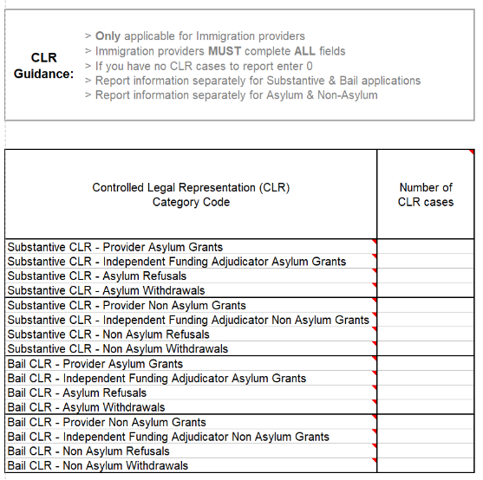

CLR table
What is this ‘CLR’ table for?
This is a redundant report, and you should just enter ‘0’ against each row.
This information is not used in relation to your NMS or outcome submissions.

Slide 12
Reporting outcome claims under controlled work

Slide 13
Claim types
Claim types to choose from
Completed claim
Stage Disbursement claim
Stage claim (only for matters opened prior to 1 April 2023)
Depending on which you choose, different fields will need to be completed. For instance, for Stage Disbursement claims, you cannot claim any Profit Costs and those fields will be greyed out in the bulkload spreadsheet or unavailable in CWA.
There can only be 1 completed claim per matter.
Where you identify that costs have been omitted from a claim, or an error was made in a claim, you must request a Claim Amendment. DO NOT submit a second claim for the additional costs.

Slide 14
Stage disbursement claims
Stage disbursement claims
These can be made in accordance with para 8.141 of the 2024 Contract:
  At least 3 months have elapsed since the matter was opened, or since any previous claim for that matter was made.
You should only report the disbursement costs incurred since the last claim was made on that matter and should ensure that the overall value of disbursements incurred across the matter, does not exceed the applicable cost limitation.
CWA may reject or limit a claim, if the total disbursements reported exceeds the initial cost limitation, and a prior authority number has not been reported to demonstrate an extension has been obtained.
You must ensure that no costs are repeated across claims.

Slide 15
Legal help, CLR, Procurement area and access point reporting
Legal help and CLR
These are separate matters, and separate claims should be made for each. If both matters were opened under the 2024 Contract, then they should both be submitted as completed claims.
The contract sets out when claims can be made – see paras 3.64, 8.75 8.92, 8.139 of the 2024 contract Specifications.
Procurement area and access points
When reporting outcomes, as you did with NMS, you report the procurement area and access point details relating to the schedule authorisation you have for that account not relating to where the client was located.
The client may be in Liverpool, but your authorisation may be under the Midlands and East of England procurement area.

Slide 16
Early bills
Early bills
Where the 2024 Contract permits you to submit a claim, prior to the outcome of the matter being known, you must submit this as a Completed Claim using Outcome Code IY.
If further costs are incurred in the matter, then you must request a Claim Amendment to this submission.
DO NOT submit a second claim for the additional costs as that may lead to double payment of fees.

Slide 17

Matter type 1 code
What matter type 1 (MT1) code should I use?
The matter type 1 code tells us which fee scheme the matter was funded under: Standard fee scheme or hourly rates? Legal help or CLR? Asylum or immigration?
Standard Fee Scheme (SFS)
IALB – Legal Help, Asylum
IMLB – Legal Help, Immigration
IACE – CLR, Asylum, Stage 2D
IACF – CLR, Asylum, Stage 2E
Hourly Rates
IAXL – Legal Help, Asylum
IAXC – CLR, Asylum
IMXC – CLR, Immigration
If the second letter of the MT1 code is:
‘A’: It relates to Asylum.
‘M’: It relates to Immigration.
If the code contains an ‘L’: It relates to Legal Help
If the code contains a ‘C’: It relates to CLR

Slide 18
Matter type 2 code
What matter type 2 (MT2) code should I use?
The MT2 codes tell us about the type of case that the client sought advice on , for example, a claim for asylum, an extension of leave, an application for bail.
Some MT2 codes can only be used in conjunction with certain MT1 codes and CWA will reject any incompatible combinations.
For instance. all UASC matters are payable under Hourly Rates, therefore you could not use a Standard Fee MT1 code (e.g. IALB) with the MT2 code IUAS. You should use IAXL instead
What outcome code should I use?
Outcome Codes “IA” to “IG” should be used where the outcome of the client’s matter is known.
Outcome Codes “IT” to “IZ” should only be used for matters where the ultimate outcome of the matter for the client is not known.

Slide 19
Profit cost field
What do I enter in the Profit Cost field for SFS matters?
You should enter the value of the work undertaken, if calculated at the applicable Escape Fee Hourly rate (see tables 7a and 8a of Sch 1 of the Civil Legal Aid (Remuneration) Regulations).
This also applies to Counsel Fees – the actual value of the work undertaken by counsel, if calculated at the applicable Escape Fee Hourly Rate, should be reported in the ‘Counsel fee’ field.
CWA will use these figures as part of the calculation to determine if the claim has exceeded the escape fee threshold.
DO NOT enter the value of the fixed fee in the profit cost fields.
CWA will trigger the standard fees automatically when you use the applicable MT1 code.

Slide 20
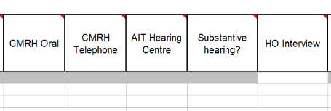
Additional payments
Additional payments under the SFS
If you have attended case management review hearings (CMRHs), adjourned hearings or home office interviews, then you can claim the ‘Additional payments’ for these via their respective fields: Select the number of each payment that you are entitled to claim.
Only 1 payment of a substantive hearing fee can be claimed per matter: Enter Yes where applicable:
  CWA will then add the value of these additional payments, to the overall value of the claim.

Slide 21
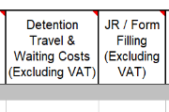
Reporting detained travel and waiting / pre-Judicial review costs
Detained travel and waiting / Judicial Review
There are two fields available in Standard Fee matters, to report costs that are payable in addition to the standard fee scheme.
These are for travel and waiting costs to a place of detention, and costs associated with providing advice on a related potential Judicial Review/pre-action advice. These costs are payable under Hourly Rates, with JR advice subject to a cost limit.
CWA will automatically add the values claimed in these fields, to the overall value of the standard fee claim, however, they will not count towards the escape fee calculation.

Slide 22
Reporting hourly rates matters
Reporting hourly rates matters
Where the MT1 codes relating to hourly rates matters are used, CWA will credit you with the values entered in the profit costs and Counsel fee field.
You should only claim up the value of any authorised cost limit in these fields, ensuring that if a cost extension has been obtained the reference number is entered in the ‘NIAT Prior Authority Number’ field.
The detention travel and waiting and JR / form filling fields, are not applicable for hourly rates claims.
Those costs should form part of your profit cost sum.

Slide 23
ECF and exemptions
Exceptional case funding (ECF)
Where ECF has been granted, when reporting the outcome of the matter, to allow MT1 and 2 code combinations to be used which would otherwise not be available, you must report the ‘Exceptional Case Reference Number’ in the field of the same name.
Exemptions
Some cases removed from the scope of legal aid of advice can be brought back into scope if an individual meets set criteria.
When reporting the outcome, the “Exemption Criteria Satisfied” field in CWA may need to be completed.
This may include matters brought into scope due to the client being a victim of trafficking / modern slavery or being a separated migrant child.

Slide 24
Submitting amendments to your submissions

Slide 25
Amendments to your submissions
Possible reasons for amendments
You may need to make amendments to your submissions for a number of reasons, including:
You have reported an incorrect number of NMS opened in a month
You have reported an Outcome using the wrong MT1 code and have been paid the wrong fee
You have submitted an Early Bill and need to add in additional costs and update the outcome
You forgot to include a disbursement in your completed claim Outcome

Slide 26
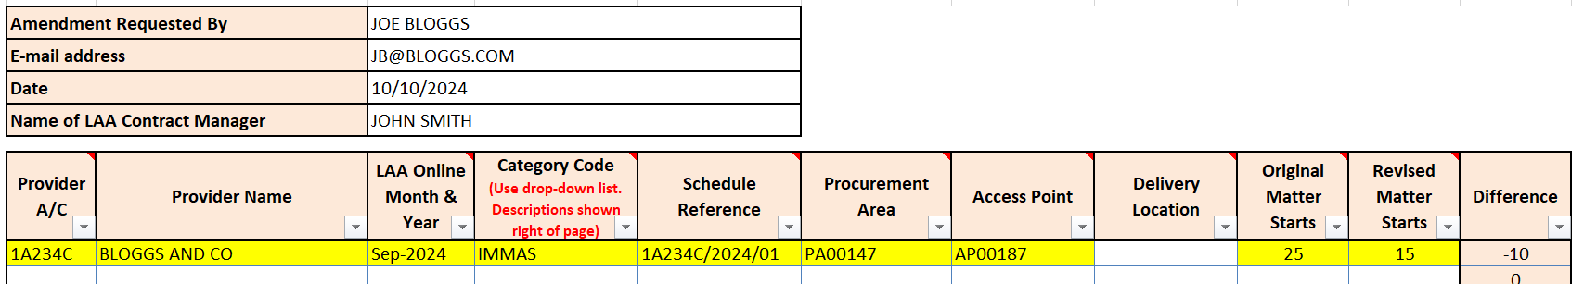
NMS amendments
Amendments to NMS submissions
Use the Claim Amendment form: Select the ‘Civil NMS’ tab.
Enter the information regarding your account, schedule, procurement area, access point, category and the month of the submission to be amended.
Enter the number of NMS you originally entered, and the value you wish to change it to.
Email your form to PA-ClaimAmend@justice.gov.uk

Slide 27
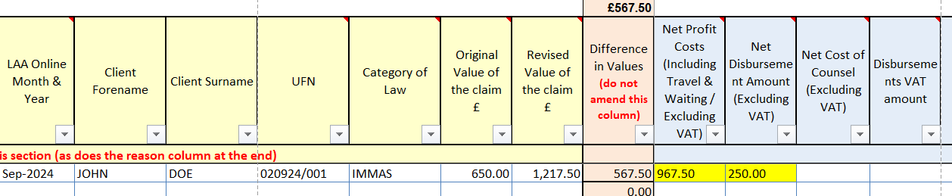
Outcome amendments
Amendments to outcome submissions
Use the Claim Amendment form: Select ‘Civil Amendments’ tab.
Enter the information regarding your account, category, the month of the submission to be amended and the name of the client and UFN of the matter. This allows us to identify the claim.
Select the fields you need to update the data for and enter the necessary information
Email your form to PA-ClaimAmend@justice.gov.uk

Slide 28
Useful contacts and links

Slide 29
Useful links
Current contract documents: Standard civil contract 2024 - GOV.UK (www.gov.uk)
Full details of LASPO and Remuneration Regulations: Civil legal aid: civil regulations, civil contracts, and guidance - GOV.UK (www.gov.uk)
Guidance on how to make controlled work claims: CWA codes guidance - GOV.UK (www.gov.uk)
Immigration topic specific guidance – Key Cards: Course: Immigration and Asylum (justice.gov.uk)
Claim amendment forms and guidance: Submit a contracted work and administration (CWA) claim online - GOV.UK (www.gov.uk)
2024 Standard Civil Contract useful information: Immigration: https://assets.publishing.service.gov.uk/media/66d0765259b0ec2e151f84ce/2024_Standard_Civil_Contract_Useful_Information__Immigration_.pdf

Slide 30
Our training website
Online Support Webchat
Use Webchat for help with IT system issues
Webinar Recordings
Our #HelpUsSayYes webinars focus on areas where there have been issues or high enquiry levels
Popular sessions are posted on the training website: Ministry of Justice and the LAA YouTube channel: Legal Aid Agency youtube channel

Slide 31
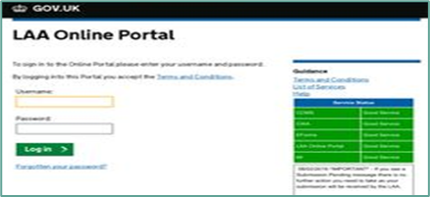


Our communications channels
Legal Aid Bulletin
A fortnightly e-alert with links to relevant pages
Join our thousands of subscribers: Sign up for the LAA Bulletin
Social Media
Follow us on X (formerly Twitter)
Get help from our customer service X account
Read our blog
LAA Portal
We post the status of our online systems on the portal’s home page

Slide 32
Legal Aid Agency
13th Floor (13.51)
102 Petty France
London SW1H 9AJ
gov.uk/government/organisations/legal-aid-agency

