Slide 1
#HelpUsSayYes webinar: Transfer of high cost cases
High Cost Family
November 2024

Slide 2


Technical tips for this webinar
Please remain on mute during the webinar
You can ask us questions throughout each section using the ‘meeting chat’
You can keep the meeting chat in view throughout the event to view other questions
Email us if you experience technical issues during the webinar: LAAHelpUsSayYes@justice.gov.uk
Camera and mic are off when icons appear like this:
Click here to view the meeting chat

Slide 3
Content
How to submit a provider transfer request
The process after a transfer
High cost family interactions
Additional guidance / contact us
3

Slide 4

Transfer of high cost family cases
Purpose of the webinar:
The purpose of this webinar is to help you understand the solicitor transfer process in high cost family cases, and help minimise the possibility of bill rejections
By the end of the webinar, you will have an understanding of:
Be able to submit a provider transfer request
• Understand the process for high cost family cases
• Know what further information you are required to provide
• Know where to find helpful guidance

Slide 5
How to submit a provider transfer request

Slide 6
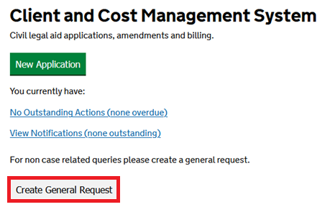
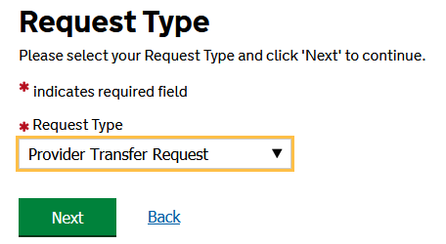
Provider transfer process: Initial request
A request for a provider transfer is submitted as a ‘General Request’. We review this request and can grant access to the case to the new provider.
From the CCMS homepage select Create General Request.
Under Request Type, select Provider Transfer Request.
Click Next.

Slide 7
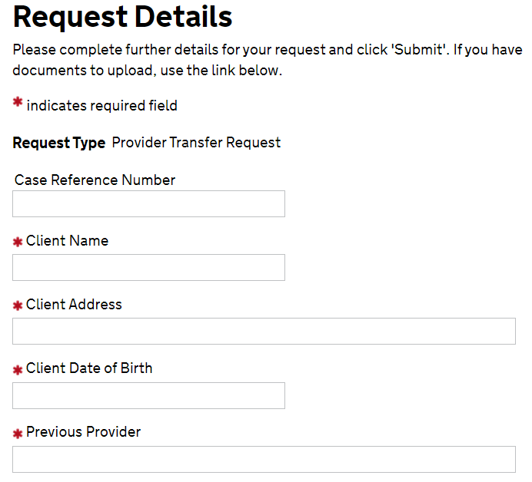
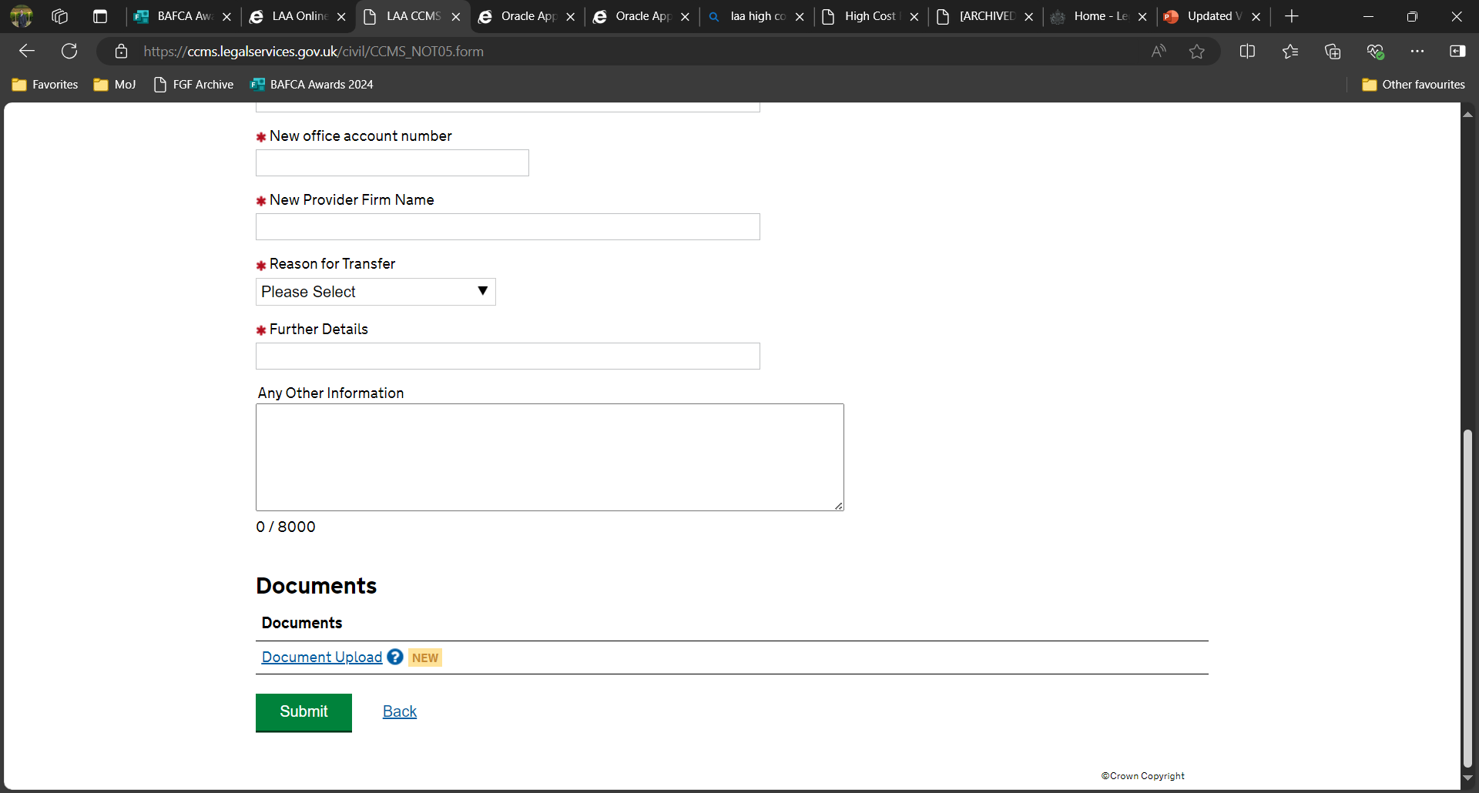
Request details
Complete all the fields in the ‘Request Details’ section, ensuring all information is correct.
Include some context regarding the transfer reason in ‘Any Other Information’.
Top tip: Copying and pasting information from Word can cause an “invalid characters” technical issue.
To resolve, please follow the quick guide: CCMS invalid characters and formatting

Slide 8
Documents
What documents should you attach to your request?
Evidence to confirm the outgoing firm’s consent to the transfer.
If the transfer reason is client dissatisfaction, a copy of a complaint the client has submitted to the previous firm together with their response.
We will request additional information if required.
Click Document Upload to activate the Document Upload section.
Top tip: Office account numbers always begin with a number (0, 1, or 2).

Slide 9
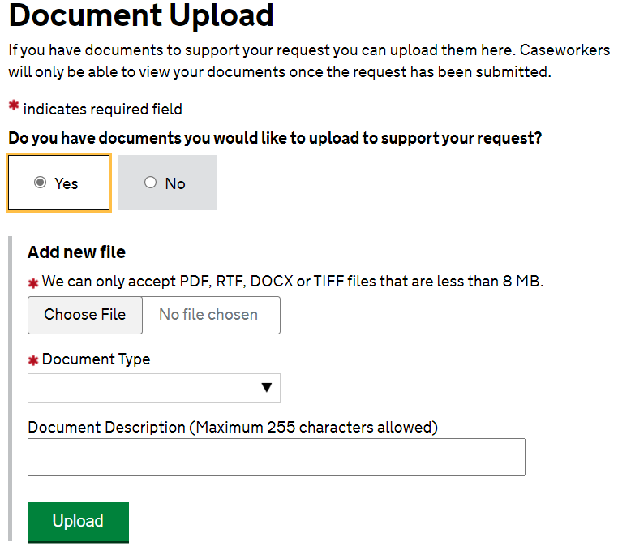
How to upload your documents
How do you upload documents?
In the ‘Document Upload’ screen, select Yes to activate the ‘Add new file’ section below.
Files must conform to the limitations specified.
Choose an accurate document type from the list below and provide a helpful document description.
Click Upload.
Once all required documents are uploaded, click Submit below this section to complete your request.
Top tip: You can upload multiple files, one by one. Please provide suitable document titles in the Document Description field.

Slide 10
Getting it right first time
Prior to submitting your provider transfer request:
Consent must be obtained from an existing member of the outgoing firm.
If the request is born from client dissatisfaction, then a complaint sent by the client to that firm together with their response should also be obtained.
Once your request has been submitted:
It is screened by our central business support team and assigned to high cost family.
If we require any further information that has not already been provided, we will send you a request by way of response.
Top tip: If the provider transfer is urgent (within 2 working days of a required amendment) please contact our customer services team on 0300 200 2020 advising of the urgency.

Slide 11
The process after a transfer

Slide 12
The process following a transfer for HCF cases
HCF cases are slightly different:
You will not need to amend the certificate to increase the cost limitation.
After allocating costs to the previous provider, you may end up with no remaining costs.
We may set up a new case plan notification for your firm. If we do, This will be assigned to either:
The provider contact, which you should assign to the case ASAP; or
The default primary contact for the firm, if a provider contact has not yet been assigned.

Slide 13
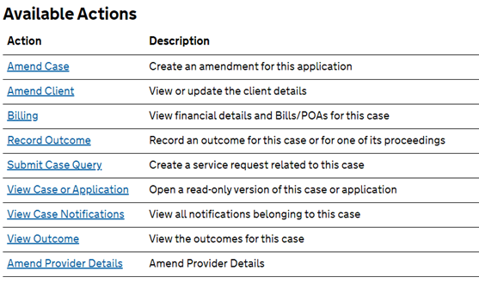
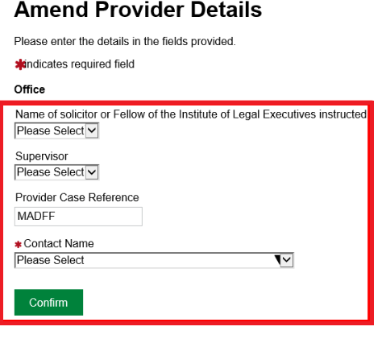
Amending provider details after a transfer
Following the transfer, you can locate the case in Cases and Applications.
From the available actions screen, click Amend Provider Details
Amend the Contact Name to the user who you wish to receive all future actions and notifications on the case.
Click Confirm.
Top tip: You are required to set a Contact Name on the case so all future notifications are sent to an active user. This is crucial to ensure active communication via your Case Plan.

Slide 14
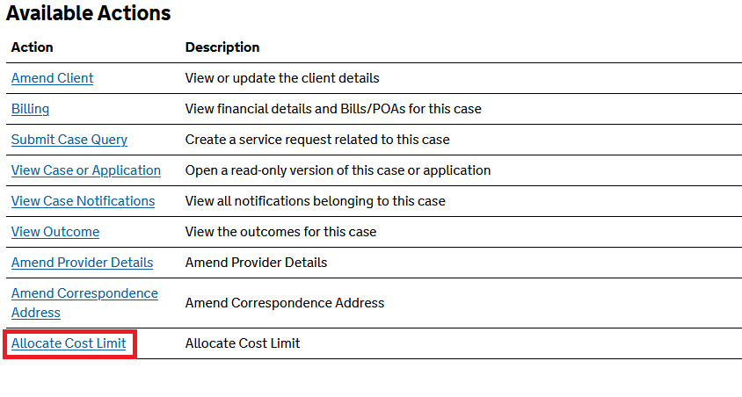
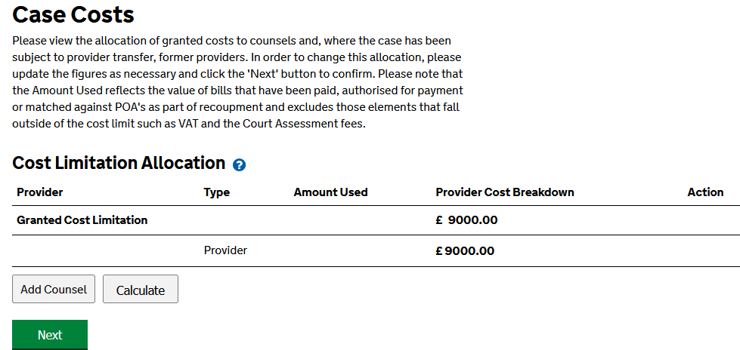
Allocating costs after a transfer of HCF cases
It will be necessary to split the cost limit between firms.
The following steps direct you to the case costs page containing a cost limitation allocation table, and help you perform this task.
Enter the amount to be allocated to the previous firm and click calculate. The remainder will be allocated to your firm.
Click Next to complete the allocation.
From the list of available actions, click Allocate Cost Limit.

Slide 15
Ensuring effective communication via CCMS
It is crucial you assign a contact to your case as soon as possible:
After a transfer, a common issue is correspondence is not read and acknowledged:
This usually occurs when a provider contact has not been assigned to a case.
If a case transfers away from a provider and that provider did not assign a contact name at the time they had ownership of the case, we have no way of knowing who to correspond with and send case plan notifications to, given that the default contact will no longer be one of that provider.
The absence of a contact name:
After a case plan notification has timed out several times without a response, we contact liaison managers and potentially contract managers
Please note:
After a case plan times out, we return it to you:
Provide a brief update regarding the progression and court timetable of the case.
This assists us to establish if the case is ongoing and is actively being monitored on CCMS.
Your responses are very helpful to us.

Slide 16
High cost family interactions

Slide 17
Additional information on interactions
We make appropriate decisions based on the individual circumstances of the case:
There are too many scenarios to list in this presentation and there is no ‘one size fits all’ approach.
We have listed some of the most common examples in the following slides.
Top tip:
You can submit a query regarding your HCF case plan via CCMS by choosing ‘VHCC Enquiry’.
These enquiries route directly to our team, and you will receive a response typically within 2-3 days.

Slide 18
Example scenarios after transfer
Single Counsel CCFS:
Who registers the case and what happens to the previous firm’s costs?
What happens if Firm 1 have fewer than 11 main days and Firm 2 then have extra days listed?
If Firm 2 obtain prior authority for leading counsel, will this affect Firm 1?
What happens if there is a group of siblings?
If the contract is in place on the eldest child’s certificate, what happens if that certificate transfers to a new provider?

Slide 19
Decision making
There are many factors which can affect our decision making. Any of the following can change how we set up your case plan notification:
Have POA's have been submitted?
Have Counsel previously billed?
What are the proceeding types?
How many previous firms on the case?
Is the case plan CCFS or fully costed?
Has exceptionality been identified?
Is the certificate for a child and if so, how old are they?
Is there an authority currently in place for 2 Counsel or KC alone?

Slide 20
Kings Counsel / 2 Counsel authority
The LAA will not remove a prior authority being granted or part-granted for the use of counsel from a granted certificate when it is transferred:
However, this authority does not immediately transfer to retained linked certificates:
Once they are relinked, you need to submit a fresh application via amendment for prior authority, or you risk not being covered to instruct KC / 2 Counsel.
If the authority was not applied for on the certificate retained by your firm:
It should be considered that you do not retain the authority, and a further prior authority should be sought.

Slide 21
Kings Counsel / 2 Counsel authority continued
The reason for this is the current provider has a duty to inform the LAA of any material change which would affect the authority. If the provider retaining the certificate does not inform the LAA of a change, it is presumed that the transfer has not affected the authority.
In the retained linked certificates however, it is considered that a material change has occurred and an ECCT case manager is required to determine if this is still required.
In circumstances where a prior authority is still required, it can be applied for in the usual way on CCMS. If you have any queries regarding the authority following transfer, please submit a VHCC enquiry on the case/s you are concerned about.

Slide 22
Contact us / additional guidance

Slide 23
Contact us
Call customer service team: Tel: 0300 200 2020
Email online support: Online-Support@justice.gov.uk
Submit a ‘VHCC Enquiry’ via CCMS
General HCF case enquiries: highcostfamily@justice.gov.uk
Complex HCF case enquiries: highcostfamilyfixer@justice.gov.uk

Slide 24
Useful Links
High Cost Family website
LAA Training and Support website
HCF 2018 Contract Forms: 1C CCFS, 2C CCFS, Fully costed
Counsel Acceptance Form (CAF)
Fully costed case plan checklist
Cost Assessment Guidance 2024 (v1, September 2024) – for use with 2024 Contracts
Cost Assessment Guidance 2018 (v10, December 2023)
Civil Processing Timescales

Slide 25
Our training website and materials
CCMS Quick Guides
CCMS Online Training
Online Support Webchat
Use Webchat for help with IT system issues: Online-Support@justice.gov.uk
Webinar Recordings
Our ‘Help Us Say Yes’ webinars focus on areas where there have been issues or high enquiry levels.
Sign up on Eventbrite: LAA Events - Upcoming Activities and Tickets
Popular sessions are posted on the LAA Training website and the LAA YouTube channel (remember to ‘like and subscribe’!)
CCMS Provider: Provider Transfer
Amend Provider Details – Legal Aid Learning
Amend a Case Cost Limitation – Legal Aid Learning
25

Slide 26
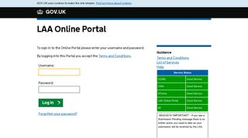


Our communications channels:
Legal Aid Bulletin
Social Media
LAA Portal
A fortnightly e-alert with links to relevant pages
Follow us on X: @LegalAidAgency
We post the status of our online systems on the portal’s home page: LAA online portal
Join our thousands of subscribers: Sign-up to LAA Bulletin >>
Read our blog
Get help from our customer service twitter account: X: LAAHelpTeam

Slide 27
Legal Aid Agency 13th Floor (13.51) 102 Petty France London SW1H 9AJ
gov.uk/government/organisations/legal-aid-agency

