Slide 1
#HelpUsSayYes webinar: New process for further information (FI) requests on business cases
Civil means team
February 2025

Slide 2


Technical tips for this webinar
Please remain on mute during the webinar​
You can ask us questions throughout each section using the ‘meeting chat’​
You can keep the meeting chat open throughout the event to view other questions​
Email us if you experience technical issues during the webinar:
LAAHelpUsSayYes@justice.gov.uk
Camera and audio off when icons appear like this:
Click on the chat bubble icon to view the meeting chat

Slide 3
Content
Introduction
New process for FI requests
Guidance
Information for client
Additional guidance / contact us
Communication

Slide 4

New process for further information (FI) requests
        Purpose of the webinar:
        The purpose of this webinar is to promote the new process for requesting FI on business cases which will be available from 1 March 2025. It will provide guidance on how to submit an application through the new process.
By the end of the webinar, you will have an understanding of:​
The background of the means assessment pilot
Who can use the new process for FI requests
How you can submit an application through the new process for FI requests
How the LAA will continue to communicate with you

Slide 5
Introduction

Slide 6
Background
We know getting extra income and asset details from clients can be time consuming:
  Essentially the provider acts as the go-between for the legal aid agency (LAA) and the client.
We recently conducted a means assessment pilot:
  We looked at ways of improving the way we work with providers to help reduce their administrative burden.
Part of the pilot process involved:
  Giving clients the option to be contacted directly by our caseworkers for further information (FI).
  Positive feedback from the pilot providers:
    Caseworkers requesting the FI directly saved between 30 minutes and several hours for complex cases.
    Helpful when the applicant was self-employed or had some involvement in a business.

Slide 7
The new process for FI requests

Slide 8
New process for requesting FI on business cases
Opening the new process to all civil providers:
  The new process will offer this option for business cases only:
    Business cases covers clients who are:
      Self-employed
      In a business partnership
      A company director or,
      Owns shares in a company.

Slide 9
How the new process can help
The new process for requesting FI aims to deliver the following benefits:
Reduce the administrative burden for the provider:
  Removing the requirement for the provider to request FI from the client.
Reduced processing time:
  Further information request goes directly to the client.
  Access to legal aid for all qualifying clients:
    Providing additional support in business cases to ensure these clients can access legal aid.
Reduction in revocations:
  Further information request goes directly to the client.

Slide 10
Guidance

Slide 11
Before submitting the application
If your client is self-employed, in a business partnership, a company director or owns shares in a company:
Step one:
  Ascertain if they have an email address and device to communicate directly with our caseworker.
  Use discretion to decide if it is appropriate to ask them to be contacted directly by the LAA.
Step two:
  Complete a provisional means assessment.
  Obtain supporting evidence from the client prior to submitting the application:
    Retain this information on file.

Slide 12
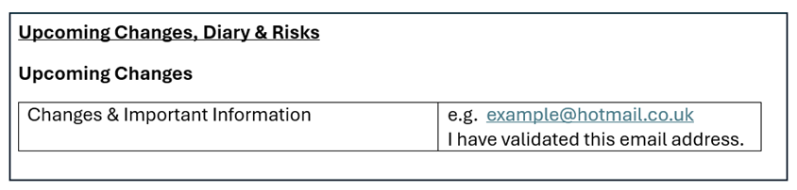
Submitting the application
Submit the application on CCMS:
  Use the ‘upcoming changes’ section on the means report to enter your client’s email address.
  Include confirmation that the email address has been validated.
Please note: Prior to confirming you have completed email validation:
  Send a message to the email address provided by your client.
  Receive a response from your client confirming it is their email address.

Slide 13
FI process explanation for clients
Provide your client with the following information:
We asked you for information and evidence on your income and assets, which we send to the LAA:
  If the LAA needs more information to complete your assessment, they will email you directly at the email address you provided. They will use the email ContactMeans@justice.gov.uk. You can use this email to send any additional information.
If you send the information straight to the LAA, your case will likely be processed faster than if you send it to us to forward on.
You may receive a feedback survey on the process once your means assessment is completed.

Slide 14
Communication

Slide 15
How will the LAA communicate with you?
The caseworker will keep you informed of FI requests sent to your client via a provider ad-hoc notification:
  All other forms of correspondence and notifications remain unchanged.
The caseworker will contact you if they are unable to obtain the required information from your client.
You will be advised of future updates on the FI process via external communications:
  Complete the feedback survey you will receive via external communications.
Please note: Applications may be submitted in Welsh language in line with the LAA Welsh language scheme.

Slide 16
Contact us / additional information

Slide 17
Contact us
Customer service team: Tel: 0300 200 2020
Email for clients to provide FI direct to caseworkers: ​ContactMeans@justice.gov.uk
Designated email service for providers: ContactMeansExpert@justice.gov.uk:
  A new designated email service to assist you when you need support from a means expert when completing the means element of a civil certificated application for legal aid.
  Additional guidance: Queries for a Means expert – Legal Aid Learning

Slide 18

Our training website
Online Support Webchat
Use webchat for help with IT system issues
Webinar Recordings
Our ‘Help Us Say Yes’ webinars focus on areas where there have been issues or high enquiry levels
Popular sessions are posted on the training website: Ministry of Justice and the LAA YouTube channel: Legal Aid Agency youtube channel. Remember to like and subscribe!

Slide 19
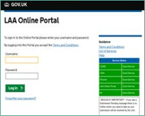


Our communication channels
Legal Aid Bulletin
Social Media
LAA Portal
A fortnightly e-alert with links to relevant pages
Follow us on X (formerly Twitter)
We post the status of our online systems on the portal’s home page
Join our thousands of subscribers: Sign-up to LAA Bulletin >>
Read our blog
Get help from our customer service twitter account

Slide 20
Legal Aid Agency​
13th Floor (13.51)​
102 Petty France​
London SW1H 9AJ​
gov.uk/government/organisations/legal-aid-agency

