Slide 1
#HelpUsSayYes Webinar: Hourly rates
High Cost Family Team
October 2024

Slide 2


Technical tips for this webinar
You can ask us questions at the end of each session through the ‘meeting chat’
Click on the ‘meeting chat’ to ask a question
You can keep the meeting chat open throughout to view other people's questions
Email us if you experience technical issues during the webinar: LAAHelpUsSayYes@justice.gov.uk
Camera and audio off when icons appear like this:
Click here to view the meeting chat

Slide 3
Content
Scope and authorities
Pre-contract costs
Hourly rates and common issues
Assessing an hourly rates case plan
Further information on staged costs
Additional guidance / contact us
Introduction

Slide 4

Hourly rates for high cost cases
Purpose of the webinar:
The purpose of this webinar is to help you to understand how the high cost (HCF) team assess hourly rates case plans to reduce the number of rejections and agree your costs first time
By the end of the webinar, you will have an understanding of:
The hourly rates case plan assessment process
The checks and assessments the HCF team do when processing this area of work
The common rejection reasons
Identifying how to enhance your submissions

Slide 5
Scope and authorities

Slide 6
Submitting your initial case plan:
Once the case is registered as high cost you are given 4 weeks to submit your pre-contract costs and staged costs.
It is important that if your case plan cannot be submitted within the deadline you request an extension via a VHCC enquiry to avoid late submission sanctions.
Check list:
Pre contract costs and supporting documents
Case plan with detailed narrative and all hearings known to date listed
Counsel fees notes or best estimates
Experts and disbursements vouchers if available
Any court orders available.

Slide 7
Certificate scope and appeals:
Certificate scope:
​The scope on a certificate is checked:
For example, if the scope is set at family help higher, you will not be covered for a final hearing
If there is a final hearing in your plan and you do not have final hearing cover, costs may be agreed in principle until the final hearing cover is sought. However, this is on a case-to-case basis.​
Appeals:
You can only appeal an interim order without appeal cover.
If a final order is to be appealed, then you will be required to submit a scope amendment to gain cover for this work

Slide 8
Prior authority:
We will check our system for any prior authorities
We highly recommend that prior authority is sough for any expert that is not listed on the codified rates or is going to exceed the recommended hours or exceed the codified rates.
This will avoid rejection.
Guidance for the remuneration of expert Witness:
3.1 Prior authority may be submitted whenever:
The item of costs (which may consist of an expert fee or other disbursement) is either unusual in nature or is unusually large (paragraph 5.10 (a) of both the 2018 Standard Civil Contract Specification and the 2024 Standard Civil Contract Specification; or
There are no codified rates set out in the Regulations for a particular expert service and there are no guideline rates set out in Annex 5 or rates are sought in excess of the guideline rates.

Slide 9
Pre-contract costs

Slide 10
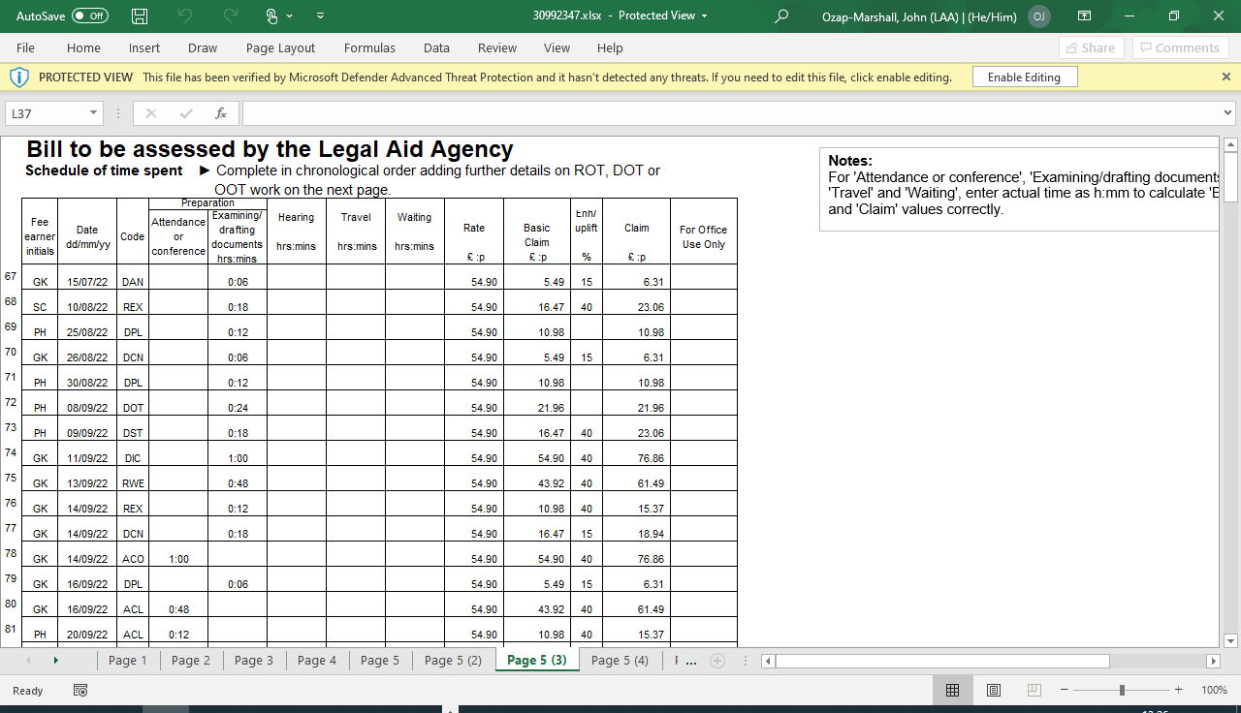
Pre-contract costs:
As of 1 May 2023, the high cost family team no longer assess the costs incurred prior to high cost registration.
The costs incurred prior to high cost registration already had a £25,000.00 limitation, and whilst that cost limitation still forms part of the high cost contract agreement, these costs are now assessed by the LAA finance team.
This has led to a 35 percent increase in reaching high cost contract agreements quicker than assessments done pre-1 May 2023.

Slide 11
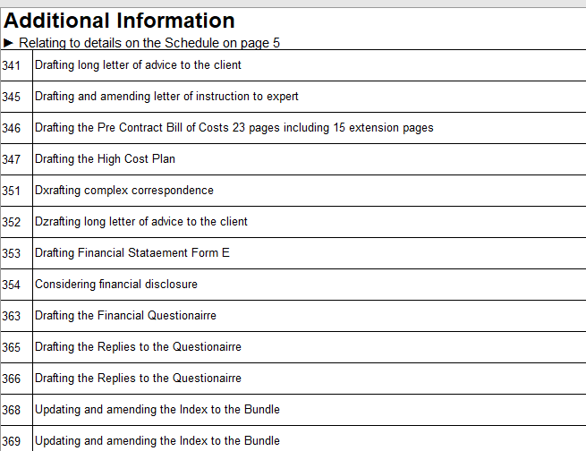
Pre-contract costs continued:
We check the applicable solicitor rates being applied to ensure that they are correct:
We point out any errors that may have been made, as well as make notes on when the work has been claimed from – to.
The assessment / offer made on any applicable enhancement sought to form part of a high cost contract agreement would also need to be factored into any pre-contract costs before any contract agreement could be reached / put in place also.

Slide 12
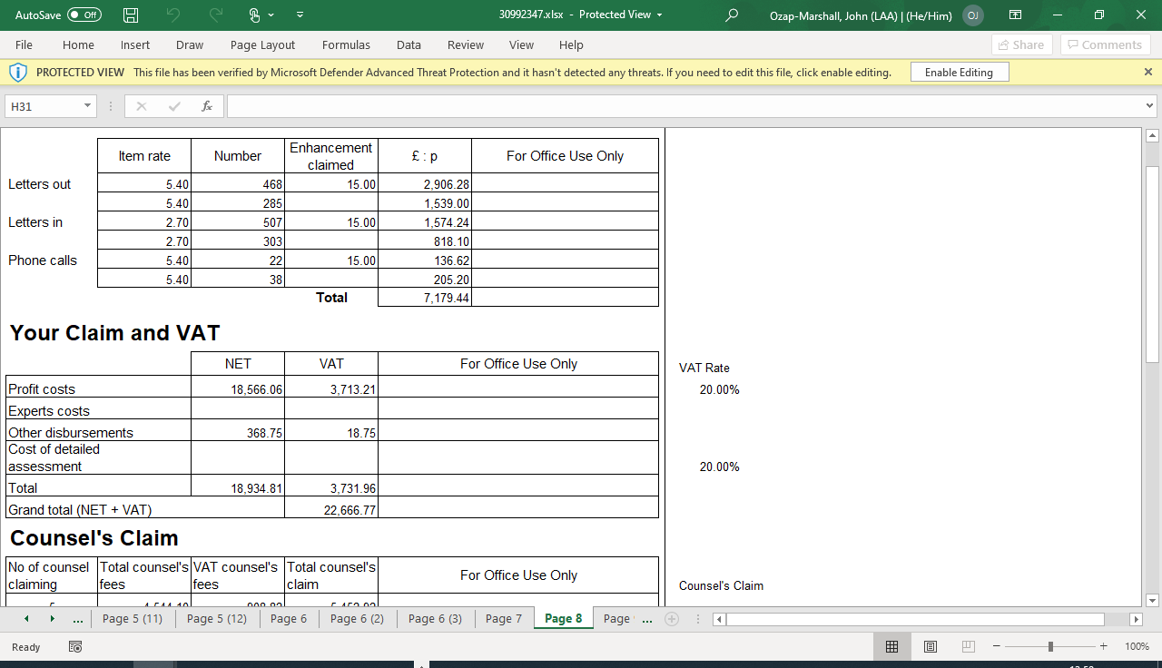
Pre-contract costs: Correspondence
The pre-contract costs are a good way of assessing the profile of costs in the case and ultimately the reasonableness in future stages.
Should the estimates for costs in Stage 1 and beyond, increase significantly, without any explanation why, we will consider the profile of pre contract costs to determine a reasonable offer for future stages.
One factor we would consider is routine correspondence.

Slide 13
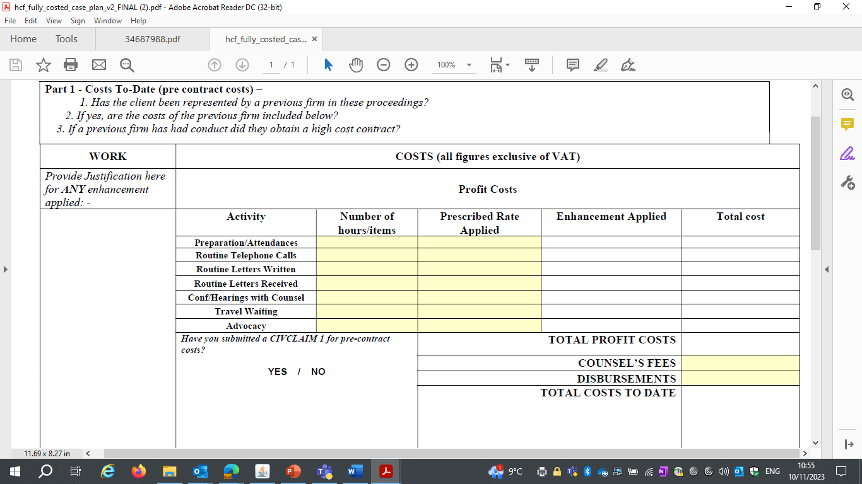
Pre-contract costs continued:
It is vitally important the cost to date section of the detailed (fully costed) family case plan, is completed in full.
If more than 1 firm has been involved with the case prior to high cost registration, both sets of pre-contract costs should be provided for both firms in the case plan form itself.
You should consider registering your case as high cost when your case costs are reaching around £20,000.
If you are not the only firm on the case this figure would include the previous firms' costs, so it is important you are aware of the costs already incurred by any previous firms, as all costs are capped at the pre-contract limit.

Slide 14
Hourly rates and common issues

Slide 15
Hourly rates tests:
Cost assessment guidance:
When considering a high-cost case plan we do this in line with the “Costs Assessment Guidance: for use with the 2018 Standard Civil Contracts”.
Reasonable and proportionate:
One of the main tests applied when considering an hourly rates case plan is whether the costs provided appear to be reasonable and proportionate.
This test is based on the information provided and we may consider something to not be reasonable or proportionate if the relevant evidence to support the work done isn’t supplied.
An example would be profit costs would be compared to other cases of the same nature, length of stage, number of hours claimed, any factors that may increase/decrease the amount claimed and the information supplied justifying your costs.
Private paying individual:
This test is whether you would expect a client on the same case to pay the costs provided without question based on the information supplied for assessment.

Slide 16
Fully costed: Common issues
Common issues when processing fully costed case plans leading to rejections:
Enhancement claimed is not justified
Profit costs not considered reasonable and proportionate
Issues with counsel fees, for example, costing the incorrect fee scheme
No narrative provided / not updated with further stages
Solicitor rates incorrect
Enhancement claimed on routine items
Stages are not dated with a start and end date
Incomplete case plan
Correspondence appears high for the length of stage and number of parties

Slide 17
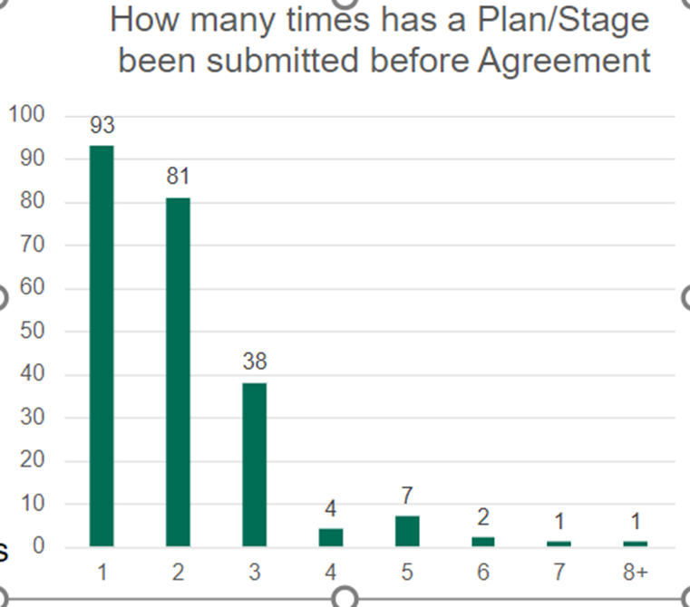
Evidence of common issues resulting in rejection:
The chart shows rejections by submission:
It does not include first submission:
There are a high number of plans agreed on the first and second resubmission, and common issues are largely the reason why they were rejected on the initial submission.

Slide 18
Fully costed: Common issues continued
If you believe that there are going to be issues on any area within a case plan which could be challenged:
Mitigate this by including further information within case narrative:
For example, correspondence: When assessing the stage, we consider the number of parties involved, the nature of the clients, number of experts, the length of the stage etc.
If you identify you are claiming a high percentage of your profit costs as correspondence, ensure you detail why. If you do not provide details:
We will make an offer we believe is reasonable and proportionate which may not reflect the realities of the case, which will prolong negotiations;
Or we could be fully reject the case plan as we may not have the information to justify as reasonable and proportionate.

Slide 19
Enhancement: Justification
The non-routine enhancement would be considered against the 2-stage threshold test detailed in Section 12 of the Cost Assessment Guidance.
Providers should detail how the test has been met rather than quote the guidance
The maximum applicable level of enhancement to be sought at County Court Level, is 50 percent.
The maximum applicable level that can be sought at High Court Level, is 100 percent.
Correspondence:
CCMS related work and attendance behind counsel is considered "routine work, therefore non-routine enhancement should not be applied to this work.
Enhancement threshold test:
Exceptional competence, skill or expertise.
The work was done with exceptional speed.
Exceptional circumstances, novelty, weight or complexity.

Slide 20
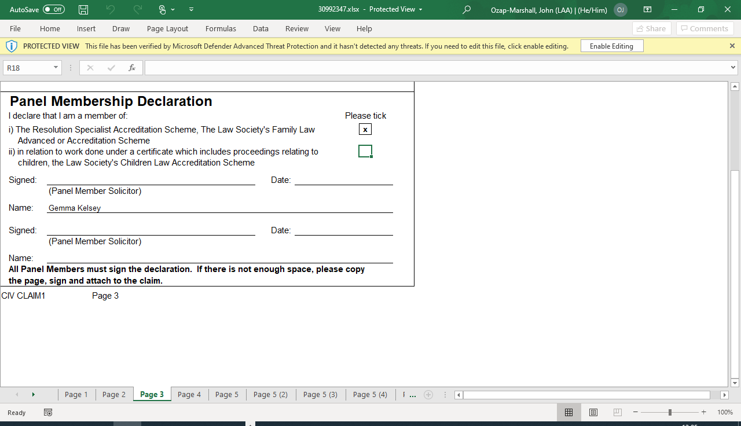
Panel membership:
In this example, the solicitor is claiming 15 percent panel membership:
Within the case plan submission, where it states: ‘Provide Justification here for ANY enhancement applied’: The solicitor should always show that 15 percent has been applied by a panel member, as well as the explanation for enhancement in general thereafter.
This can be applied to routine items but, you cannot add this on to non-routine enhancement, even if the work is carried out by the panel member
Please note: As per section 12.23 of the cost assessment guidance, the Panel Membership Enhancement is a guaranteed minimum enhancement (for those fee earners applicable to claim it) and is not payable in addition to any enhancement allowed under the general Specification.

Slide 21
Reasonable and proportionate costs:
There are many factors which contribute to profit costs being considered unreasonable and disproportionate. These are covered in many of the common issues
No narrative or incomplete narrative: The narrative provides a case manager with the details needed to assess the case: The "where, when, how and why."
A description of the court orders will tell us directions. However, they will not tell us that a solicitor spent 2 hours with a vulnerable client while they worried about court. These are factors we need to know when assessing reasonableness.​
The type of client you have may affect the level of correspondence:
Is the other party a litigant in person?
Is your client anxious and calling you often?
Please note: High levels of correspondence without justification can lead to rejection: Detail anything that may lead to a higher-than-normal level. ​

Slide 22
Reasonable and proportionate costs continued:
Stages with no start and end dates:
The length of a stage is important for assessing if the costs are reasonable and proportionate.
It can affect factors such as the:
Level of correspondence,
Level of attendance on client,
Level of attendance on counsel
All of these will increase profit costs; therefore, we need to know the stage length to assess what is reasonable.​

Slide 23
Perusal of documents:
What to consider:
If there are large bundles to peruse it is helpful to know:
The number of pages in the bundle
If the provider has triaged the bundle and focused on the essential parts for perusal
If it is all necessary material or a summary
What type of document, such as medical reports etc

Slide 24
Incomplete case plan / incorrect rates:
A case plan can be considered incomplete for many reasons including:
Any costs that are "TBC" if fees such as experts or counsel are unknown, please include your best estimates to prevent costs being rejected.
Previous solicitors' costs not detailed,
Future hearings not detailed,
Pre contract costs not detailed on the case plan,
Narrative not being updated with the stages.
Solicitor incorrect rates:
Claiming incorrect rates is another common rejection reason, please use the rates calculator to ensure the correct rates are applied. Rates_Calculator_v2.17.xls (live.com)
Incorrect or unknown counsel fees:
Counsel fees being incorrect or unknown
What rates / enhancement are being claimed.
Please note: Counsel fees depend on the proceedings, the client being represented and the level of court.

Slide 25
Further information on staged costs

Slide 26
Further information:
The date of high cost registration forms the start date of stage 1:
Beyond this, the start and end date of future stages is up to the provider.
Once a stage is agreed, it is agreed at a maximum total to be claimed:
If you require profit costs to be amended within an agreed stage, you must show the work was unforeseen and it must be at least a 5 percent increase on the costs.
Please note: The narrative must be updated with each stage. It should be an evolving document to give us relevant information as to what will happen in the stage and information on any directions or circumstances that may make a certain stage go out of profile with the previously agreed stages.

Slide 27
Billing throughout and upon conclusion:
Once your first submission is assessed and agreed by high cost family, you will be invited to submit a contract:
Once this is uploaded, you can submit a cost amendment for the contract value.
You can submit interim bills for pre contract and any agreed stages.
Once the case has concluded and all of your costs are agreed by high cost family, your final stage will be submitted as a final bill.
If there are any queries regarding billing, please submit a billing enquiry for our finance team to assist you.

Slide 28
Additional guidance / Contact us

Slide 29
Contact us:
General HCF case enquiries: highcostfamily@justice.gov.uk
Complex HCF cases enquiries: Highcostfamilyfixer@justice.gov.uk
Customer service team: Tel: 0300 200 2020

Slide 30
Useful links:
High cost case guidance: Civil high cost family case guidance
LAA training website: Ministry of Justice
High cost contract: High cost contract
Counsel acceptance form: Counsel acceptance form (CAF)
Fully costed case plan checklist: Fully costed case plan checklist
Cost assessment guidance: Costs assessment guidance 2018 - Version 6 - October 2022

Slide 31

Our training website
CCMS Quick Guides
CCMS Online Training
Online Support Webchat
Use Webchat for help with IT system issues
Webinar Recordings
Our ‘Help Us Say Yes’ webinars focus on areas where there have been issues or high enquiry levels
Sign up on ‘Eventbrite’
Popular sessions are posted on the training website: LAA learning website and the LAA YouTube channel: Legal Aid Agency youtube channel Remember to like and subscribe!
CCMS Provider: Family High Cost Case Registration/Query – Legal Aid Learning (justice.gov.uk)
CCMS provider: submitting a prior authority – Legal Aid Learning (justice.gov.uk)
Amend a Case Cost Limitation – Legal Aid Learning (justice.gov.uk)
Amendments – Legal Aid Learning (justice.gov.uk)

Slide 32
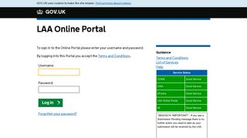


Our communications channels
Legal Aid Bulletin
Social Media
LAA Portal
A fortnightly e-alert with links to relevant pages
Follow us on Twitter
We post the status of our online systems on the portal’s home page
Join our thousands of subscribers: : Sign-up to LAA Bulletin >>
Read our blog
Get help from our customer service twitter account

Slide 33
Legal Aid Agency 13th Floor (13.51) 102 Petty France London SW1H 9AJ
gov.uk/government/organisations/legal-aid-agency

