Slide 1
#HelpUsSayYes Webinar: Litigator graduated fee scheme.
Litigator graduated fee scheme (LGFS) team
September 2024

Slide 2



Technical tips for this webinar:
Please remain on mute during the webinar
You can ask questions throughout the session through the ‘meeting chat’
Click on the ‘meeting chat’ to ask a question
You can keep the meeting chat open throughout to view other people's questions
Email us if you experience technical issues during the webinar: LAAHelpUsSayYes@justice.gov.uk
Camera and audio off when
icons appear like this:
Click here to view the meeting chat
Working with others to achieve excellence in the delivery of legal aid

Slide 3
Content
How to complete a Claim for Crown Court Defence (CCCD) application
LAA process
Additional guidance

Slide 4

Litigator Graduated Fee Scheme
Purpose of the webinar:
The purpose of this webinar is to demonstrate how to complete a claim for crown court defence (CCCD) application
By the end of the webinar, you will have an understanding of:
The information needed to complete the claim for crown court defence (CCCD) application
The LAA application process

Slide 5
How to complete a Claim for Crown Court Defence (CCCD) application

Slide 6
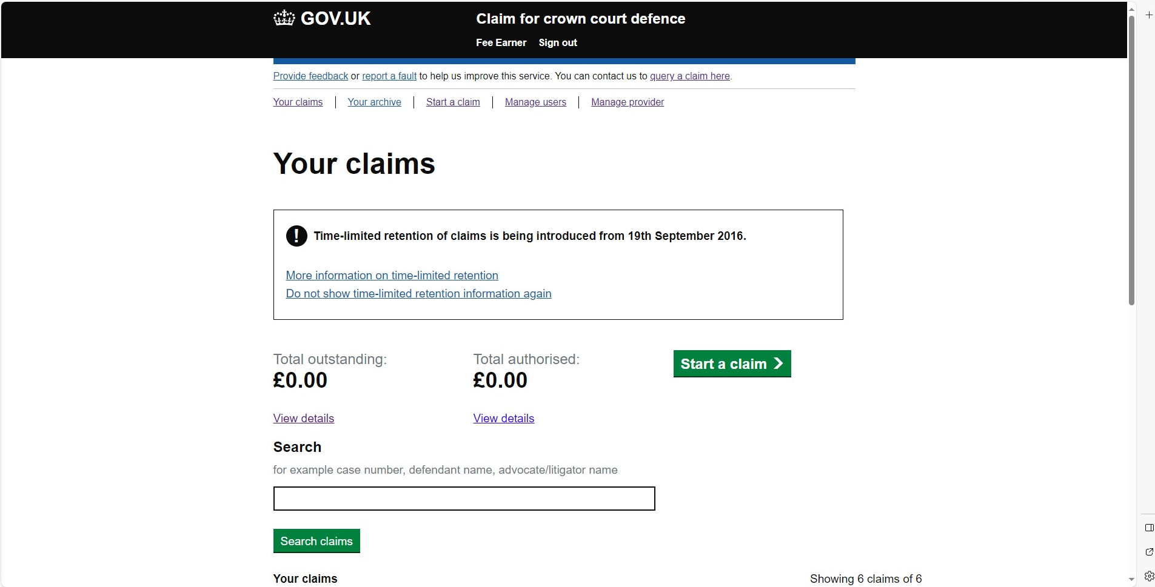
Start a Claim:
Select start a claim.

Slide 7
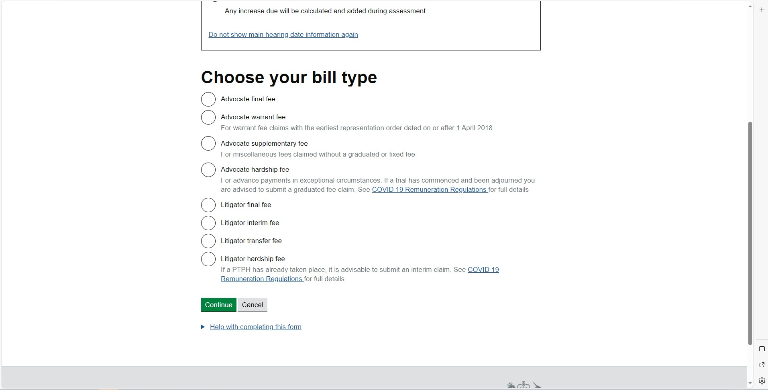
Bill type:
Select the type of bill that you wish to claim from the list
  For this example, we will be showing an LGFS final bill
Providing access to justice through working with others to achieve excellence in the delivery of legal aid

Slide 8
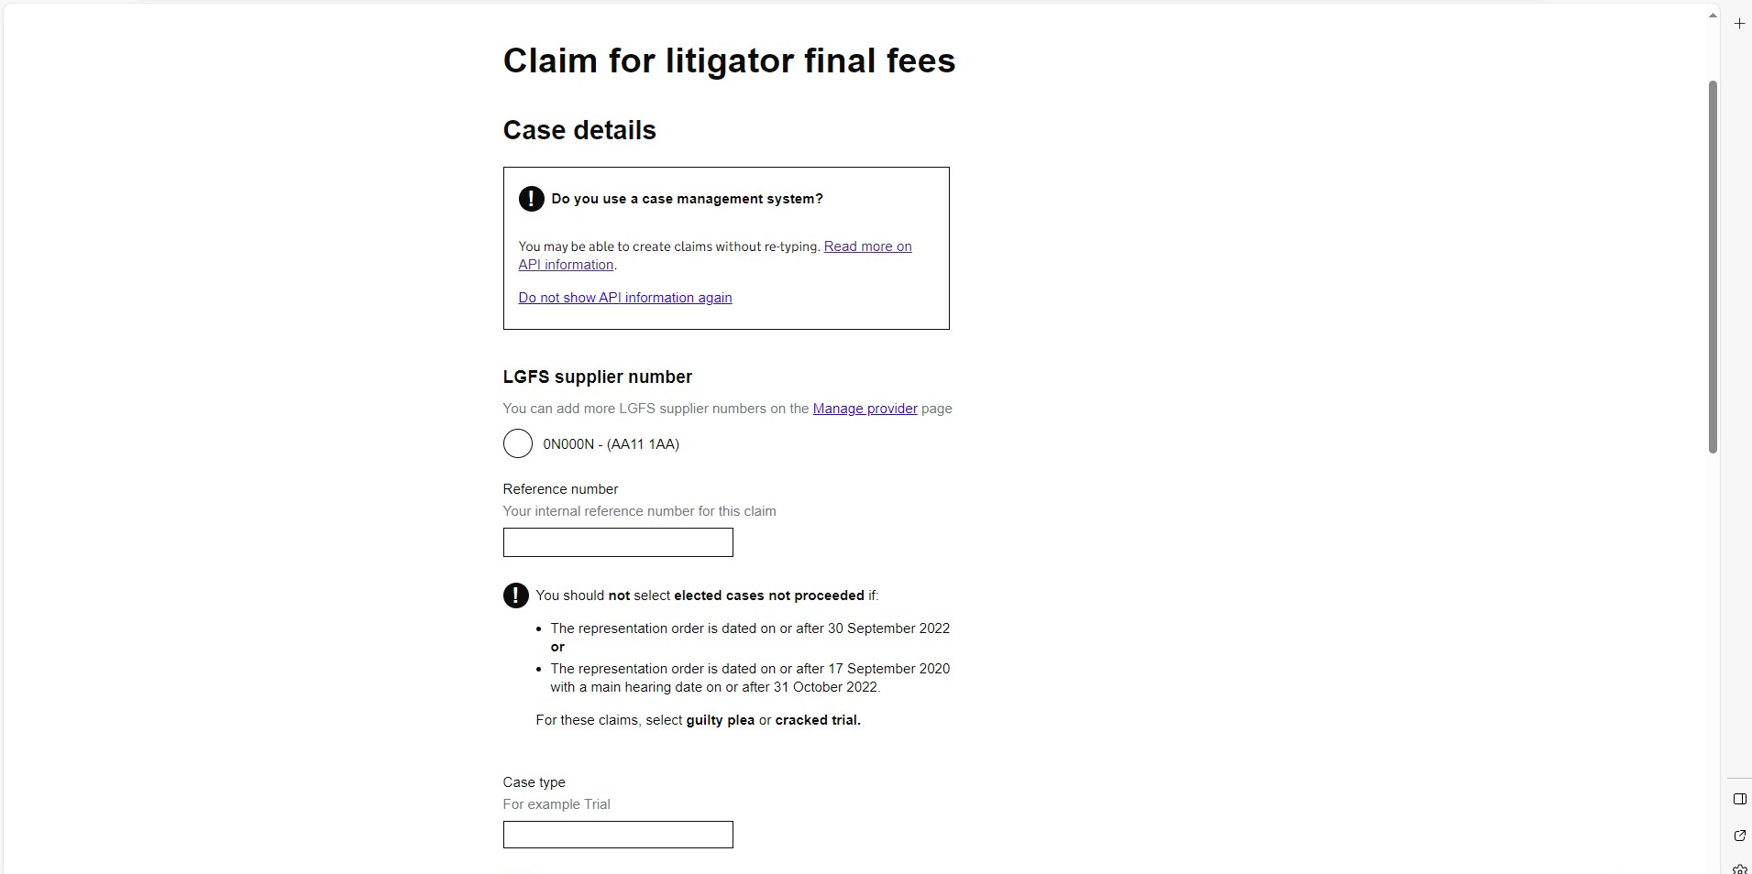
Select Account number:
Select the account number you wish to claim under:
Providing access to justice through working with others to achieve excellence in the delivery of legal aid

Slide 9
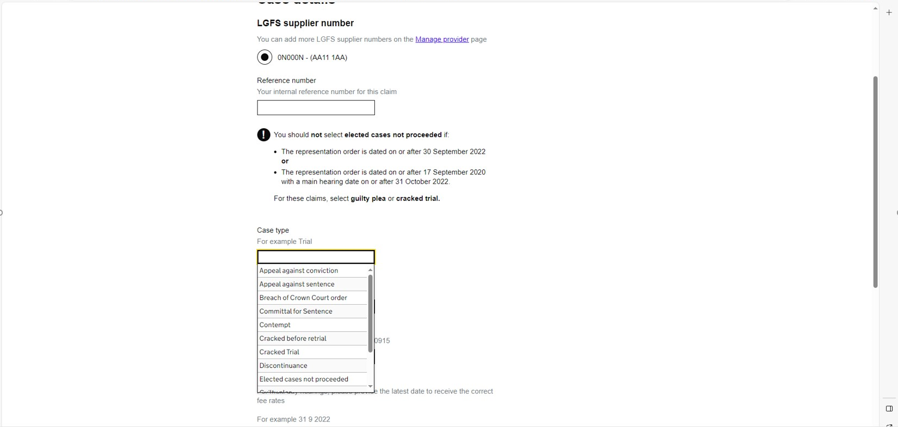
Type of case:
Select the type of case being claimed:

Slide 10
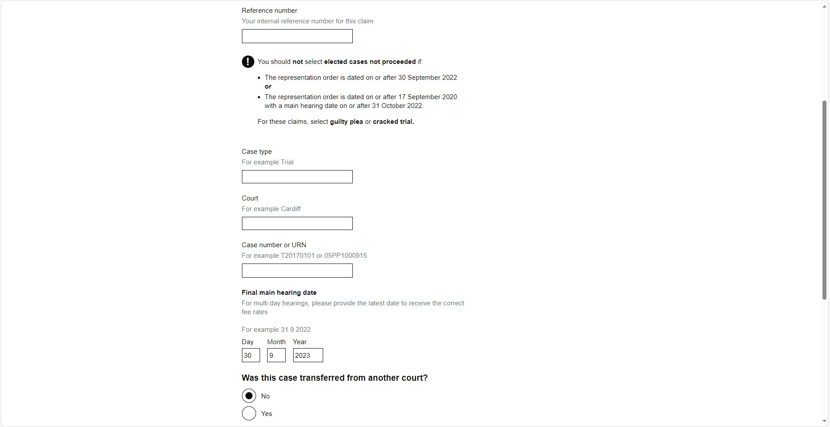
Court and case number:
Confirm the court where the case was heard.
Confirm the case number.
  Please note:
    For Xhibit cases, provide the A,S or T numbers;
    For Common Platform cases use the URN for the case.
Confirm the final date of the main hearing

Slide 11
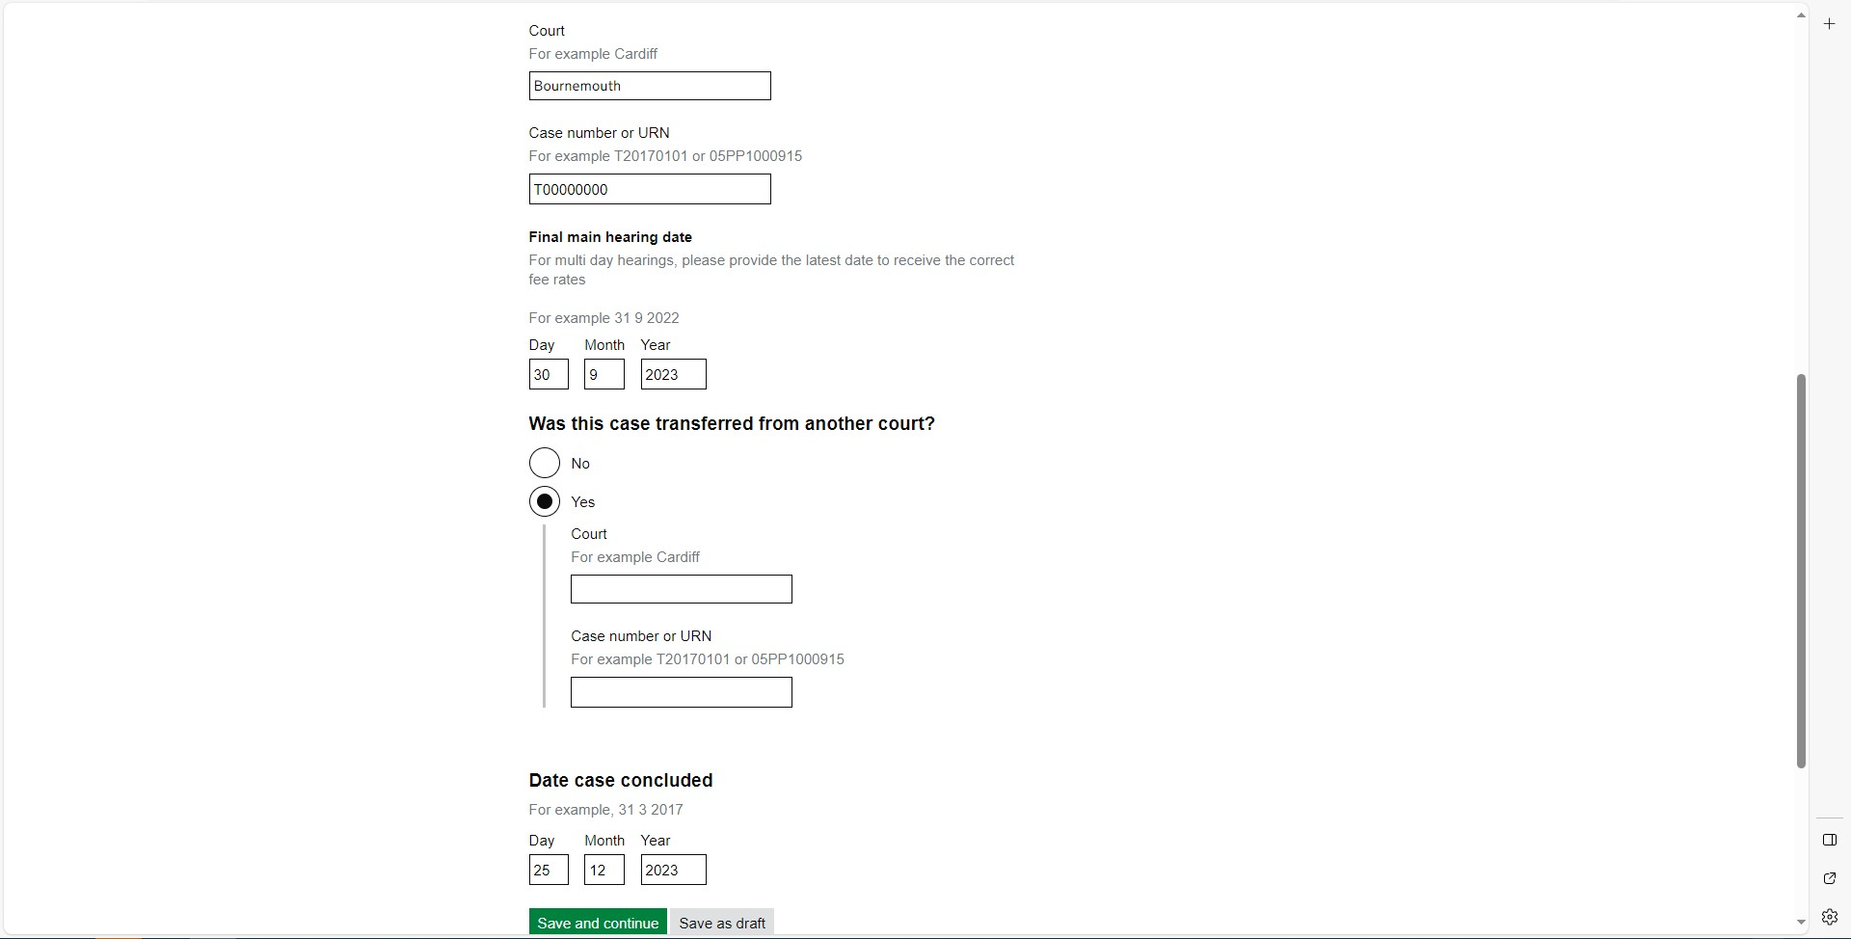
Transfer Court:
Inform us if the case has transferred between courts:

Slide 12
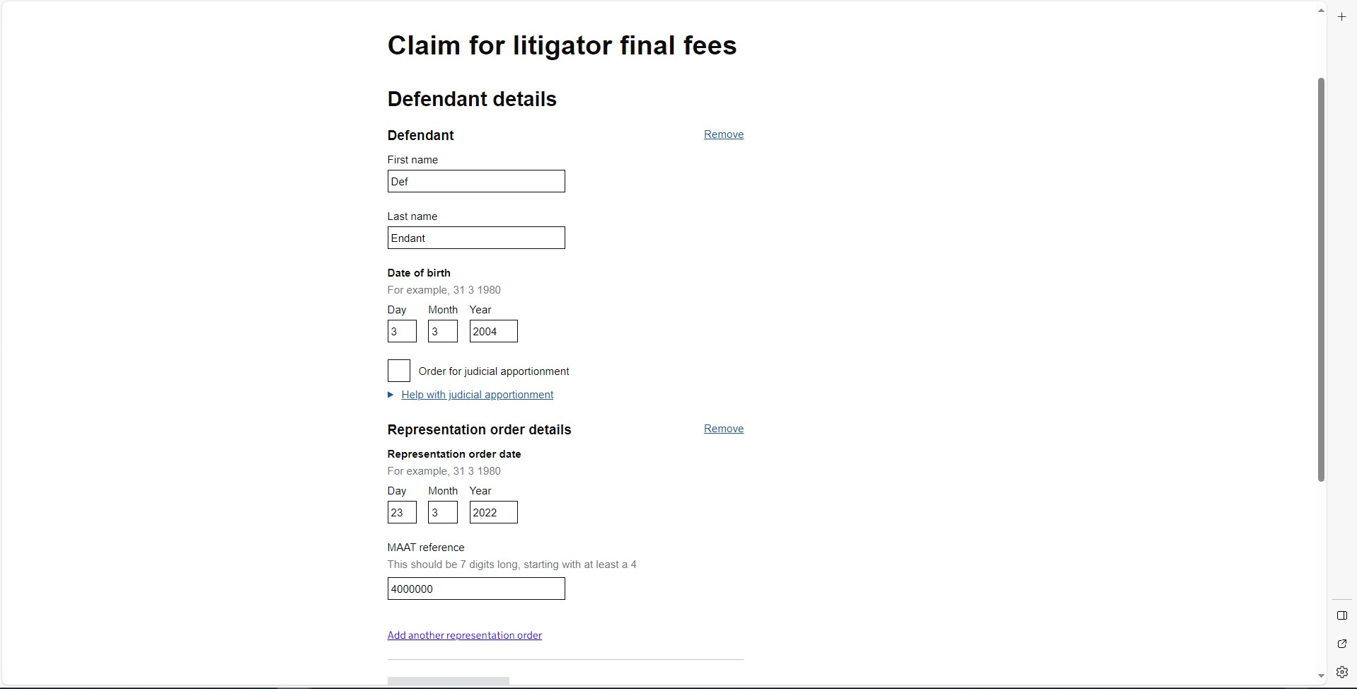
Defendant details:
Complete the defendants' details including their MAAT number.
Please note: Our internal system will create a claim based on the MAAT number

Slide 13
Add additional defendants:
Select ‘Add another defendant’ and complete the defendants' details including their MAAT number, as previous slide.

Slide 14
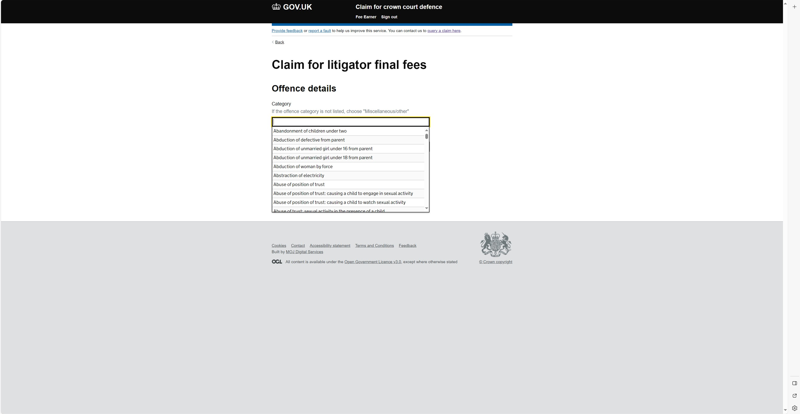
Offence:
Confirm the offence band you wish to claim from the indictment.
Please note:
Once you have entered the offence, the system generates the appropriate classification.
Some will have multiple options, for example Fraud

Slide 15
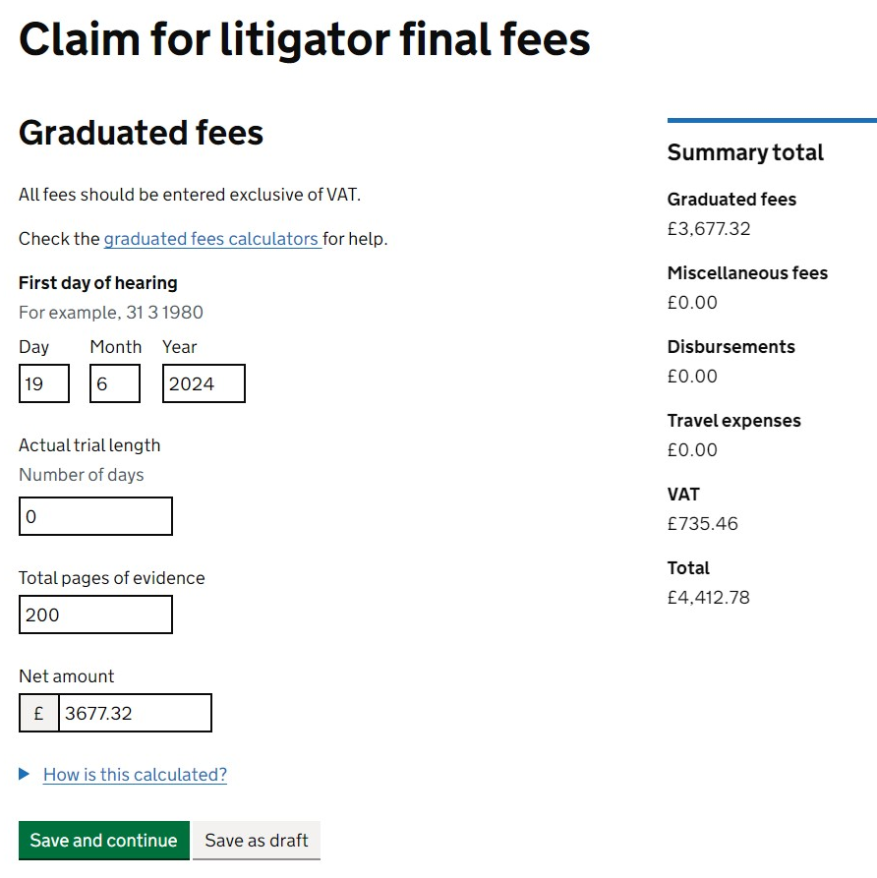
Trial days and pages of prosecution evidence (PPE):
Enter the number for trial days if applicable
Enter the total number of PPE claim Including any electronic material.

Slide 16
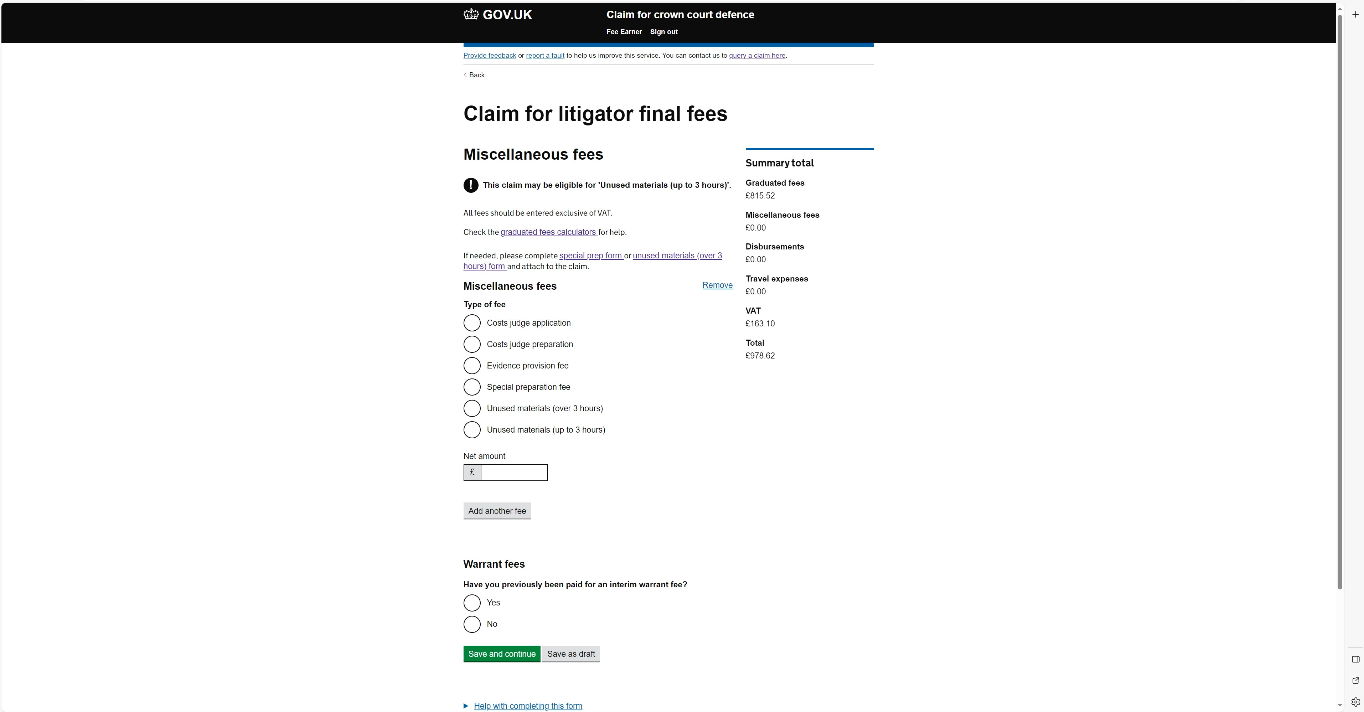
Miscellaneous fees:
Enter any miscellaneous fees such and unused material or special preparation

Slide 17
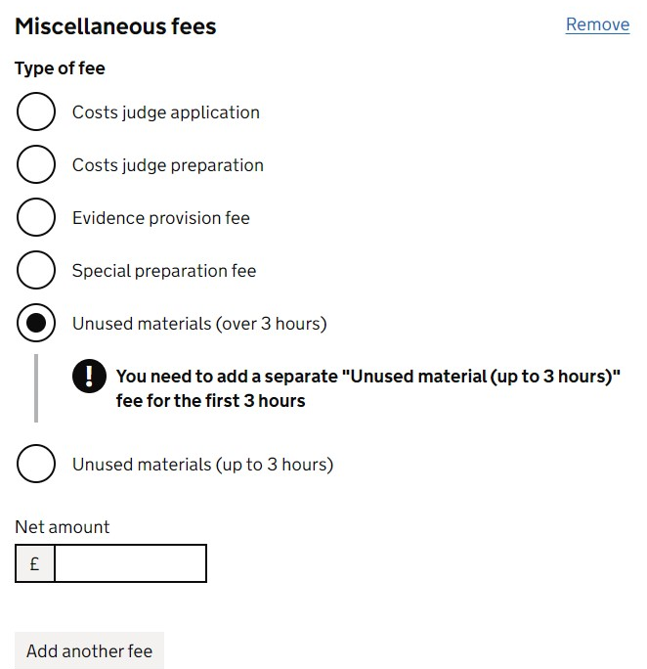
Miscellaneous fees: Unused material continued
Unused material for the first 3 hours is payable on any cracked trial / trial case with a representation order on or after 17 September 2020.
The first 3 hours spent considering unused material is payable as a fixed fee.
Any time above this is then claimed separately. For example:
  If the total time spent considering unused material is 12 hours, any time in excess of the first 3 hours, a completed LU1 would be required.
  For claims over 10 hours, we would require a worklog.

Slide 18
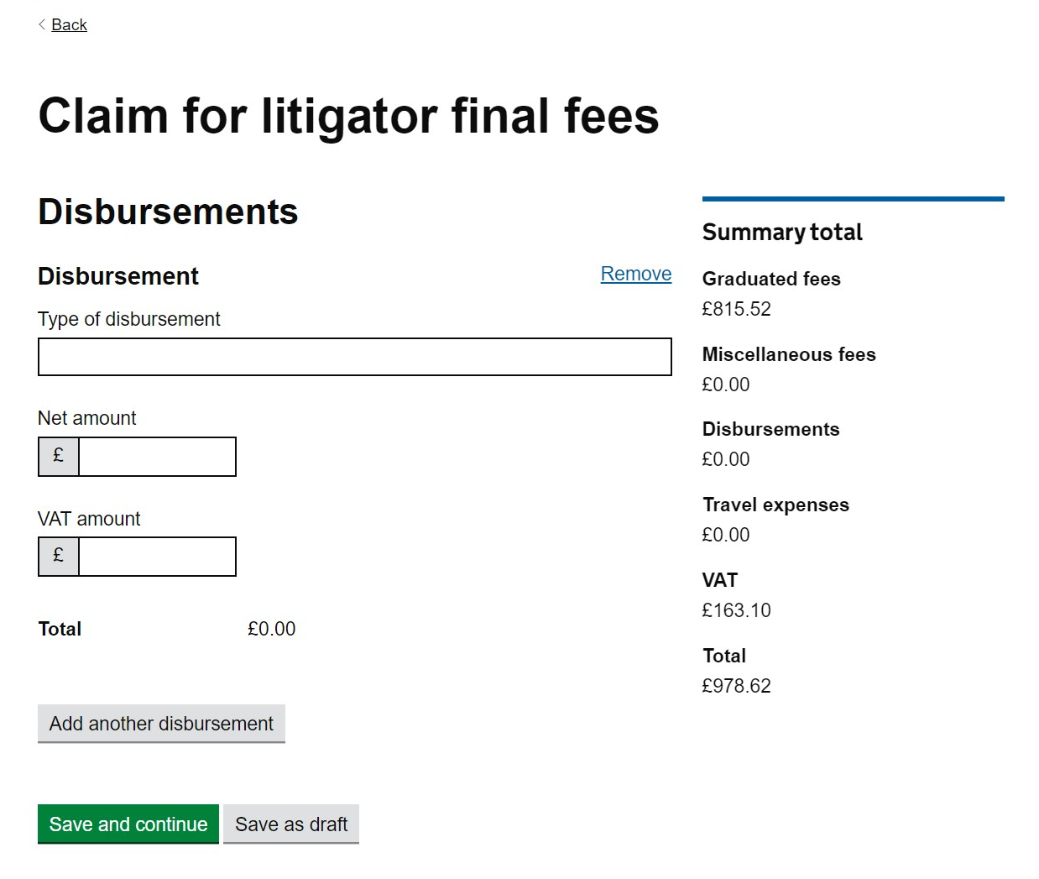
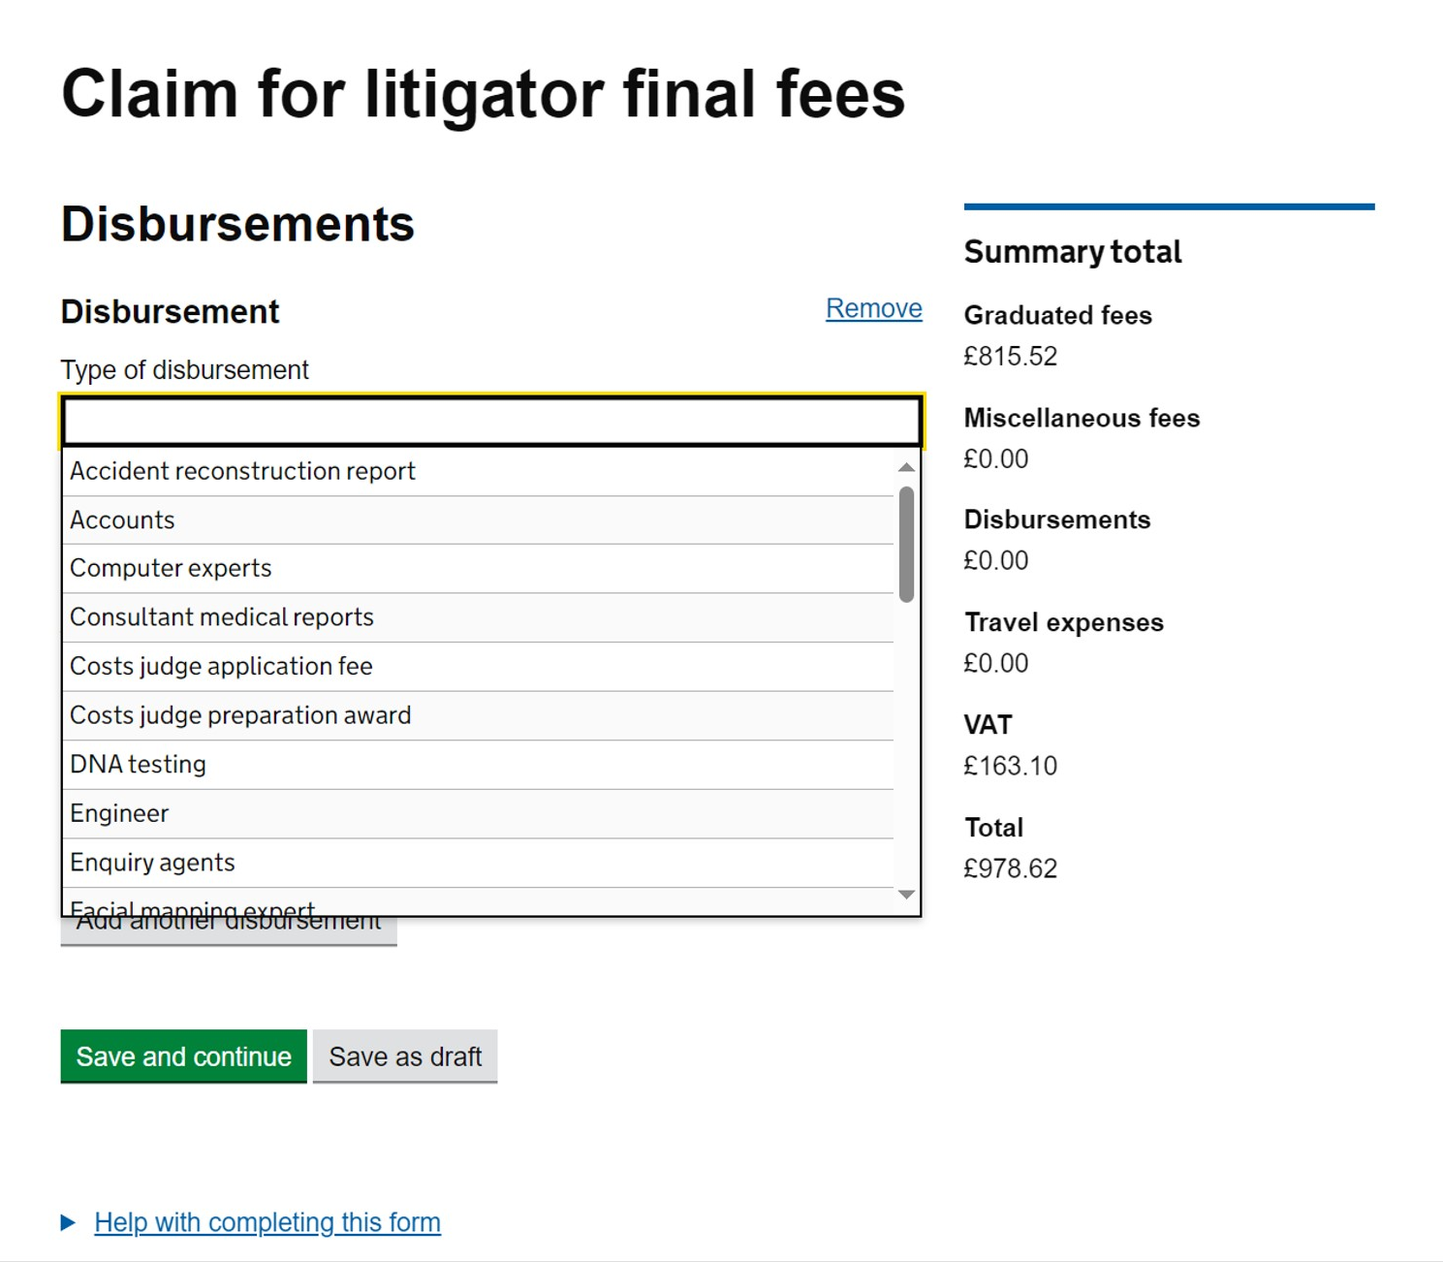
Disbursements:
Disbursements can be added here: Enter the value of disbursement.
Enter the type of disbursement:

Slide 19
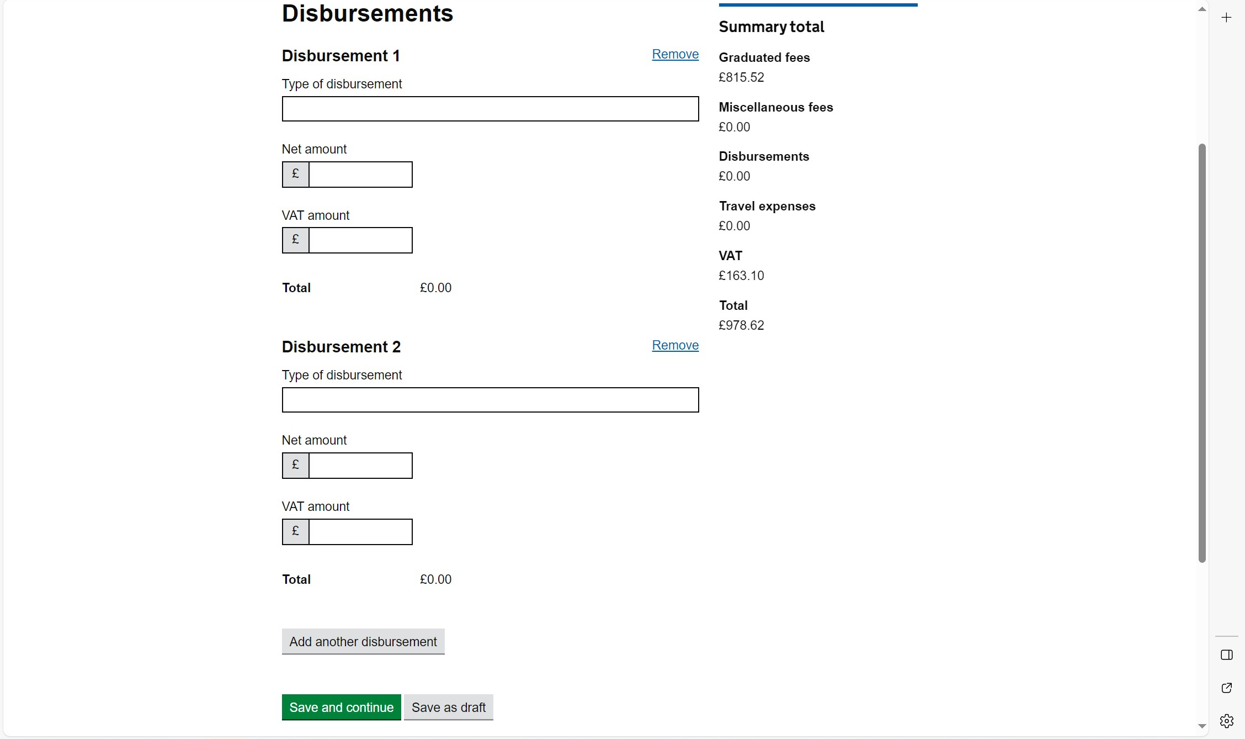
Add additional Disbursements:
Additional disbursements can be added here by selecting ‘Add another disbursement’.

Slide 20
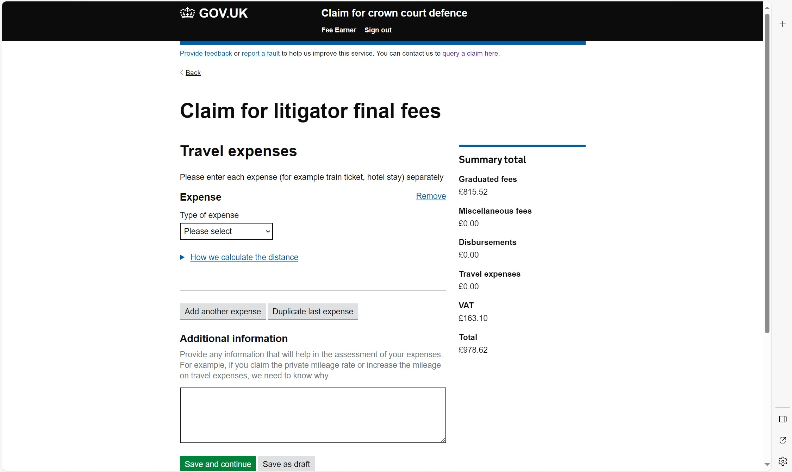
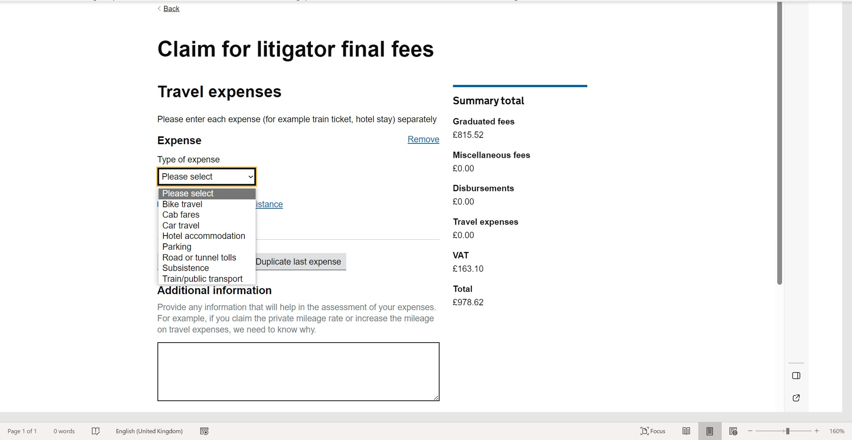
Travel expenses:
Travel expenses would be added here as well as any additional information to allow us to consider the travel expenses.
Select the type of expense

Slide 21
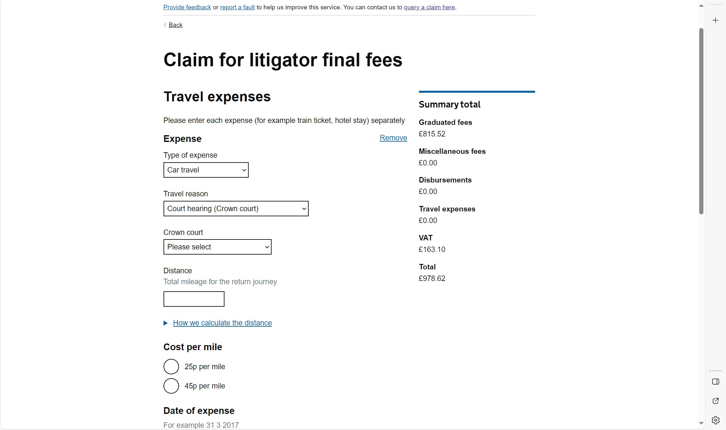
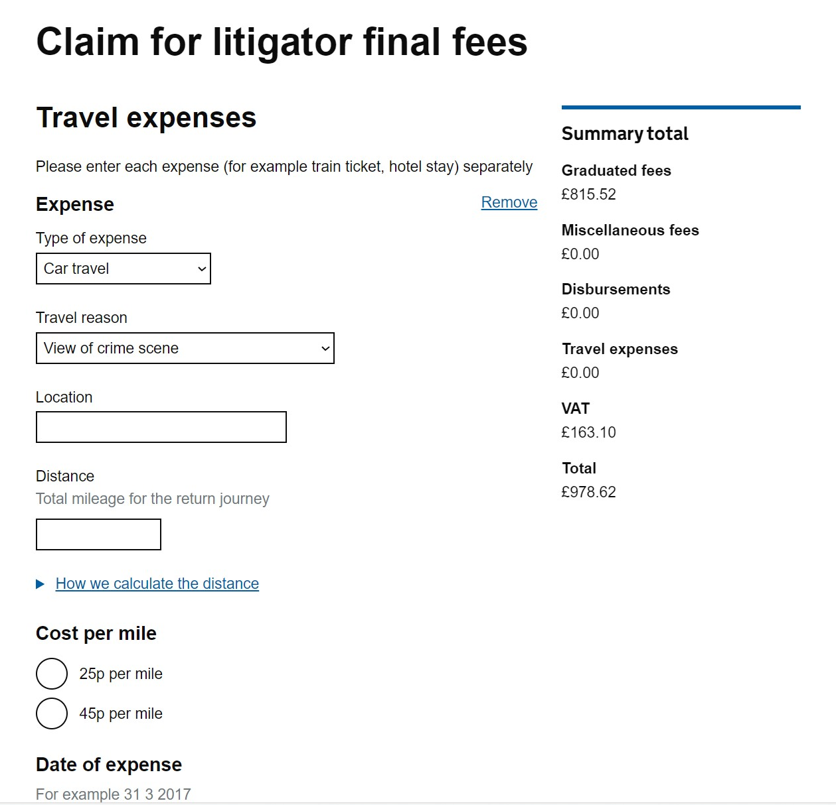
Travel expenses: Car
For car travel enter the distance and the rate per mileage claimed. 45p to court will need to be justified. Select court or prison.
For travel to other destination enter the postcode of the location travelled to.

Slide 22
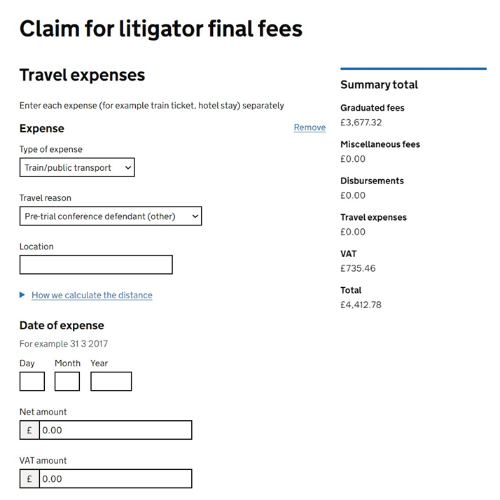
Travel expenses: Taxi / train
For train and / or taxi fares enter the amount claimed:

Slide 23
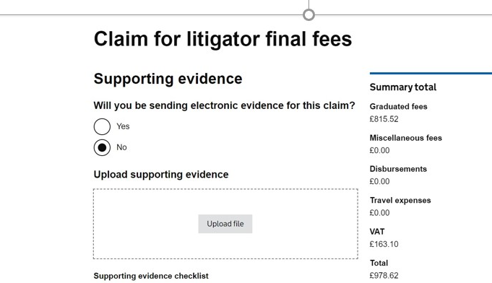
Supporting evidence:
If your claim has electronic evidence, upload it to the secure file exchange.
Upload the supporting documents such as indictment, LAA report, invoices

Slide 24
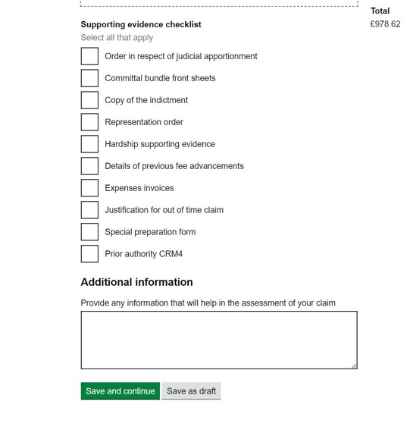
Supporting evidence checklist:
Indicate what supporting document you have provided.
  If the claimed for a graduated fee, rather than a fixed fee, it is mandatory to provide the indictment .
  You can provide additional information for any aspect of the case here

Slide 25
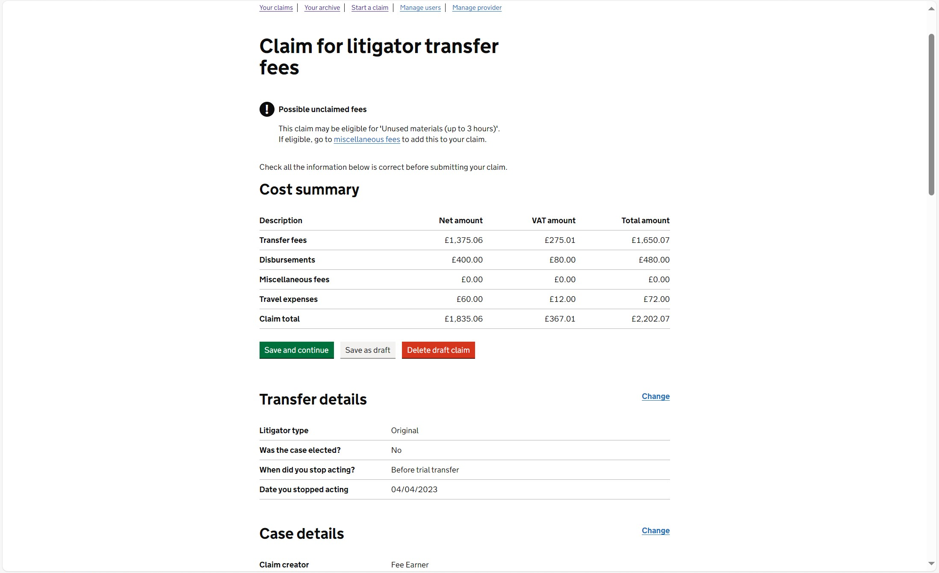
Overview:
You will be brought into an overview screen of what has been claimed
You can make any amendments before submitting
Select save and continue

Slide 26
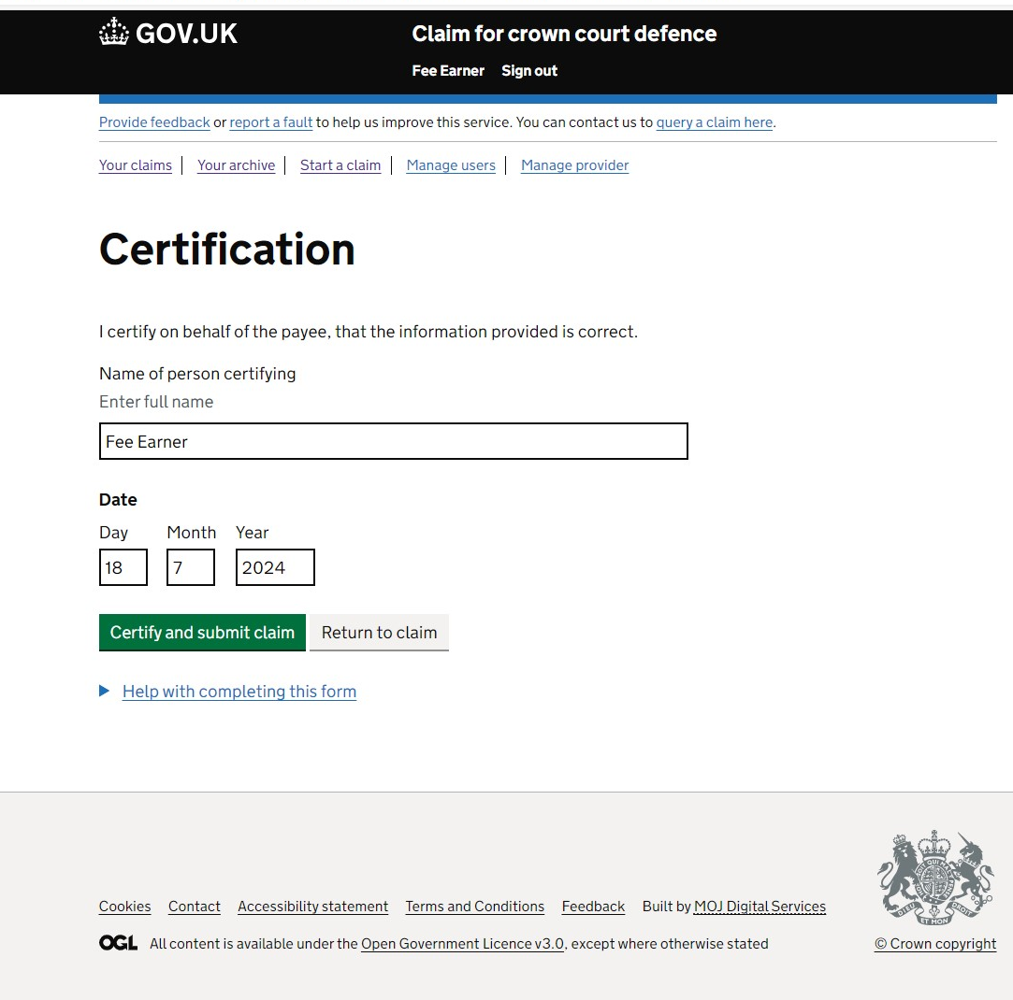
Certification:
The certification page: Enter the name of the Fee Earner certifying the claim.

Slide 27
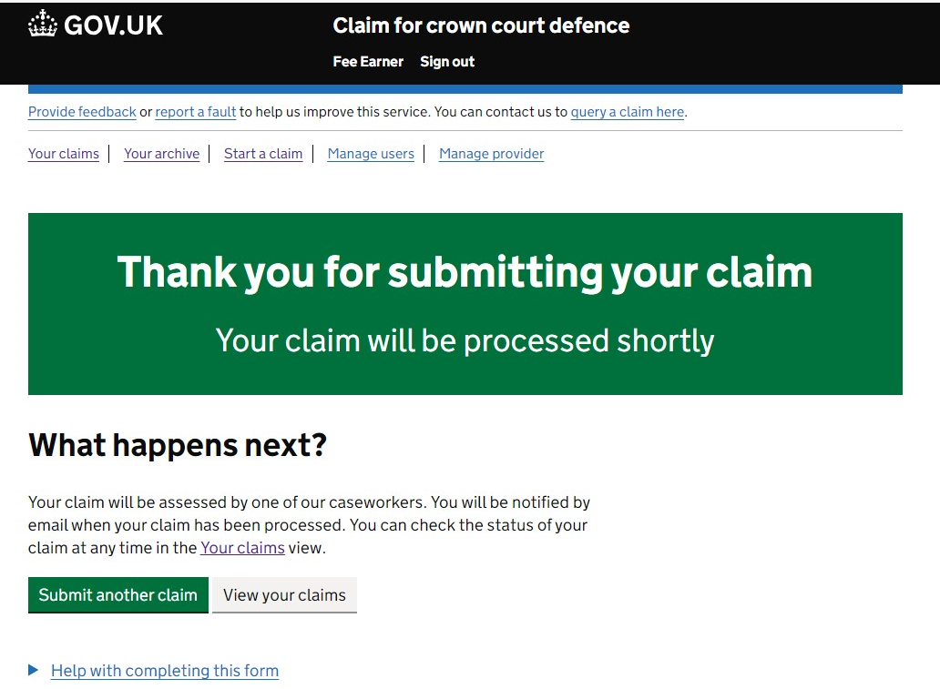
Submission confirmation:
Confirmation the claim has been submitted.

Slide 28
LAA process

Slide 29
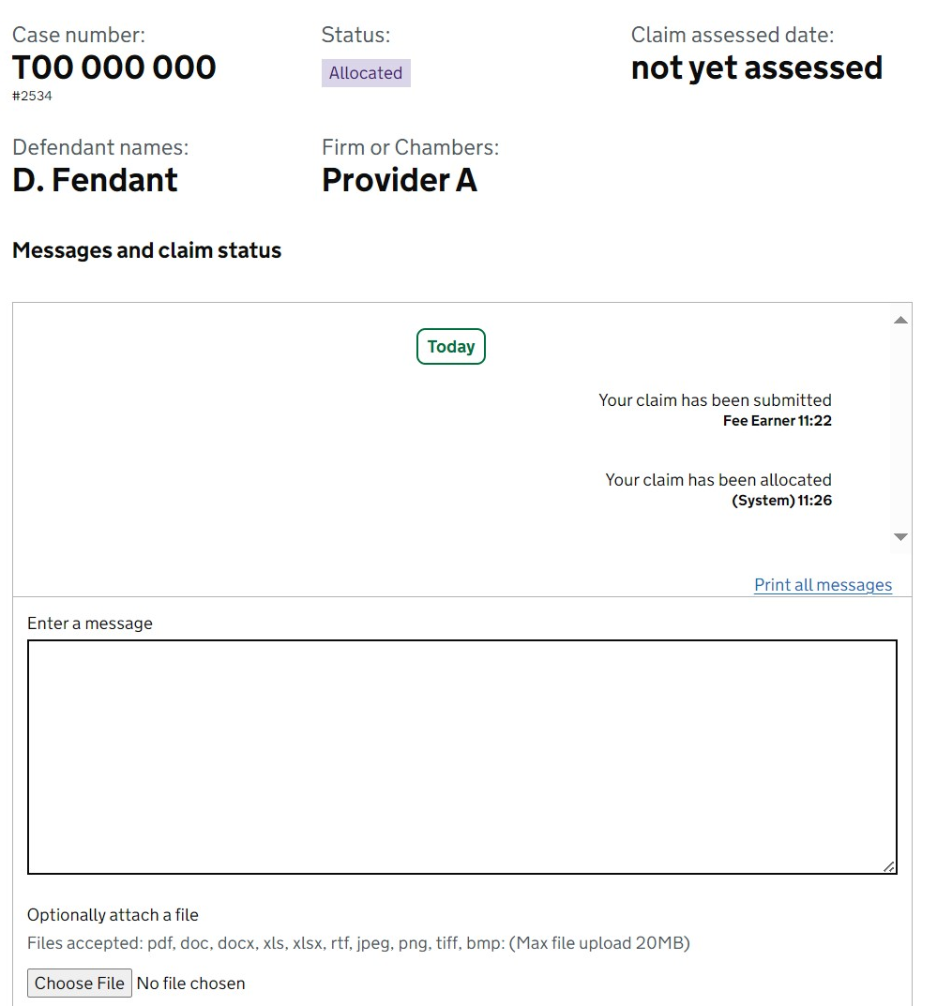
Information for providers:
When the case has been allocated to a caseworker, the status will show as ‘allocated’.
Please note: Occasionally we use holding queues for work allocations. This will appear the same to the provider as when it is allocated to a caseworker.
If you see a claim reallocated or allocated ahead of the time given on our website, this is likely what has occurred.

Slide 30
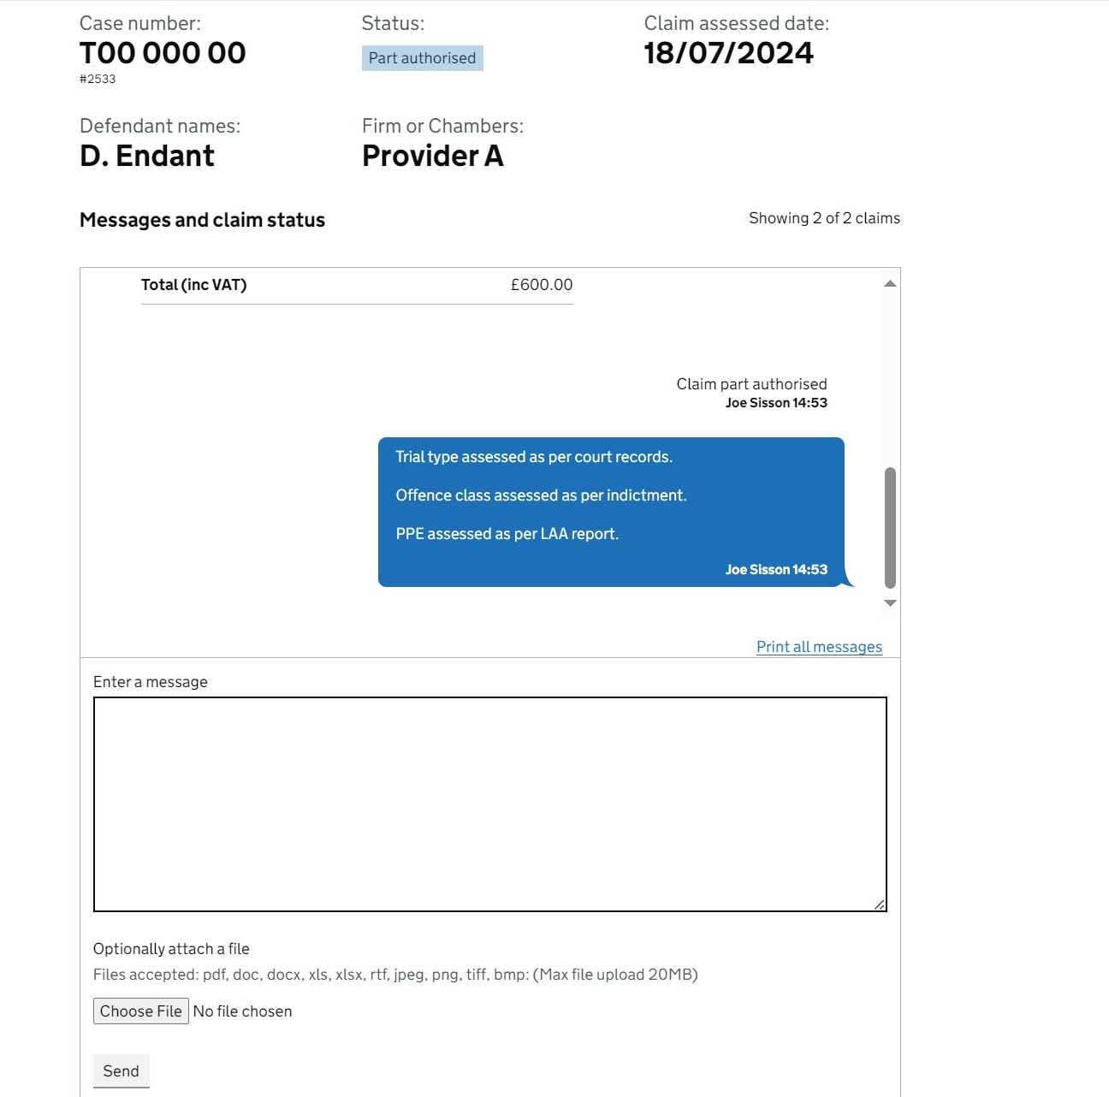
Assessment:
When the assessment has been made, the caseworker will send a note explaining the assessment unless paid in full. The caseworker completes the assessment summary which details the figures paid.

Slide 31
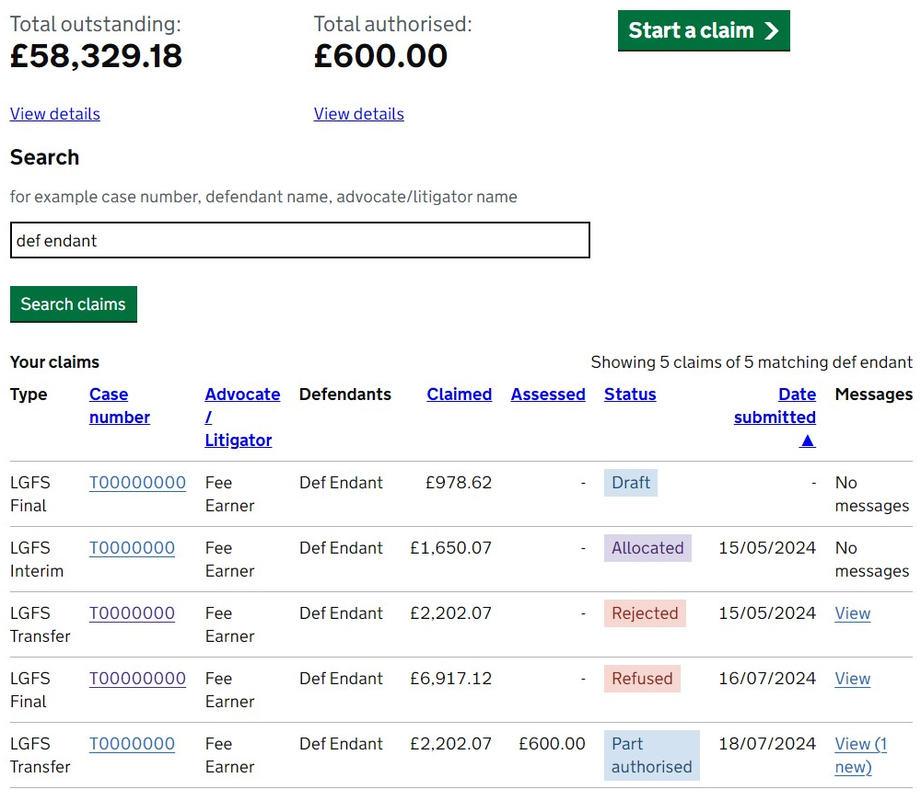
Provider list of claims once assessed:
Once we have assessed the claim on CCCD, you will see:
  The amount assessed
  The authorisation status (in this example it is part authorised).
    A message, if applicable, which will explain the assessment.

Slide 32
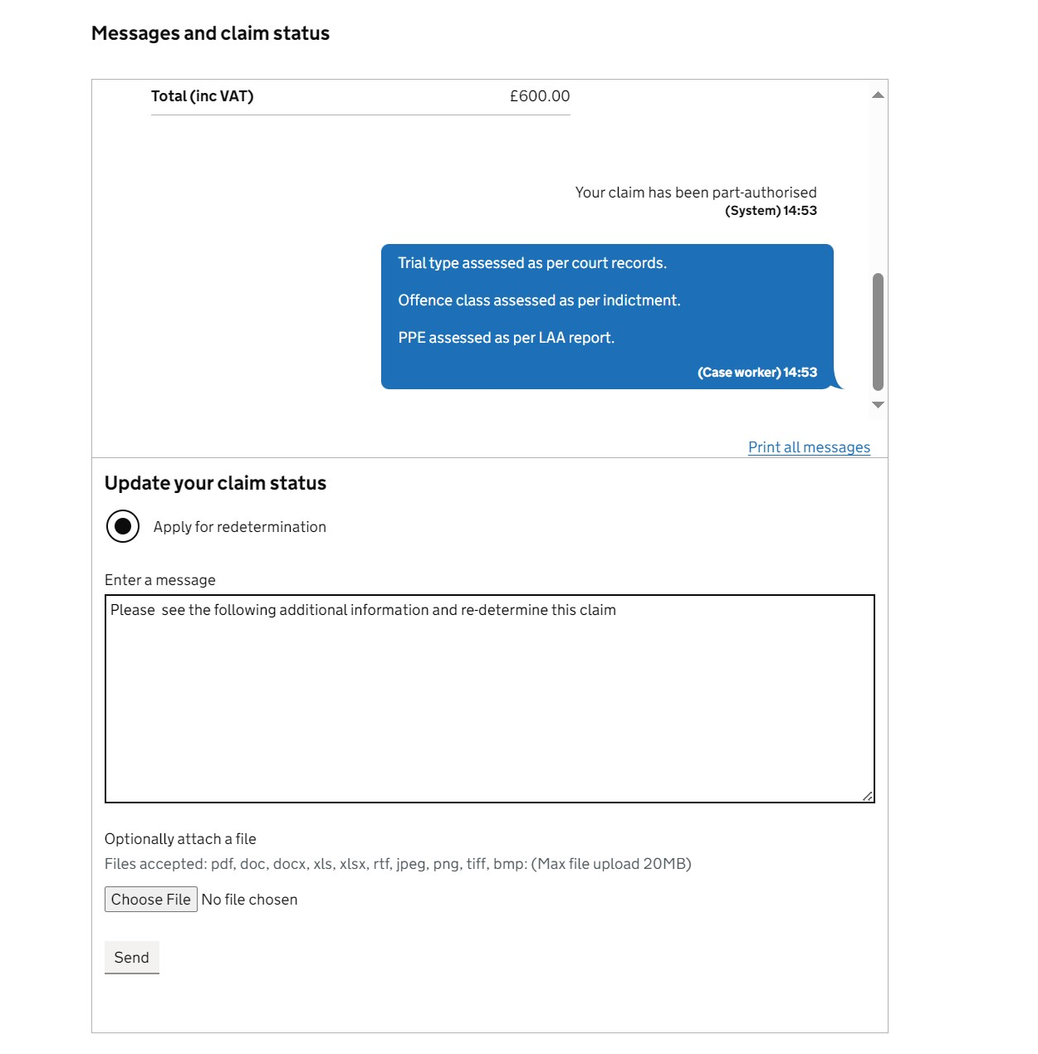
Appealing an assessment:
If you wish to appeal the assessment made:
Select ‘Apply for redetermination’
Complete the message field:
  Explain the area of the assessment you disagree with
  Attach any relevant evidence to support your appeal.

Slide 33
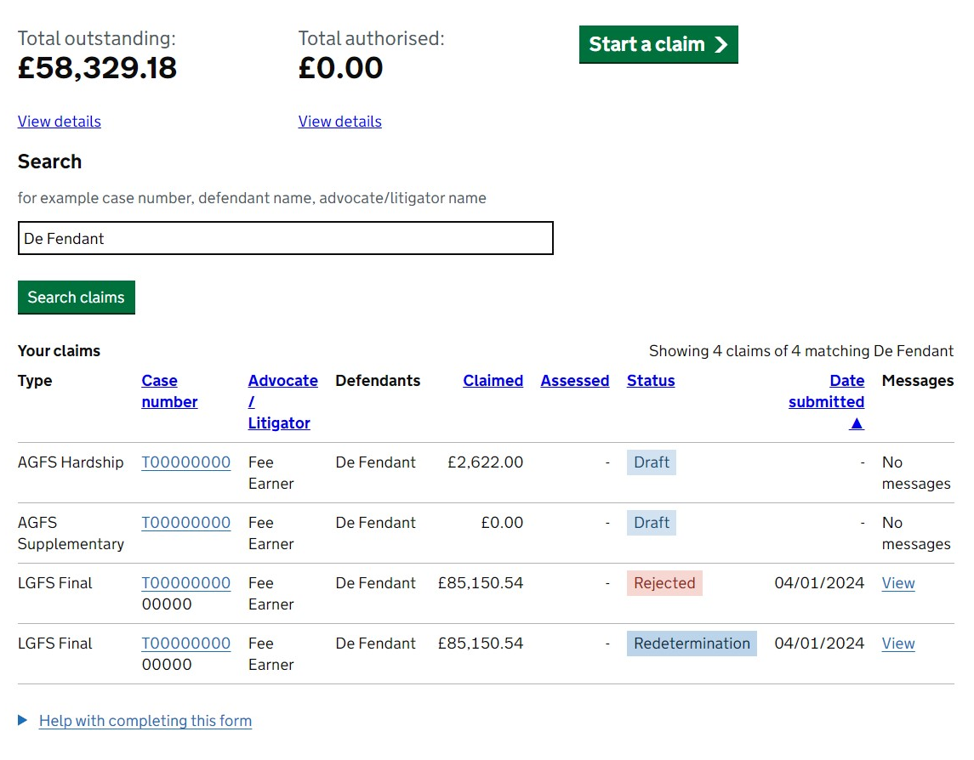
Redetermination:
Once the redetermination has been requested, it will show in the provider list of claims: Status will show as a redetermination.
Then automatically sent to the LGFS appeals work queue, pending assessment.

Slide 34
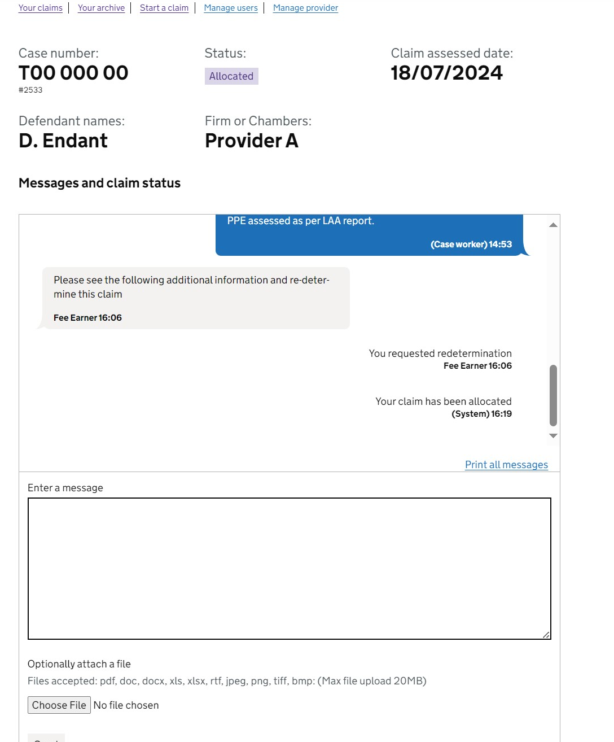
Redetermination continued:
The LGFS team will allocate the case to a caseworker who will consider the basis of the redetermination.
Similarly to the original assessment, we will send a message and explain our decision on the redetermination.

Slide 35
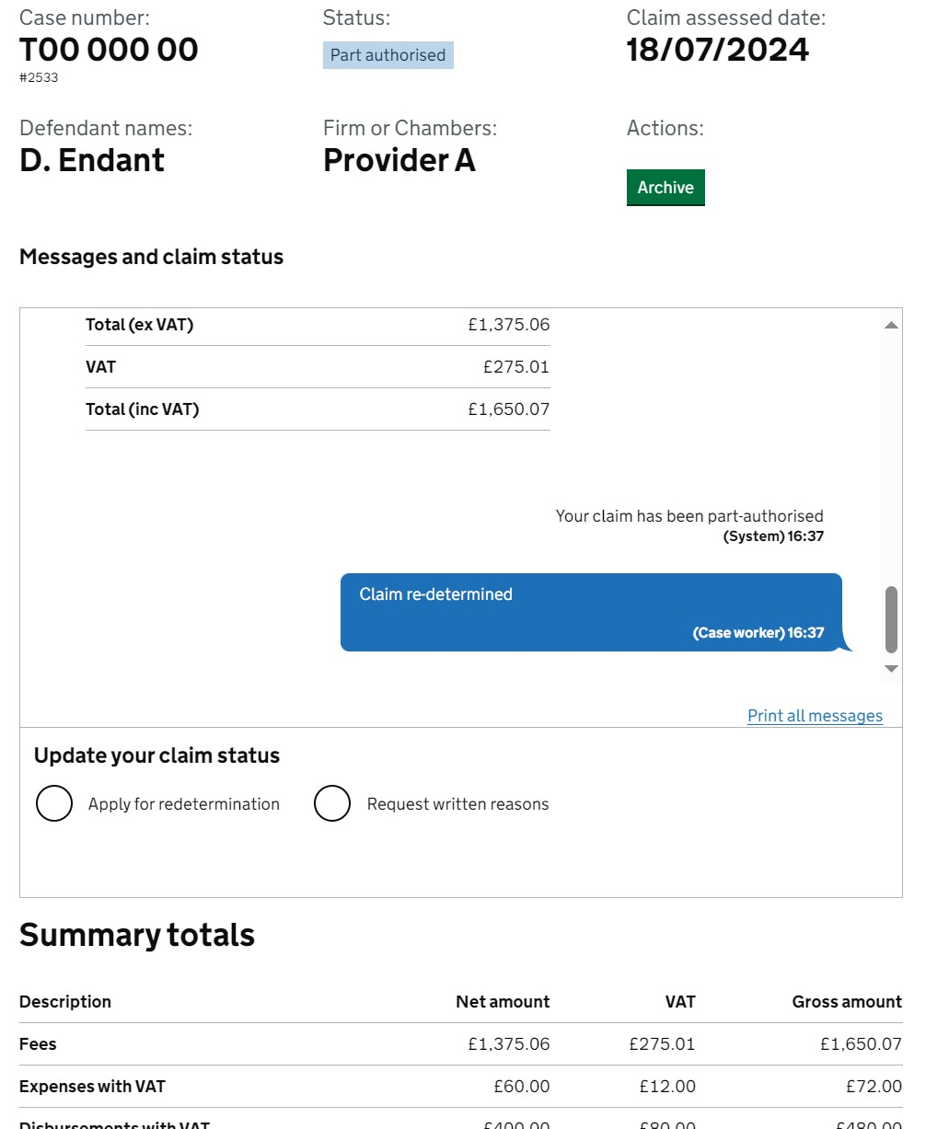
Post assessment:
After assessment by the LGFS team the claim will show in the ‘your claim’ list with a new message
The example shown is still part authorised.

Slide 36
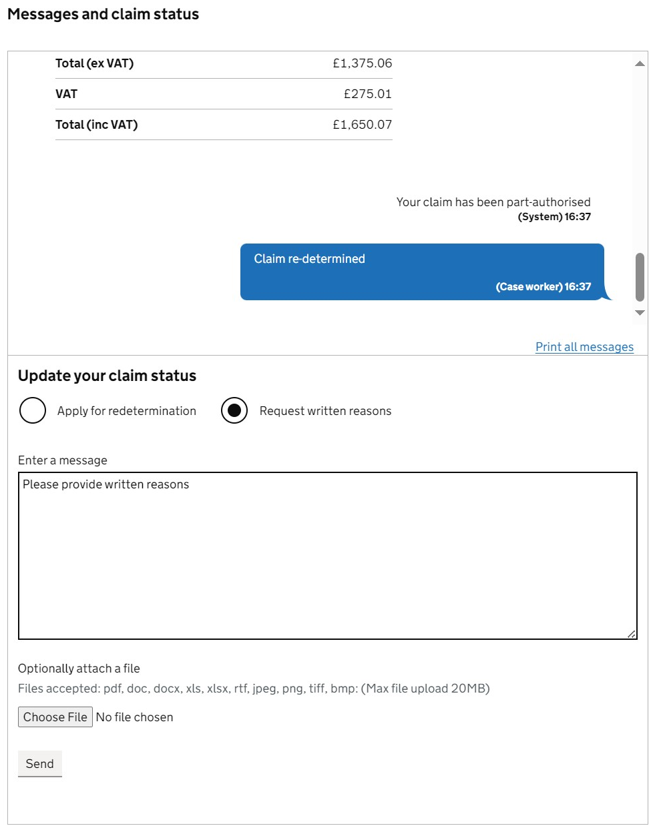
Post assessment: Provider options
You will have 3 options:
If you accept the assessment, you can archive the case.
Request further redetermination:
  You can provide further information fpr the caseworker to consider.
Request written reasons:
  If you do not agree with the decision made, we advise to request written reasons. These will be provided by an experienced caseworker if we agree with the decision previously made. This will allow appeal it to a Costs Judge.

Slide 37
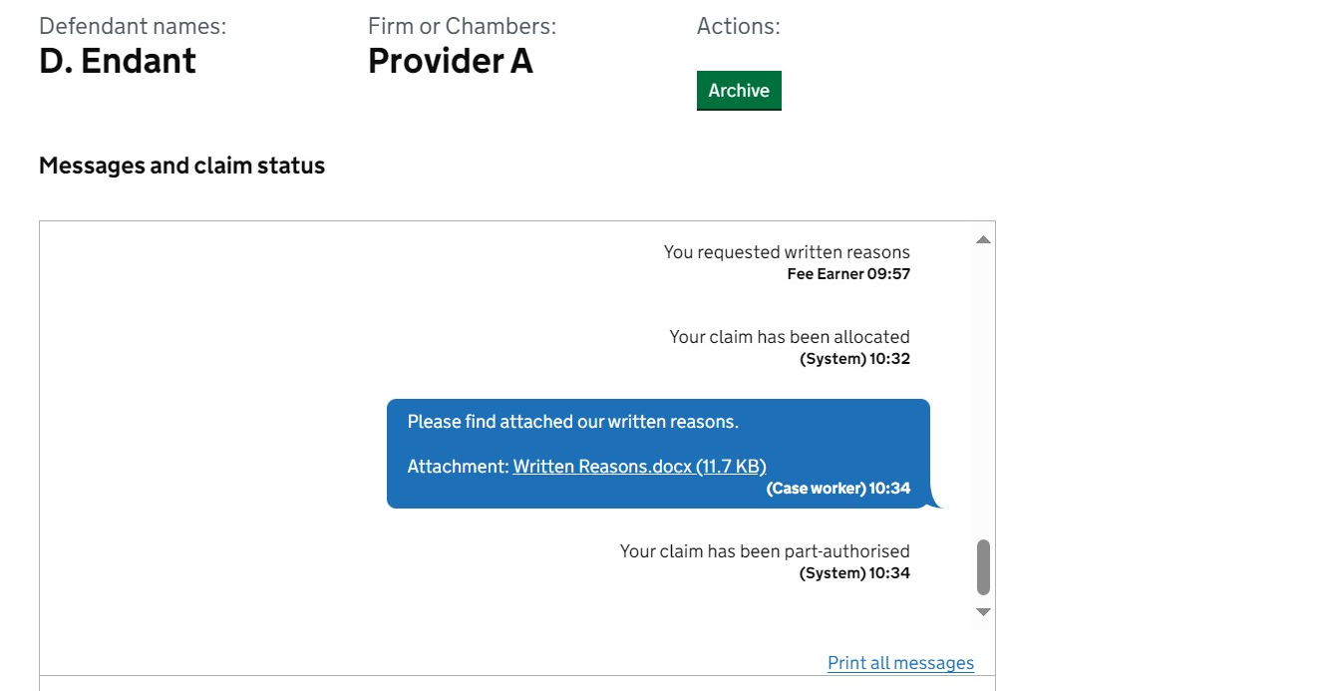
Next steps:
Once the caseworker has provided written reasons, if you would like to take this matter to the Senior Courts Cost Office, you have 21 days on receipt of the letter to do so.
  Alternatively, if you decide not to proceed, you can choose to archive the claim.

Slide 38
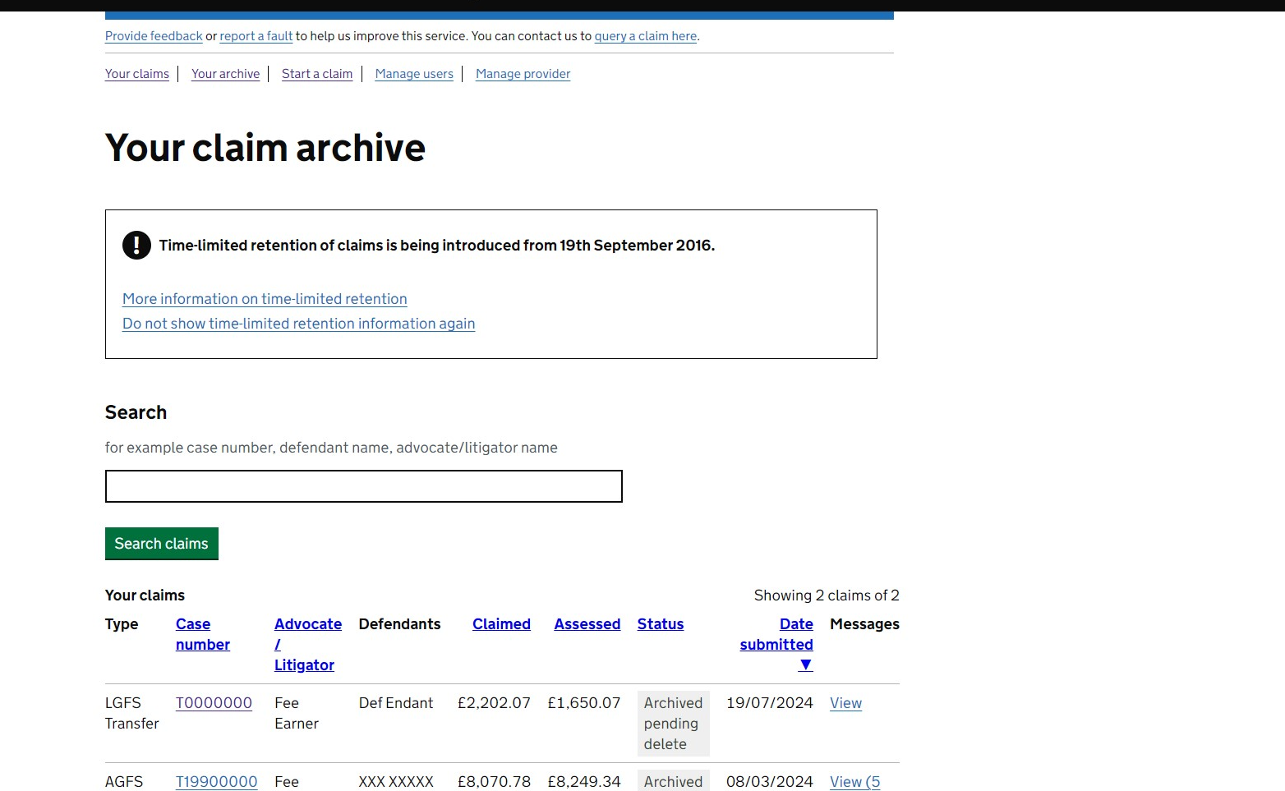
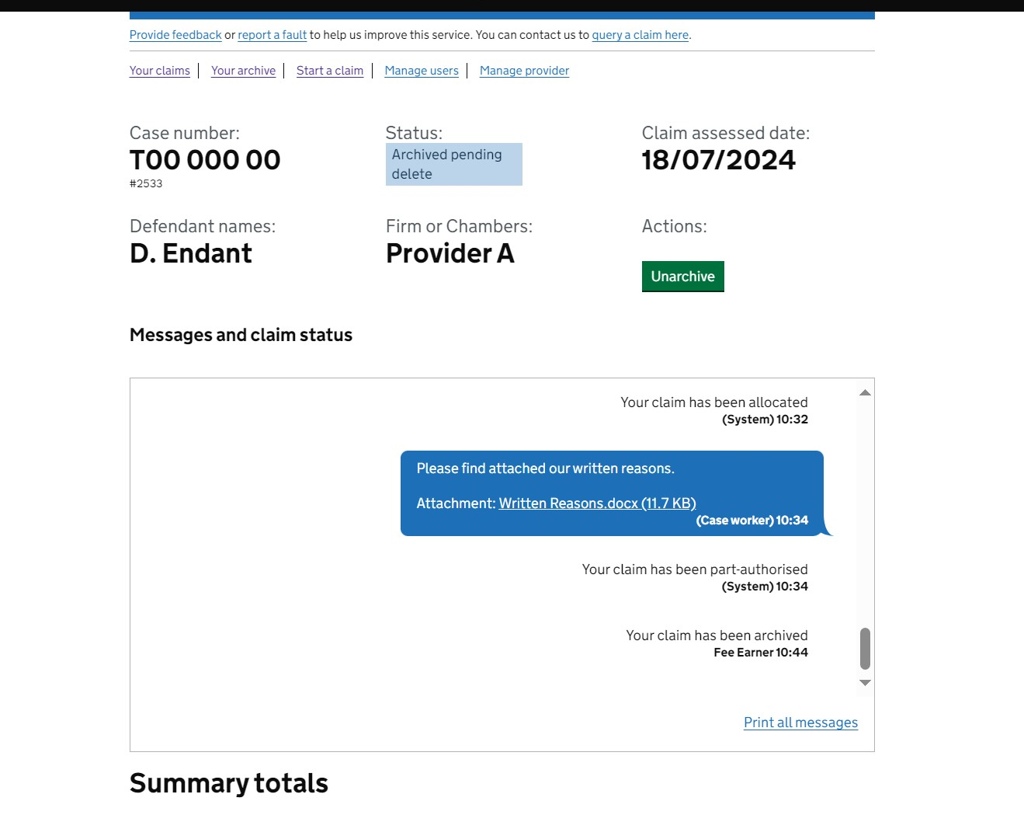
Archiving a claim:
In this example the claim has been archived:
  The claim will still be available for 16 weeks after archiving.
  The claim can be unarchived during those 16 weeks if required.

Slide 39
Additional guidance / contact us

Slide 40
Useful links / contact us:
Links:
Claim for Crown Court Defence:
Sign in to claim for Crown court defence (claim-crown-court-defence.service.gov.uk)
Secure file exchange: https://www.gov.uk/guidance/secure-file-exchange
Processing dates: Crime processing dates - GOV.UK (www.gov.uk)
Contact us:
• For any electronic evidence claim that needs to be sent directly to our office, please send to the following:
FAO: LGFS team, Floor 3
1, Unity Square,
Queensbridge Rd,
Nottingham
NG2 1AW
DX 10035

Slide 41

Our training website:
Crime guidance
Online Support Webchat
Use Webchat for help with IT system issues
Webinar Recordings
Our ‘Help Us Say Yes’ webinars focus on areas where there have been issues or high enquiry levels
Popular sessions are posted on the training website: Ministry of Justice
Ministry of Justice: Crime landing page

Slide 42


Our communication channels:
Legal Aid Bulletin
Social Media
A fortnightly e-alert with links to relevant pages
Follow us on X (formerly Twitter)
Join our thousands of subscribers: Sign-up to LAA Bulletin >>
Read our blog
Get help from our customer service twitter account

Slide 43
Legal Aid Agency
13th Floor (13.51)
102 Petty France
London SW1H 9AJ
gov.uk/government/organisations/legal-aid-agency

