Slide 1
Substance Misuse Framework - Recovery Orientated Systems
INSIGHTS EVENT Presented by Larry Eve Operations Manager The Basement Recovery Project

Slide 2
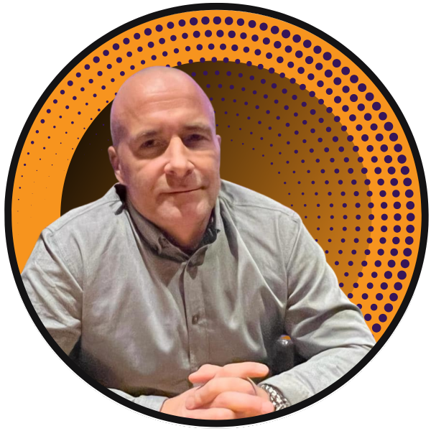

Intro: Role and Organisation
Person in long-term recovery
Worked across inpatient detox and rehab
13 years at TBRP. Now Operations Manager
17+ years of innovative LERO community service
CLERO leader and OHID consortium member
Comprehensive services: housing, frontline access, methadone queue, enhanced detox & rehab
Key alliance partner: Fostering a ‘professional family’ approach to service design and support
Notes:
Larry Eve – Person in long term recovery – Have worked across Inpatient detox and rehab settings
Started as a sessional group/support worker Operations manager at The Basement Project for 13 years
We are a well-established forward thinking LERO serving our community for over 17 years
A CLERO leader and consortium member with OHID
The landlord – the front door – the new methadone queue – enhanced community detox and quasi residential rehab
An integral part of an alliance model creating a “professional family” approach to service design and supporting those in need of help

Slide 3

You can’t create a recovery-oriented system without the voice of lived experience
A system without lived experience is like building a road with no destination.
We offer understanding—not just insight.
We've felt the system's gaps firsthand.
This isn’t just about policy—it’s about people.
Notes:
Designing a recovery system without people in recovery is like building a road without knowing where it needs to go.“
We Bring More Than Insight—We Bring Understanding"
"We’ve Felt the Gaps in the System Firsthand“
"This Is About More Than Policy—This time its About People"

Slide 4

Understanding the benefits of lived experience in service design and delivery, offering hope, meaning and purpose.
Meaning: Lived experience shapes regional prison drug strategy meetings by offering fresh, meaningful insights.
Hope: Initiatives—such as Bus-to-Bed, recovery evaluations, staff training, and guest seminars—provide hope for those stuck in addiction and offending.
Purpose: Our Drug and Alcohol ISFL pilot builds an evidence base showing how lived experience instils genuine purpose for both professionals and individuals in recovery.
Notes:
Our work so far:
Voice of lived experience on the Yorkshire and Humber regional prison drug strategy meetings as critical friend bringing new MEANING to the table
Our bus to bed - Taking the recovery temperature evaluations – staff training – guest speakers at seminars – and more recent all combine to bring HOPE to those stuck in the cycle of addiction, offending and desperation
Creating an evidence base that demonstrates the impact and effectiveness of working with lived experience as part of the Drug and Alcohol group ISFL pilot to help manufacture a genuine sense of PURPOSE not just for professionals in the field but als individuals in recovery

Slide 5

Challenges and opportunities of working with HMPPS and learning from how other organisations overcame challenges.
Vetting process not yet receptive
Recovery must be core to policy and values
LEROs should be included in tender specifications (with evidence)
Mutual aid in prisons remains a postcode lottery
Recovery and trauma training needed for all staff, including SLTs
Notes:
The vetting process is not ready to welcome us
Enabling recovery needs to be at the heart of policy and organisational values
LERO’s need to be written into tender specifications (and evidenced)
Mutual aid in our prisons is still a postcode lottery
Recovery and trauma specific training for all operational and non- operational staff – including SLT’s

