Slide 1
Probation and the Operational Framework A Health and Justice Partnership Perspective

Slide 2
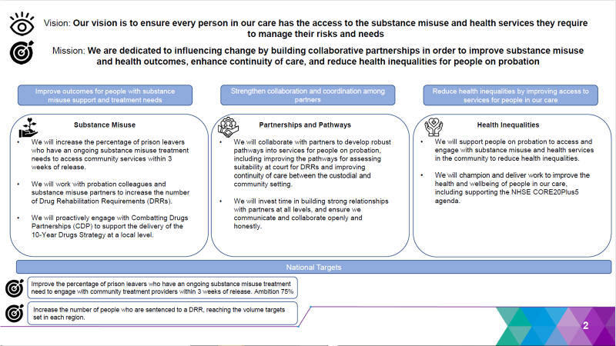
Health and Justice Strategic Framework from Government
Working across3 core Areas – built around recommendations from the Dame Carol Black Review
Drug & Alcohol Services
Partnerships
Health inequalities
ALL are barriers to improved Probation outcomes
National Continuity of Care Target of 75%
Targets set locally
Notes:
Key aspects here are we are starting with the continuity of care target of 75% and the CSTR uplifts as national priorities, then looking forwards to other health inequalities which prevent people on probation from engaging better and progressing towards desistance
BUT RED IS WHERE OUR MAIN EFFORTS ARE FOCUSSED

Slide 3




The transition to community and probation Working in partnership to build and sustain recovery capital
Key to the success of the model is interdependency between all our agencies
Probation relationship begins at the start of the sentence – community or custodial
Using our embedded assets to the best advantage of our caseload – OMU – Resettlement teams/Meetings – Prison Inclusion Meetings – Reconnect Services - to communicate effectively client needs to the community
Dame Carol Black review has generated enormous network of good practice, sharing forums and opened new doors into treatment, recovery and maintenance roles
Focus on wider recovery capital components and determinants – Housing, ETE, Mental Health & DWP
Effective use of probation funding to facilitate enhanced recovery support for community service users and prison leavers
Notes:
What’s key to the
A person’s recovery journey starts in custody as they set themselves targets and aspirations for what they want to achieve on release. Where they want to be and what they want to do. And the framework supports that thinking and we will work with sentence management colleagues to encourage that promotion of work on drug and alcohol issues and preparation for release from Day 1.

Slide 4
What the framework will provide for clients via the Probation service
Workforce that understand the importance of recognising and understanding diversity of needs
Shapes training which will provide strong baseline knowledge around drug and alcohol but access to SME’s through partnerships
Promoting the tools at practitioner disposal e.g. CSTR’s / Treatment supporting Alcohol Tags
Uses our EPOP (Engaging People on Probation) to promote recovery through LE connections
Building recovery capital through our wider partnership services
They see a system that:
Focuses on individual needs
Listens
Talks effectively, with aligned goals and shared objectives for the people they work with
Demonstrates through practice the link between recovery and desistance
Results in an engagement that is built on trust as well as little bit of a leap of faith
What the framework will feel like for clients
Notes:
and meets them where they’re at ( continuity of care doesn’t just mean successful transition into treatment – it means finding your wing mentors in recovery purposeful roles in their community settings that allow them to continue to grow )

Slide 5
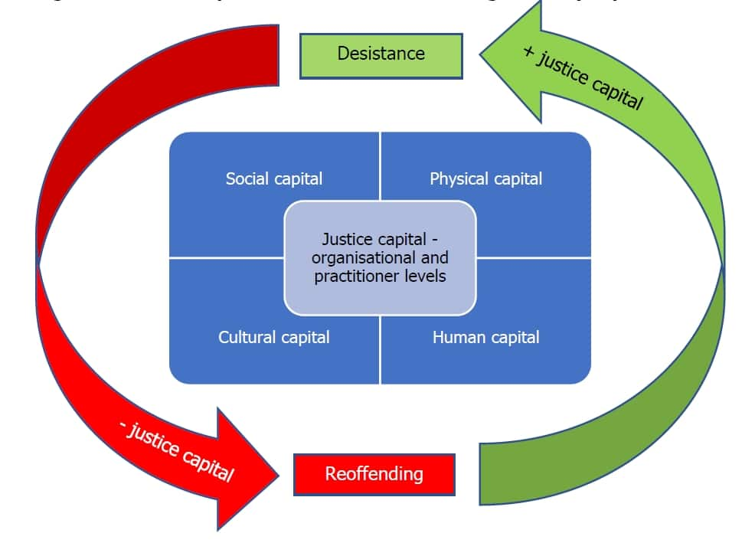
Hazel Kemshall, HMI Probation, justice capital, Kieran McCartan, recovery

