Slide 1

Insights Presentation
Recovery Approaches in Approved Premises

Slide 2

Approved Premises (AP) Recovery Focussed Approved Premises (RFAP)
What are Approved Premises? Public Protection
Following Harm to Hope strategy, our response was to set up Recovery Focussed APs as a proof of concept and to develop recovery approaches in all APs.
Recovery Focussed Aps?
The RFAP locations were selected on evidence of risk, need and rehabilitation - (H2H)
Understanding: “Hurt is at the centre of all addictive behaviours.” (Gabor Maté)
The model is for RFAP’s is to break the cycle by providing continuity of recovery
Staff trained by LERO’s as Recovery Coaches- what’s strong not what’s wrong
Track referrals from DRW/ISFL
Once accepted onto the pathway; preparation for release; pre-release workbook / transition planning
Residents spend 10 sessions per week on recovery/ rehabilitative activity
Each RFAP steeped in the local recovery community including with mutual aid/ peer led groups
Notes:
Ap’s- public protection, for high risk/ very high risk of harm to public, monitoring and oversight, over 100 and average stay btwn 8-12 weeks
4 RFAPs
RFAP’s enable continuity of recovery from prison, have a schedule of recovery activities and staff trained in recovery approaches
10 sessions per week, SMART
has a harm minimisation, relapse prevention and recovery growth plan so can hit the ground running
Innovations; prison tracking, recovery coach training with prison staff, mixed SMART cohort at one AP
Harm to Hope document , Adder , County Lines

Slide 3
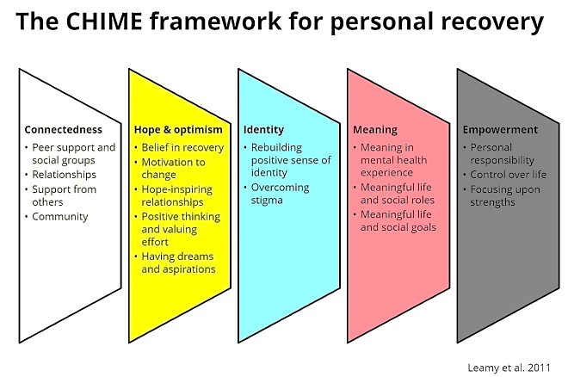
RFAP ETHOS - CHIME Model
Connection is the opposite of addiction not abstinence
Hope is the main component: people need to feel connected, supported, believed, and worthy
Identity, what is strong not what is wrong – focus on positives, not shame and stigma
Meaningful AP Placements ensure that there is busy schedule which is purposeful and
Empowerment- Culturally sensitive- recovery is individual
Notes:
1.Focus on recovery from Incentivised Substance Free Living Wings/ Drug Recovery Wings or work started in prison, such as meaningful engagement with DART within custody visit with PSO and or OMIC staff, In cell work, personalised abstinence workbook of recovery to cover transition from custody to AP . Connectors
2. to support their transition and the support they can access on release
3. Placement within rehabilitation recovery community – different things for different people
Police intel- cost of living crisis- tablets from China and Russia- takeways and taxi’s/ arrive in the post – by connecting with recovery orgs we can use this intel to inform our work
FOCUS Groups and questionnaires- it is what AP residents and stakeholders want

Slide 4
Summary of recovery work
Recovery in every AP – mixed cohort so we are making recovery visible with Mutual Aid Groups (AA/NA/CA/ SMART) “Myth Busting and Introductory Sessions” via national online events and in person visits, piloting OHID FAMA sessions, Recovery Month events and linking with LERO’s.
Toolkit- how to guide for RFAP’s but also what every AP can do to introduce recovery; levels of recovery
Innovations; prison tracking, recovery coach training with prison staff, mixed SMART cohort at one AP, FAMA sessions
Lessons learnt- vital to focus on transitions from custody to AP and AP to the wider community. As such we now have First week out schedule, Warrior Down plan and Outreach all in early stages
Research and Evaluation underway
Call to action - what can YOU do in prisons, community services to help us promote recovery in APs
Notes:
We are proposing to have 6 early adopter sites; excel spreadsheet- using evidence/ data from OHID / Harm to hope strategy. Areas that had
High crack/opiate use
Multiple deprivations
Changing futures x5 – offending, substance misuse, dv, mh, accommodation
LERO’s
Naloxone
Drug deaths
ISFL prison releases

