Slide 1


National Year
of Reading
The CFO Programme

Slide 2


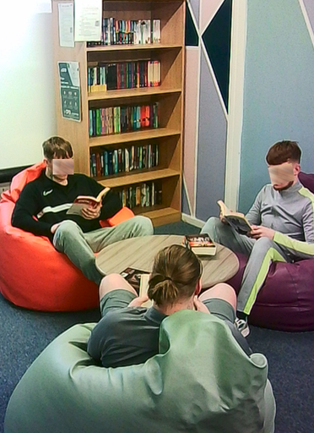
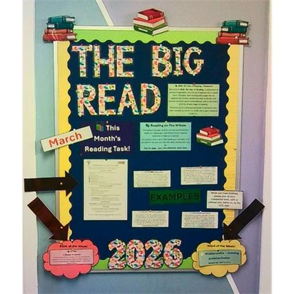
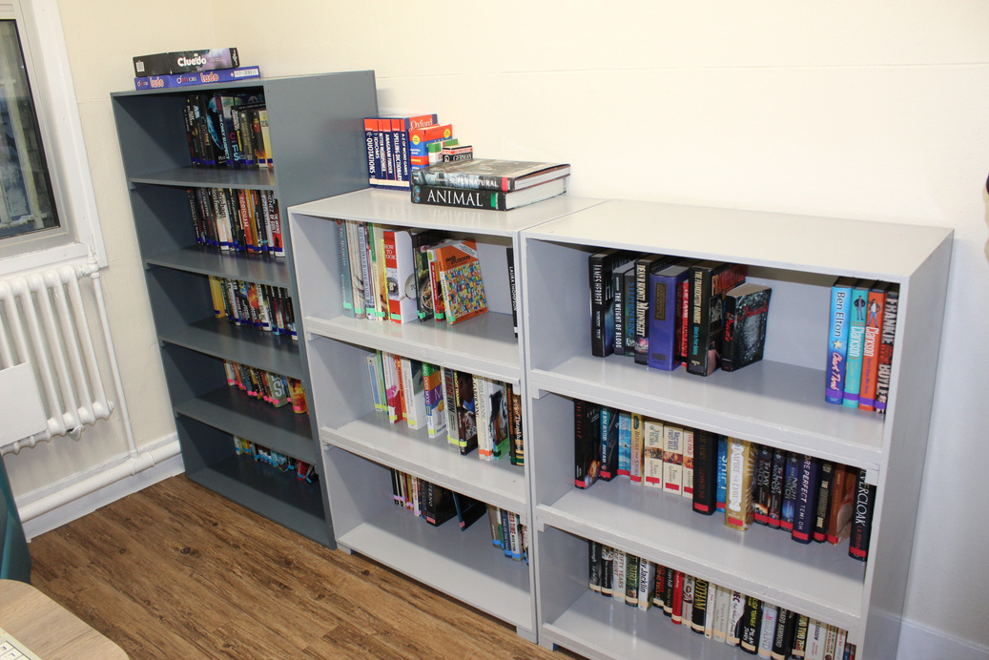
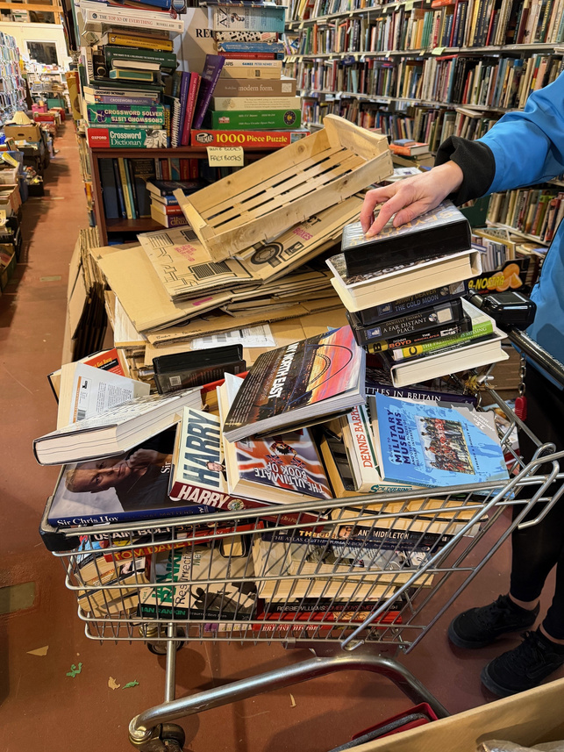
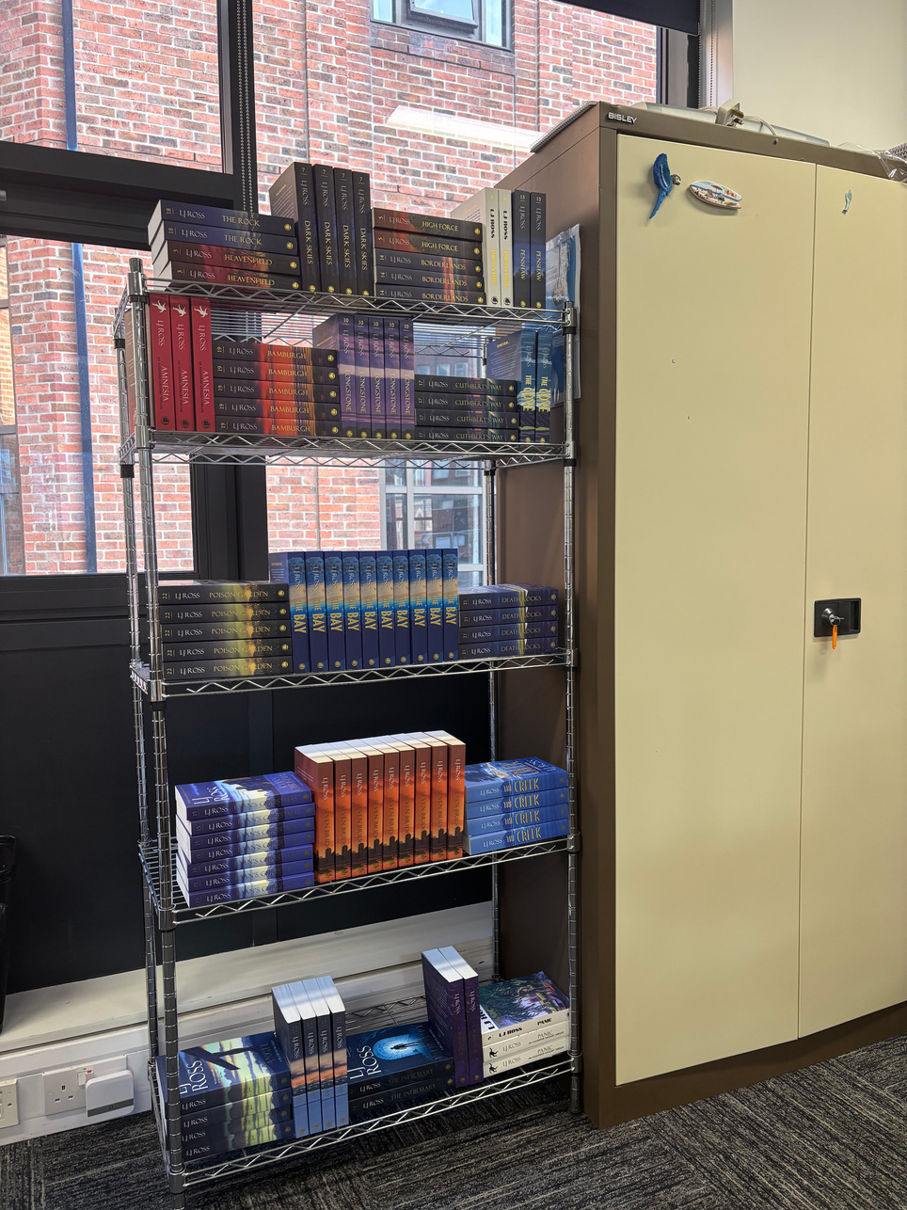
CFO in Custody
Book Clubs
Reading Activities
New Wing Libraries
Books donated from Borderline Books in the North East
Reading Mentors

Slide 3
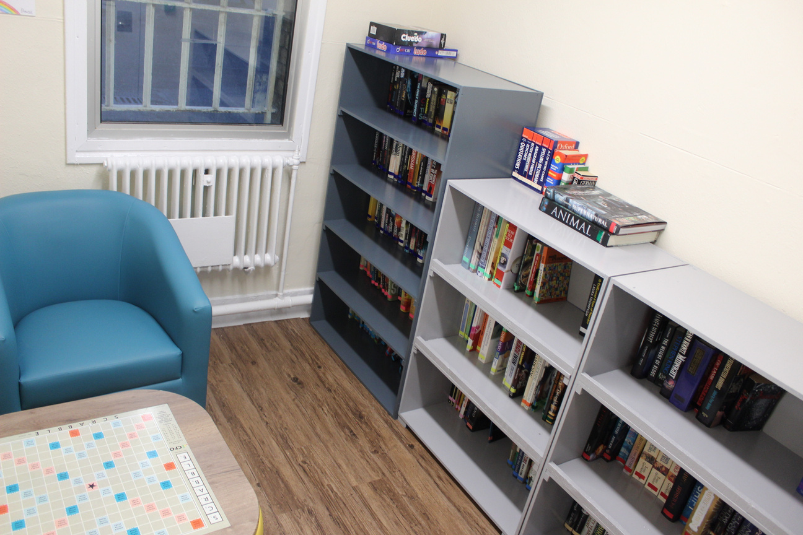

CFO in Custody - Better Days
When it seems to get too much
And you feel like you are losing touch
Remind yourself you’ve come so far
And keep believing in who you are
Take each day one step at a time
And everything will be just fine
Try not to worry about the rest
All you can do is try your best
Make a change or start a new
Find something that’s right for you
Leave your troubles and past behind
There’s plenty more still left to find
There’s so much more that you can give
And better days for you to live
Look into the future and you will see
The person you know that you can be
Notes:
One of the most powerful examples of our reading work comes from the CFO Unity Wing at HMP Humber.
Our participants on the wing describe the newly created library as a calm space where they can switch off and relax.
After benefiting from the library, one participant wrote a poem which he described as the first thing he had written in years. With his permission I will share it now. It captures what reading and writing can unlock for someone who is beginning to rebuild confidence.
Pause to read the poem from the slide.
Reading can help people process emotions, build identity and imagine a different future.

Slide 4
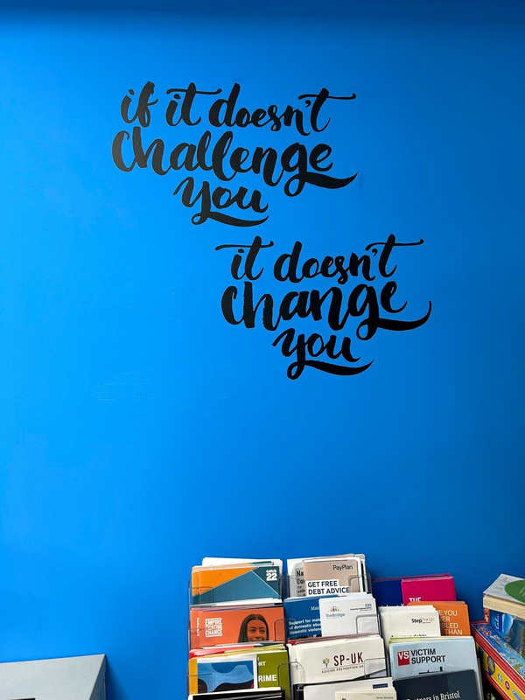
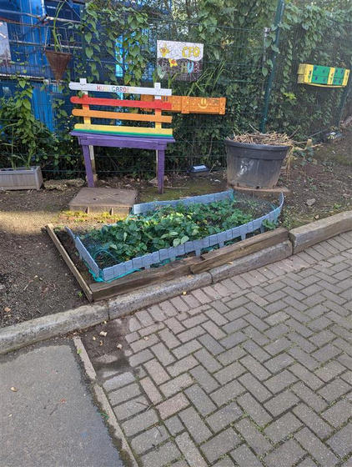
CFO in the Community
Helps people build or retain reading habits
Encourages people to engage at a pace that works for them
Supports job searching by building confidence with applications and interviews
Reading built into everyday activities; cooking, art, physical activity
Strengthens wellbeing, routine and confidence during transition
Notes:
When someone leaves prison, the transition can be intense. New responsibilities, appointments, housing issues, finances, family pressures, and a lot of uncertainty. Reading can be one of the simplest stabilising routines someone can carry with them. It is familiar, it is achievable, and it can create a calm moment in a day that feels chaotic.
In the hubs, reading is not a standalone offer. We weave it into everyday activities so people experience reading as part of real life rather than something separate or intimidating. If someone is learning to cook, they are reading recipes, instructions, ingredient lists, timings and measurements. If they are doing art or creative activity, they might read short prompts, follow simple guides, or write reflections. On nature walks we can use reading as a tool for wellbeing with short reflection cards or simple information prompts that encourage observation and conversation. In drama or performance activities, reading might be a short script, a character profile, or something the group creates together.
The same is true for employability support. When participants work with DWP colleagues and hub staff, reading is part of looking at job descriptions, understanding vacancy requirements, completing forms, and building confidence with applications and interviews. We are building practical confidence, step by step, in a way that does not feel like a classroom.
This is also about keeping the habit going. We want someone who started reading on a wing or in a wing library to feel that it still belongs in their life after release. The hubs give them a space where reading is normal, supported, and connected to other progress.

Slide 5
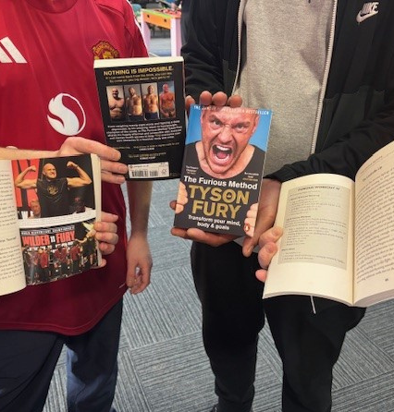
CFO Book Club
“Book Club is great. It has been helping me with my confidence and reading skills, as well as my dyslexia.”

Slide 6
Opportunities to get involved
Borderline Books
Activities from National Literacy Trust
Discounted Books from Jacaranda Publisher
Free Easy Reads
Children’s books available for parents
Penpal Books Clubs
Book Swaps
Books Recommendations
National Literacy Trust Anthology
CFO published book of short stories

Slide 7
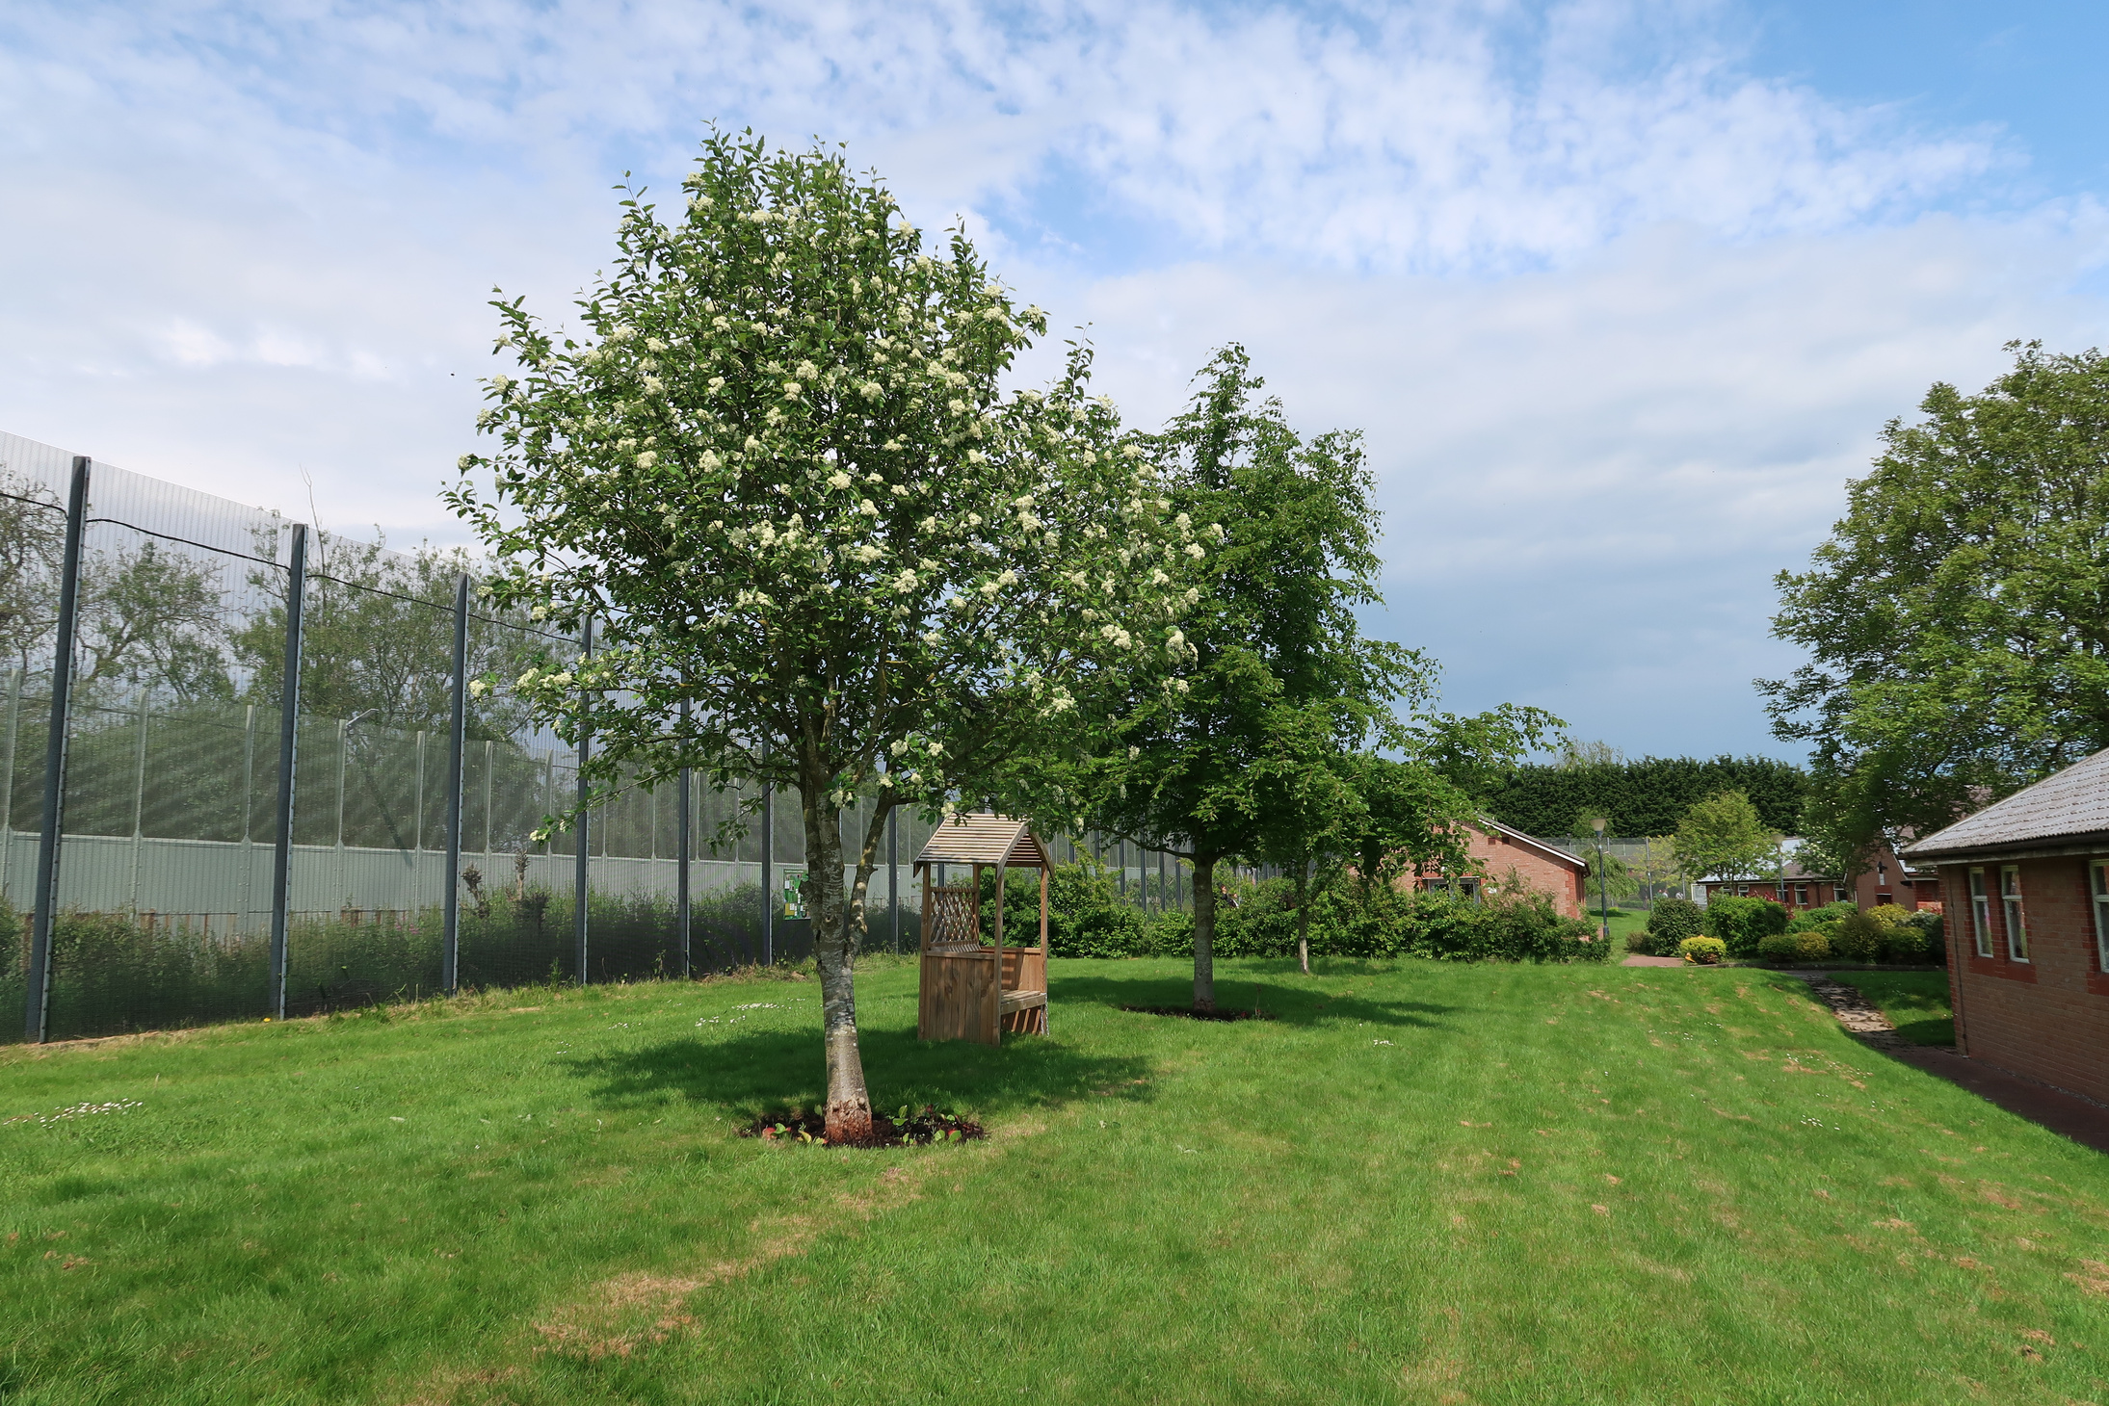
thank you
For more information please contact:
CFO-communications@justice.gov.uk

