Slide 1


June 2026
READING STRATEGY
HMP & YOI Chelmsford
Gemma Brockman
Head of Reducing Reoffending

Slide 2
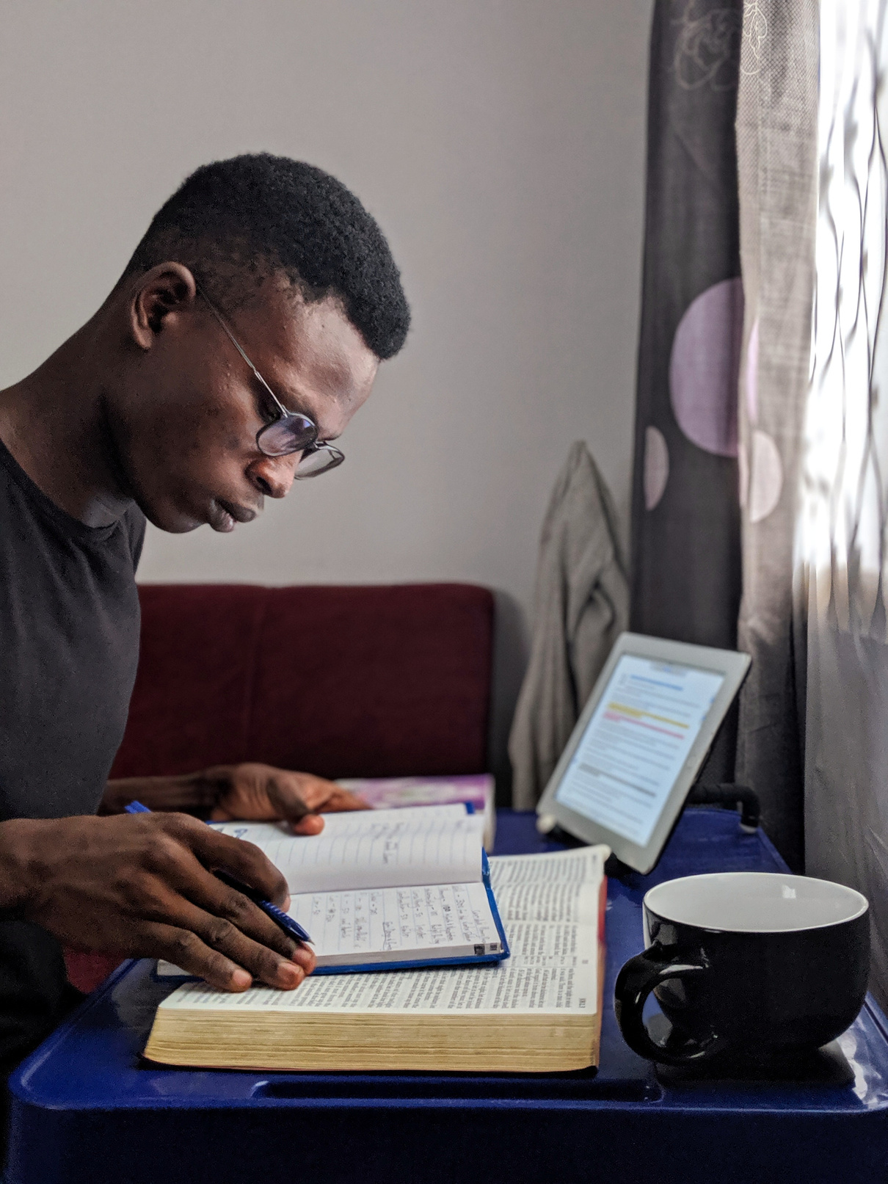
Reading is positioned as part of community life; through aspects such as family contact, faith, health, wellbeing, safety, neurodiversity support, peer relationships and progression.
The aim is an embedded culture of reading throughout all prison strategies — not a single education-only intervention.
The offer is built around access diverse range of activities, senior leadership role-modelling.
Impact is measured by robust monitoring through data and feedback with successes/progression regularly celebrated.
Our model: a whole prison approach

Slide 3
Our model: a whole prison approach
Leadership: SLT participation in reading activities and published book reads, resource investment, staff training embedded, reader of the month
Family: StoryBook Dads, raising readers, interactive family reading events
Faith: Faith-based reading challenge. Messy Church family reading and crafts sessions
Reading for pleasure: Library access including evenings, book clubs, book corners, Reading Ahead, Author visits, poem of the month
Pride / sense of achievement: Reader of the month, course achievement recognition, reading progression case study celebration
Community life: Wing book clubs, forums, dedicated keyworkers
Wellbeing & Safety: Poetry & writing competitions. Reading activities for those on violence or self harm support plans. Book for every man at reception
Health: Reading reflections throughout Healthy Lifestyle gym courses. Multi-disciplinary meetings to identify additional support
Neurodiversity: ND Buddy scheme, book clubs, bespoke support need identified
Skills & progression: Reading threaded through all education & work, low level reader support, reading together weeks, book corners, reading goals on learner plans, reading screeners

Slide 4

National Year of Reading
In addition to our current reading offer, we have created new reading activities to
celebrate and recognise the National Year of Reading. Examples of activities include:
Family reading events:
In celebration of World Book Day (March) , International Children's Book Day (April), Roald Dahl story day (sept), World Nursery Rhyme Week (Nov)
Interactive family events including arts and crafts, story-tellers, face painting, fancy dress, reading corners. Themed to event.
Shared reading:
In celebration of Share a Story Month (May)
Shared reading of ‘A Boy Called Saul’ – the most requested quick read within our Book for Every Man scheme. Prisoner reading groups, author led creative writing session, SLT book read – all including the book author
Summer reading challenges:
In celebration of summer reading challenge month (July)
Launch of both Faith-based and health-based reading challenges with individual bespoke reading booklets. Launch of wing reading competition. 2026 SLT Reading Ahead diaries to commence
Reading support for health & wellbeing:
In celebration of ND Celebration Week (March) and World Mental Health Day (Oct)
Launch of ND book club and reading events. Safety led creative writing competitions, spotlight on book reviews for those on ACCT/CSIP & impact of keywork support for low level readers
Reading skills progression:
Celebrating progression
Launch of Reading Together weeks in Education, Industries and ND. Delivery of bespoke phonics and non read & write training. Sharing of case studies.

Slide 5
Book for every man
Working in partnership with our Early Days in Custody function we identified a need to reduce anxiety & self harm on their first night helping build a safe, settled and decent environment. A way to achieve this was to offer all men a quick read book on their first night to keep their mind occupied.
Impact
"It shows care” “It was nice to be offered” “Kept my mind at peace” “It helped on my first night”
“Something to do. Entertainment. It was good to have something short to read. Easy to get through”
“It helped a lot – because it can very busy at night and I’ve a lot of stuff going on. Reading it was a good distraction.”
“There were things in the book I could relate to”
“Brilliant writer! Keeps you guessing. I never read. This was my second book in my life.
Normally I get bored quick, but I read this in one go. I want to read more! I want to read more by these authors”.
“Kept me distracted on my first night, I like that it was short and easy to read. Something to do. I don’t read on the outside”
“It helped because you visualise the storyteller and what’s going on from what the author has written.
It’s different to watching TV.”
“An excellent book – I’m on the second time round with it now so I can try and remember it”
892 books given to date
Following the success these books are now offered to those in seg, healthcare and constant watches
100% of men stated they liked having a book on arrival to Chelmsford
79% of men felt having a book helped them on their first night
Prisoners attend the library to continue reading by requesting follow-on books

Slide 6
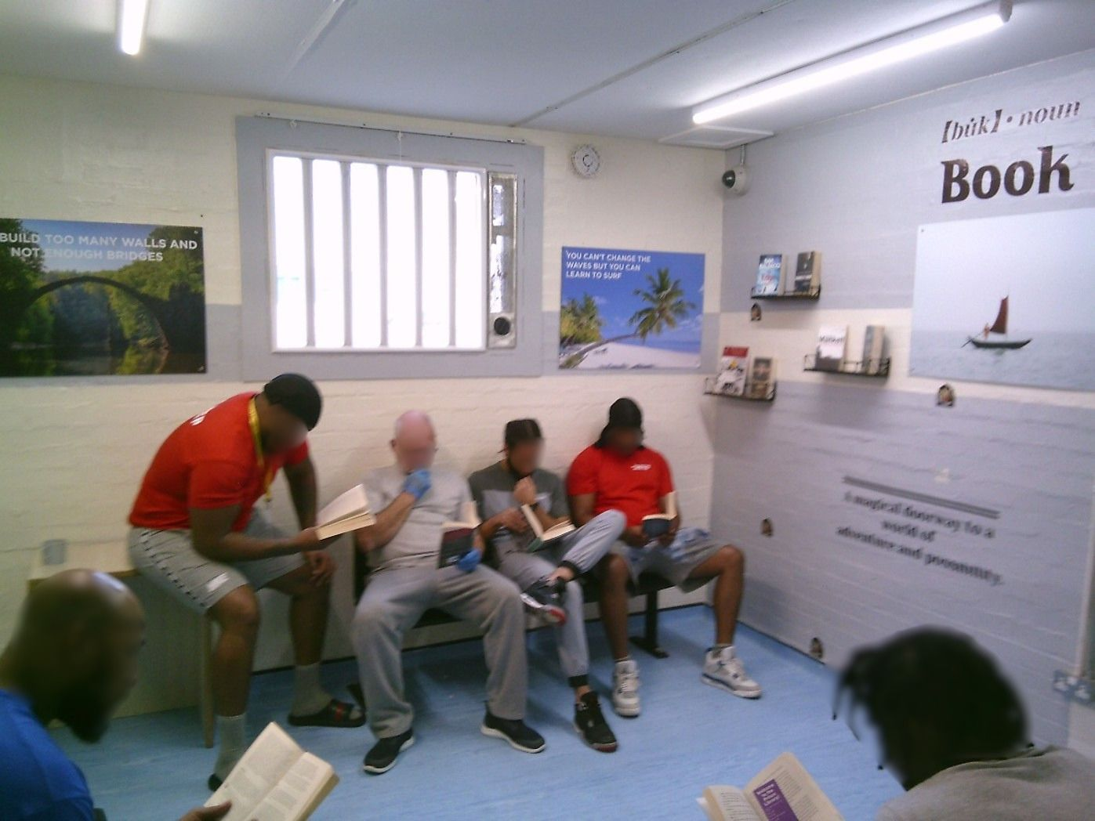
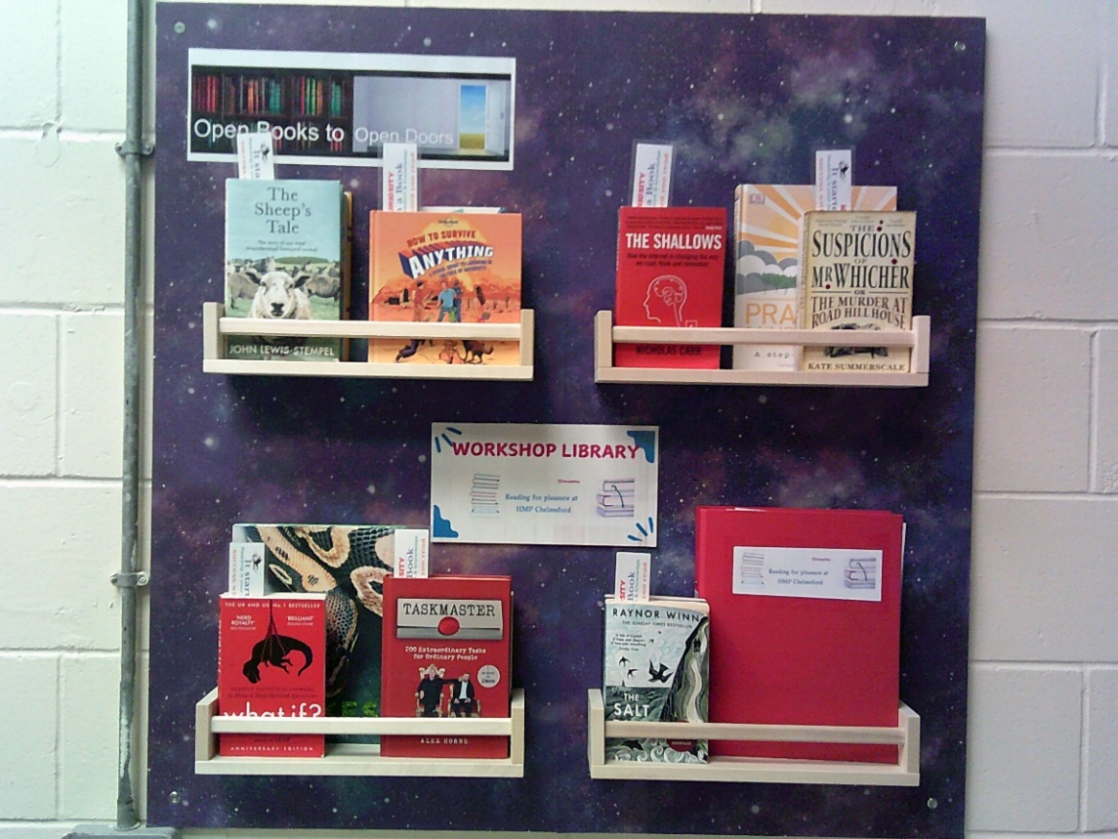
Impact
Increase in library attendance by nearly 200 men per month
45 men participating in Reading Ahead
All low-level readers have been allocated a Keyworker
4 staff book reads published on launchpad
Over 200 men participating in the Faith-based reading challenge
95 enrollments to the Healthy Lifestyle course undertaking reading reflections in each module
297 staff members received training / awareness on our reading offer throughout the reading celebration month
8 members of the Senior Leadership team have completed their first Reading Ahead Diaries
39 men took part in Safety reading and creative writing competitions
An average of 13 men have increased by at least one level in Literacy each month
84 men participated in raising readers with their children, and 142 men have participated in poem of the month

Slide 7
Making a difference
Voices from Chelmsford
What we are taking forward
“It helped on my first night.”
“I want to read more.”
“Now, I am even thinking about writing my own book.”
“This kind of activity gave me a rare chance to lose myself in an activity that has nothing to do with being in prison and just for 90min made me forget my issues.”
“Having something like this arranged for us, certainly endears the staff to prisoners and creates a sense of being cared for.”
“It’s really good with writing to your family and reading your family’s letters and how you talk to them if you haven’t spoke in a long time..”
“I picked up one of those easy-read books from the wing. I read it from start to finish. That’s the first time I’ve ever done something like that by myself”
Reading is supporting safety, wellbeing, confidence, family relationships and progression — as well as classroom learning.
We measure impact through library attendance and loans, participation in activities, English progression, Reading Support Levels, family initiatives and prisoner / staff feedback.
Everyone enjoys reading and develops skills in different ways; learning and engagement is better when people are doing something they enjoy.
Celebrating success inspires people to keep reading and helps maintain buy-in and drive.
The key lesson from Chelmsford is that reading grows when the whole prison owns it.

