Slide 1
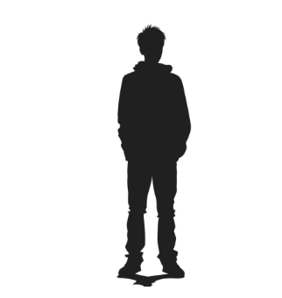
Books for Boys
"Basically they want me to leave my people behind..."​

Slide 2

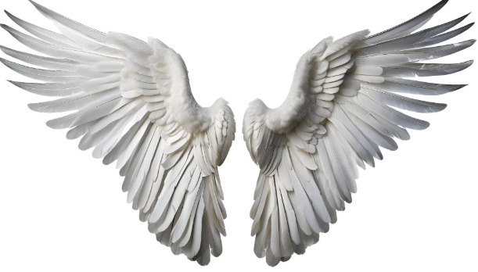
What exactly are we saying about reading?
"Best that has been thought and said" Matthew Arnold
Mind expanding
Shibboleth
Cultural legacy
Access to mainstream life
Well-meaning moral panic
Magic Wand
Class distaste
Pygmalion

Slide 3

You're unhealthy – eat this!
Screening on arrival
Reading interventions including phonics
Monthly Functional Skills reading assessment
ESOL interventions
Library tracking, recommendations and 1-2-1s

Slide 4

Be useful to us
Literacy and reading built into
vocational pathways
Emphasis on how reading can improve life chances
Real-life texts and reading scenarios
Emphasis on qualifications and entry requirements

Slide 5

Have fun this way instead
Book on the bed
Masked reader
Reading races
Reading quizzes
Author visits
Audio Books
Enrichment weeks
Drop Everything and Read
Shared novels
Graphic novels and comics
Age-appropriate topics in easy readers

Slide 6
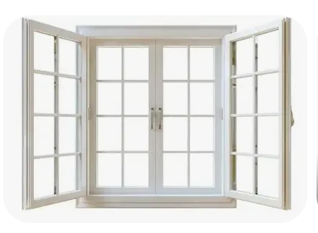
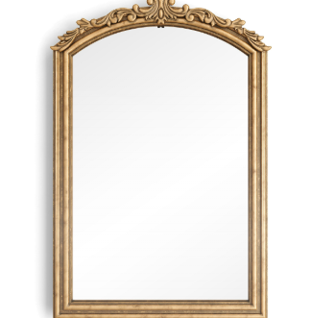
Think like this...
What world do we want prisoners to explore?
What self do we want prisoners to encounter?
Is the novel still 'novel'?

