Slide 1
Prison Libraries
How do they support reading?

Slide 2
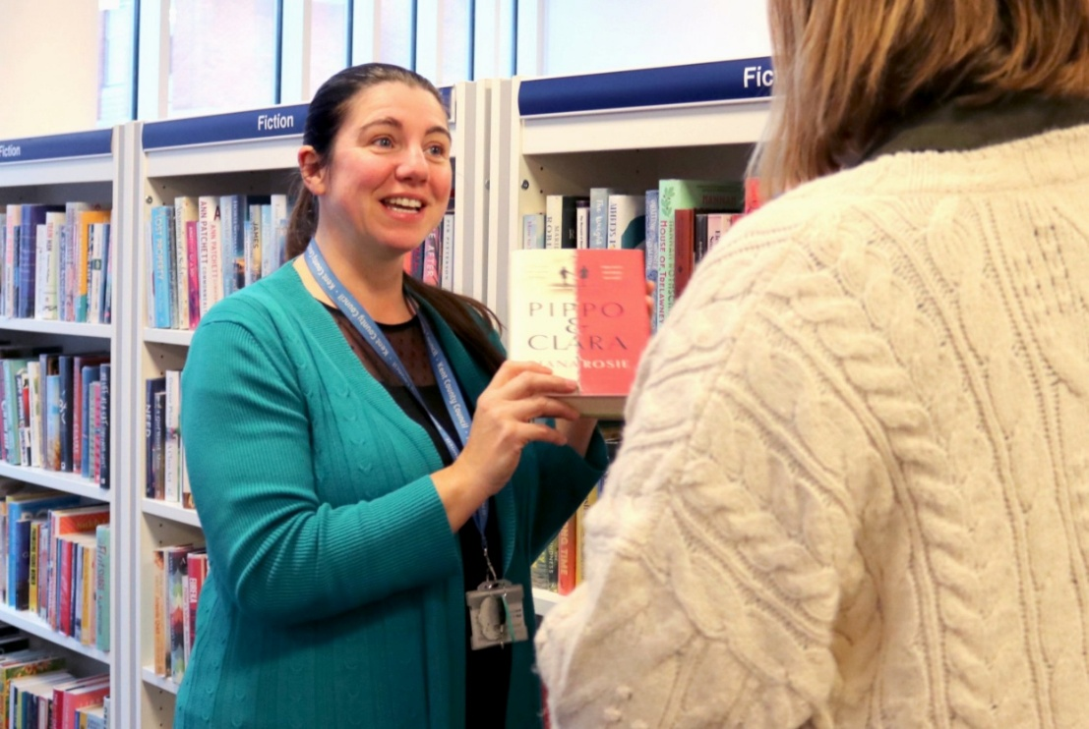
Why is a library visit important?
How is it better than the shelf of books on the wing?
Staff engagement
Environment
Stock
Activities
“I feel like a human being not only a prisoner. A place where I can feel normal, wanted and understood. Thank you.”

Slide 3

What makes a good prison library?
Staffing
Stock
Environment
Accessibility
Information
“The library is the prisoners’ emergency services”

Slide 4

How can the prison library help with reading, including family reading?
Books!
Literacy support
Family projects
“I love doing this, it makes me feel really connected with my family and visa versa when they listen to it. The opportunity has helped my family and I get through this tough time I have put us in.”

Slide 5

What can the library do for you and your prison?
Staff member benefits
Better behaviour
Improved outcomes
Community
“The library has helped me through a mental health crisis. I have been waiting to see mental health for months and reading helps me to calm down, wind down and takes my mind off things.”

Slide 6
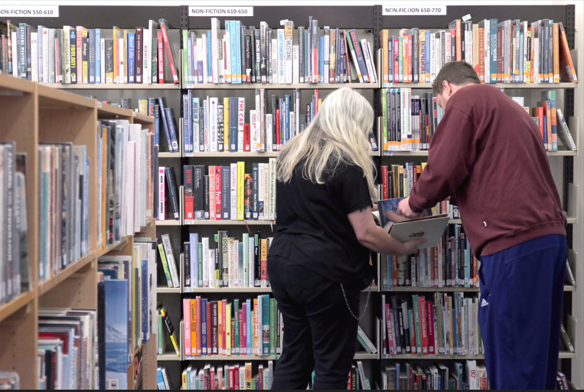
What can you do?
Access
Promotion
Inclusion
Get involved
“Library staff and orderlies are all very friendly and helpful. Love coming here as its peaceful.”

Slide 7
Thanks for listening

