Slide 1

Working in partnership with
The HMPPS Settlement Model:
Using regime activity to support people in
prison during key transitions
Presenting: Jennifer Stickney and Emma Holmes
Consultant Occupational Therapists from the Offender Personality Disorder Pathway,
working in partnership with HMPPS Enable Programme
Paper co written with Chris Gunderson HMPPS

Slide 2


What we know about the prison population
Many people in prison have experienced adversity and disrupted early relationships that can affect their ability to manage transitions.
There is a higher-than-expected prevalence of health and processing issues that impact someone's ability to adjust and transition through prison
Entering prison, moving between prisons, and preparing for release are significant transitions that can impact identity, wellbeing, and engagement in meaningful activity.
Effective support during these transitions is essential to promote adaptation, wellbeing, and successful community reintegration.

Slide 3
What we know about regime activity
There is a key link between use of time, wellbeing and risk in custody.
• Increased time in-cell and away from meaningful purposeful activity is correlated to increased risk towards others and increase in mental health difficulties and suicidal behaviour
• Spaces within a prison where people are engaged in purposeful activities have fewer incidents of violence and aggression
• Activity can be used to regulate mood and behaviour
• Group activity can improve relational security
• Meaningful activity can support the development of a prosocial identity within the prison environment
• An activity is only purposeful if the person taking part finds it meaningful!

Slide 4
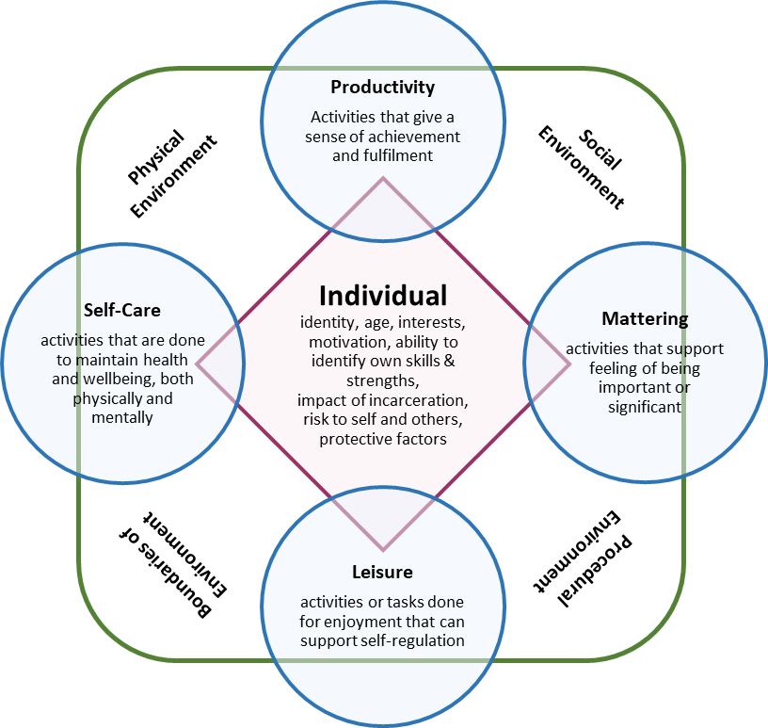
Prison Regime: Supporting Key Transitions in Custody
Regime activity provides key opportunities
Regime activity should be underpinned by Time Well Spent principle
HMPPS has broadened the definition of purposeful activity
To be genuinely purposeful, activities must be relevant to the individual; meaningful engagement depends on understanding individual needs
Different types of activity provides different benefits
An individuals engagement is impacted by their own skills, knowledge and ability as well as the environment around them
Model of Wellbeing in Health and Justice
Notes:
Regime activity provides a key opportunity to respond to people's changing needs throughout custody.
The Time Well Spent principle focuses on increasing the amount of time people spend in activities linked to an identified need.
HMPPS has broadened the definition of purposeful activity to include activities that support wellbeing, physical and mental health, and the development of social and life skills, alongside work and education.
To be genuinely purposeful, activities must be relevant to the individual. Regime planning should therefore be tailored to each person's needs, supporting them through key transitions in custody and towards resettlement.
Meaningful engagement depends on understanding individual needs and reflecting these within personalised regime plans, particularly during key transition points in custody.

Slide 5
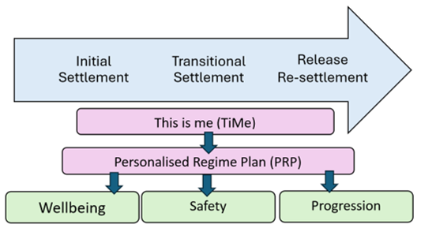
The Settlement Model
Three key transitions:
Arrival → Transfer → Release
One consistent approach:
TiMe and PRP used across all transitions
Focus on meaningful regime engagement: Matching needs to opportunities
Intended Outcomes:
Wellbeing, safety, progression

Slide 6


Prototyping
Set up
Two remand prisons selected
Senior Leadership support secured
Dedicated operational leads were appointed
Key work model agreed
Staff received training and awareness sessions
A structured Keywork pathway was introduced
Learning
Key worker entry sample
Feedback via check ins
Safety data
Focus groups
Delivery
X amount of TiMe and PRP sessions ran
Sessions were run over a 6 month period
One site had a dedicated key worker model
One site ran a pooled key worker model
Notes:
Two remand prisons were selected due to having established keywork processes, allowing TiMe and PRP to be tested within existing operational practice.
Senior leadership support was secured from Area Executive Directors, Prison Group Directors and Governors to ensure local commitment and oversight.
Dedicated operational leads were appointed, with Band 3 and Band 4 prison officers recruited to coordinate delivery, quality assurance and data collection.
Staff received training and awareness sessions to build confidence in using the TiMe and PRP tools and to support consistent implementation.
A structured keywork pathway was introduced, with priority keywork delivered during the first 30 days in custody:
Week 1: Immediate needs
Week 2: TiMe
Week 3: Personalised Regime Plan (PRP)
Week 4: Review of progress and engagement
Regular feedback and adaptation were built in, with bi-monthly reviews enabling tools and processes to be refined in response to staff and prisoner feedback.

Slide 7

Key findings from Prototyping
Regular site feedback, focus group findings, key work entry sample testing and safety data indicated that:
Consistent keyworkers matter
TiMe and PRP supported safer settlement into custody
Improved understanding of individual needs
Earlier access to support and regime opportunities
Enhanced keyworker experience and job satisfaction
Delivery conditions impact success
Notes:
Consistent keyworkers matter – Continuity helped build trust, reduced repetition, and made keywork sessions more meaningful and effective for people entering prison.
TiMe and PRP supported safer settlement into custody – The structured approach helped identify needs early, address challenges quickly, and support people during what many described as a difficult transition.
Improved understanding of individual needs – TiMe enabled keyworkers to gather meaningful information about strengths, needs and barriers to engagement, informing more personalised support.
Earlier access to support and regime opportunities – The process increased awareness of available activities and enabled earlier referrals to services such as neurodiversity support.
Enhanced keyworker experience and job satisfaction – Keyworkers reported feeling more valued and able to make a positive difference through relationship-based, personalised keywork.

Slide 8

What Next
Refine tools (accessibility through language, application of theory, time taken to complete and write up)
To broaden prototyping across different prison settings and transition points
Understand application with specific prison populations (offence specific, Women's estate, recall)
building the evidence base for how personalised regime planning can support engagement, wellbeing, safety and progression throughout custody.

